Slide 1
Improving Teaching through a Community of Practice
EDU 6241
University of Ottawa
October, 2012
Wei Luo (Lori)
Gloria Romero

Slide 2
Article:
Improving Teaching Through a Community of Practice. (Herbers et al., 2011).
Extra source:
Richards, J. & Farrell. T. (2011). Practice Teaching a Reflective Approach. New York, NY: Cambridge University Press.
Why?
Relevant to what we are doing as grad students at UoO
CoP: good idea to be started in an academic context

Slide 3
Food for thought …
“Teachers in most schools were accustomed to showing up at professional-development sessions, listening respectfully, taking part in the day’s assigned activities, leaving, and then continuing to do what they had always done in their classroom” (Hubbard, Mehan, & Stein, 2006, p. 247, in Hardy, 2012).

Slide 4
Outline:
Warming up:
Testimonials
Discussion 1: Forms PD activities
Article:
Context
Definitions & characteristics of a CoP
Description & results of the study
Strengths & Weaknesses
CoPs in Chile and China
Discussion 2: Setting up a CoP

Slide 5
Testimonials:
David Pratt
Madeline Zhou
What have you done for your professional development as a teacher?

Slide 6
Discussion 1: Forms of professional development
(Richards & Farrell, 2011)
Please choose the ones you’ve done, and provide examples.
Audio- or video-record a lesson
Written accounts of lessons
Teaching journal
Case reports
Teaching portfolio
Critical incidents
Action research
Student teacher support groups
CoP

Slide 7
Improving Teaching through a Community of Practice (Herbers et al., 2011)
This article “describes the experiences of 4 graduate education faculty members involved in a CoP designed to deconstruct individual teaching experiences through critical reflection and discussion” (p. 90).
The paper provides definitions and characteristics of CoPs

Slide 8
Improving Teaching through a Community of Practice (Herbers et al., 2011)
Community of Practice (CoP) (as cited in Herbers, 2011):
Wenger developed the term “community of practice” .
“A community of practitioners where newcomers attempt to acquire the sociocultural practices of the community” (p.92).

Slide 9
Improving Teaching through a Community of Practice (Herbers et al., 2011)
Characteristics of a CoP:
It “involves a group of people who have common interests and who relate and interact to achieve shared goals”
“It focuses on exploring and resolving issues related to the workplace practices that members of the community take part in” (Richards & Farrell, 2011 p.165).

Slide 10
Improving Teaching through a Community of Practice (Herbers et al., 2011)
  Components of CoP:
  Domain: a shared domain of interests and concerns, commitment to the domain, valuing collective experience
  Community: interaction, sharing information, developing relationships, learning from each other
  Practice: to share resources and experiences, share tools to solve problems, promote scholarship and change

Slide 11
Improving Teaching through a Community of Practice (Herbers et al., 2011)
Theoretical Framework behind the study:
Wenger’s definition CoP
Transformative learning theory (TLT) (p. 91)
  “The desired outcome of educational reform to be the transformation of individuals and society.”
  “Using past experiences to construct a new experience as a guide for future action.”
Critical reflection and deep introspection: integrate theory with classroom practices

Slide 12
Improving Teaching through a Community of Practice (Herbers et al., 2011)
Study described in the article:
Aim: to promote formal change in professional practice
Participants: four faculty members in University of the Incarnate Word (UIW)
Duration of CoP experience: met each moth for more than two years
Practices of CoP:
  Sharing teaching experiences,
  Reading and reflection on teaching practices,
  Applying survey to students,
  Questioning each other,

Slide 13
Improving Teaching through a Community of Practice (Herbers et al., 2011)
Results of the study:
Gains after CoP practice:
A sense of responsibility for learning and teaching,
Willingness to participate in CoP
Determined if teaching practices reflected the theories they espoused
Used CoP data to improve teaching and programs
Altered teaching practices: reconsidered course objectives, texts and activities
Engaged more with students
Developed a sense of trust, openness and faculty partnership

Slide 14
Improving Teaching through a Community of Practice (Herbers et al., 2011)
Strengths:
Applicable
Practical
Concrete results of CoP experience
Reflective learning
Transformative learning
Clearly written
A new term, but old practice

Slide 15
Improving Teaching through a Community of Practice (Herbers et al., 2011)
Weaknesses:
No challenges or limitations are mentioned, e.g. disagreement in teaching philosophy
Similar beliefs among CoP members. How good is it?
Unclear procedure
Mixed CoP experience with their classroom practice with students
It assumed that readers have previous knowledge in specific areas, e.g. OD
Other sources needed

Slide 16

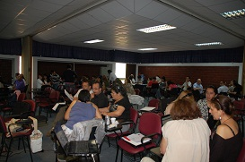

CoP in Chile: face-to-face and online CoP
Regular teachers’ meetings and workshops (school and university level)
Red de Maestros (Ministry of Education; Aim: give voice to novice and senior teachers in the country)

Slide 17
CoP in Chile: face-to-face and online CoP
http://ww.rmm.cl/website/index3.php?id_seccion=25&id_contenido=40
http://ww.rmm.mineduc.cl/website/index1.php?id_contenido=154&id_seccion=24

Slide 18

A CoP Online Practice Case in China:
Wang, L. (2011) Teacher’s online CoP: A literature review. China Audiovisual Education, 9, 31-42.
Participants:
  Prof. Lu Wang: research team from Capital Normal University in Beijing, China;
  Teachers from nine primary and middle schools across China.
Since 2009
CoP practice process:
based on authentic assessment, reflective learning and learning partnership
  Recording teachers’ classroom teaching practice;
  Assessing recorded data by researchers;
  Improve teaching through reflective learning;
  Sharing recordings as study materials with other teachers;
  Experiencing learning partnership in discussion groups.

Slide 19
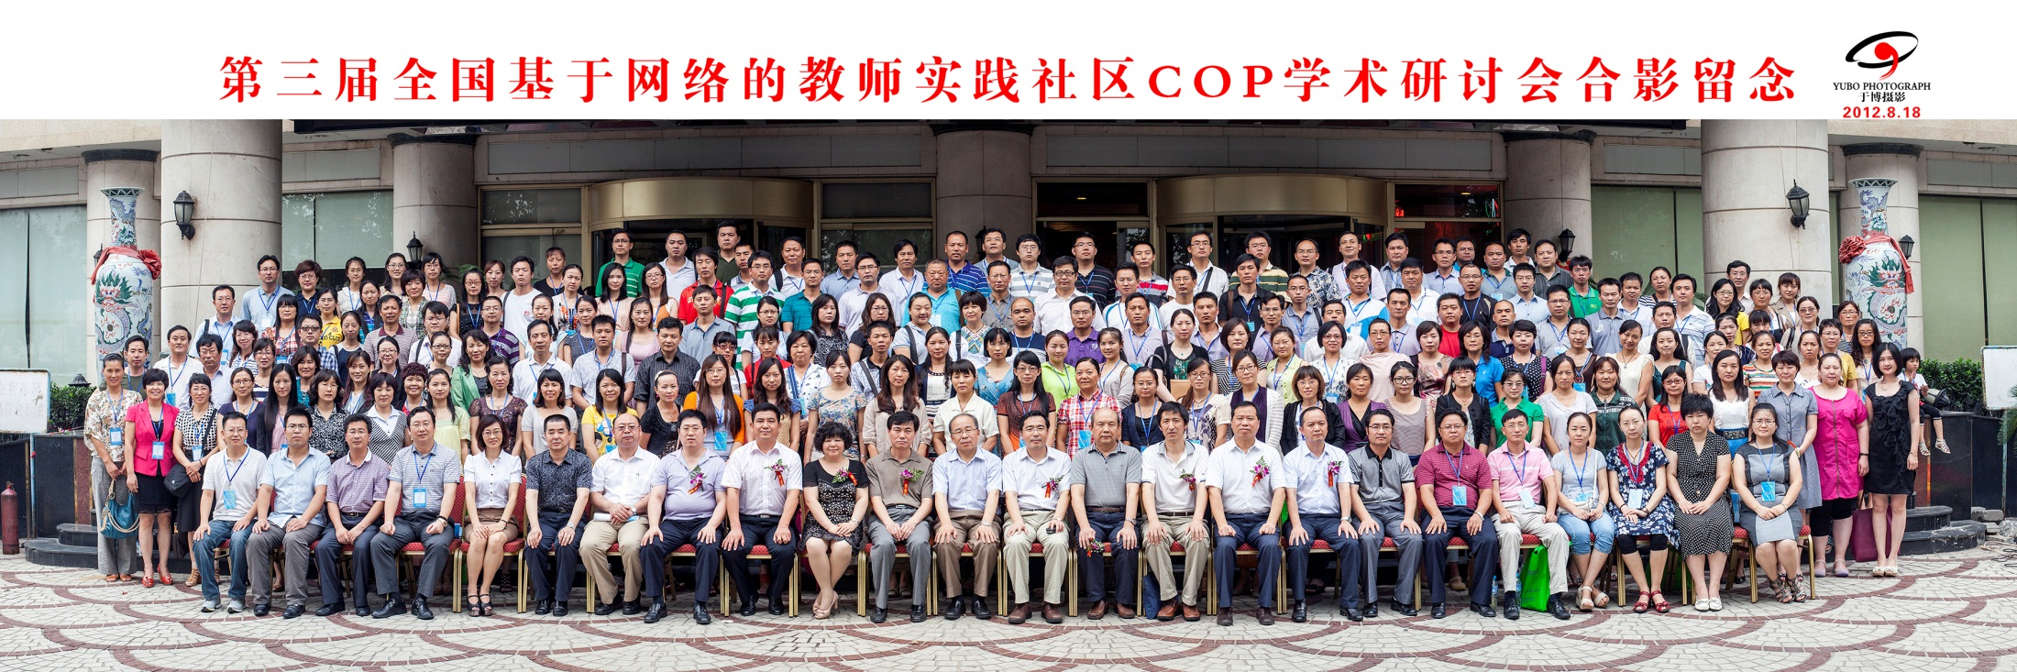
A CoP Online Practice Case in China: http://www.etkeylab.com/cop/
Teacher online CoP symposiums in China have been held annually since 2010. Teachers from different schools present and discuss about their thoughts about CoP online practice.
The following is a photo of participants of a teacher online CoP symposium held in August, 2012.

Slide 20
Discussion 2: Imagine you are going to set up a CoP
What are the topics?
What are the activities?
Where to meet and how often?
What gains?
What challenges would you expect?

Slide 21
Why not setting up a CoP?
Community of Practice Design Guide
Cambridge, Kaplan, & Suter. (2005) Retrieved October, 2012 from http://net.educause.edu/ir/library/pdf/nli0531.pdf

Slide 22

Thanks
Gracias
Xie Xie
Happy Halloween!

