Slide 1
Components of SLE Curriculum Development: Options and Choices
Douglas Fleming
Faculty of Education
University of Ottawa
Notes:
[opening slide: make a joke about using PowerPoint; relate TESL Canada experience]
note Young (2004). When good technology means bad teaching. Educause Centre for Applied Research

Slide 2
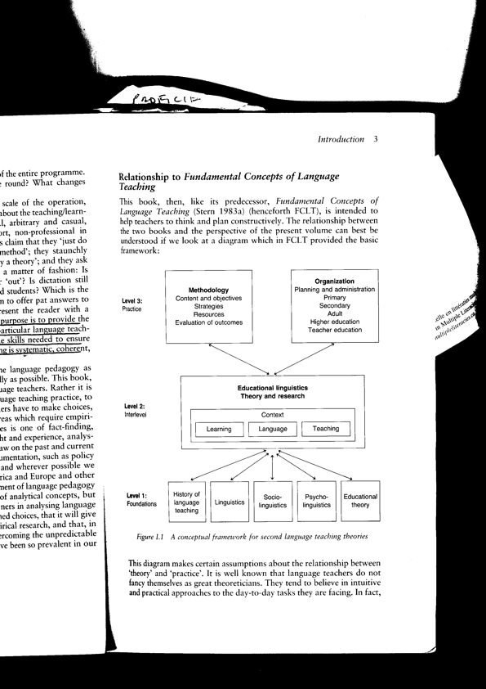
Stern, 1992, p.3

Slide 3
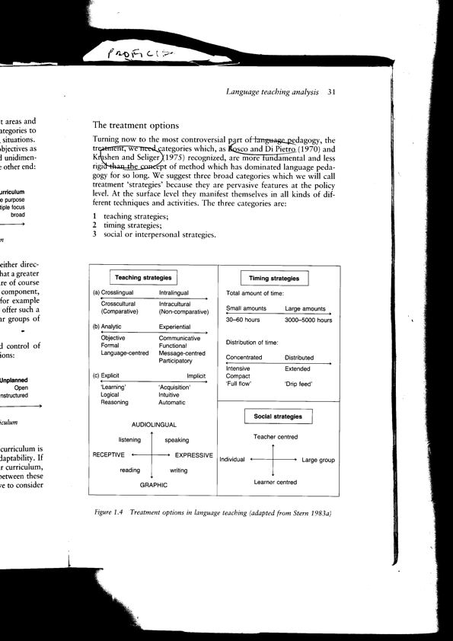
Stern, 1992, p. 31

Slide 4
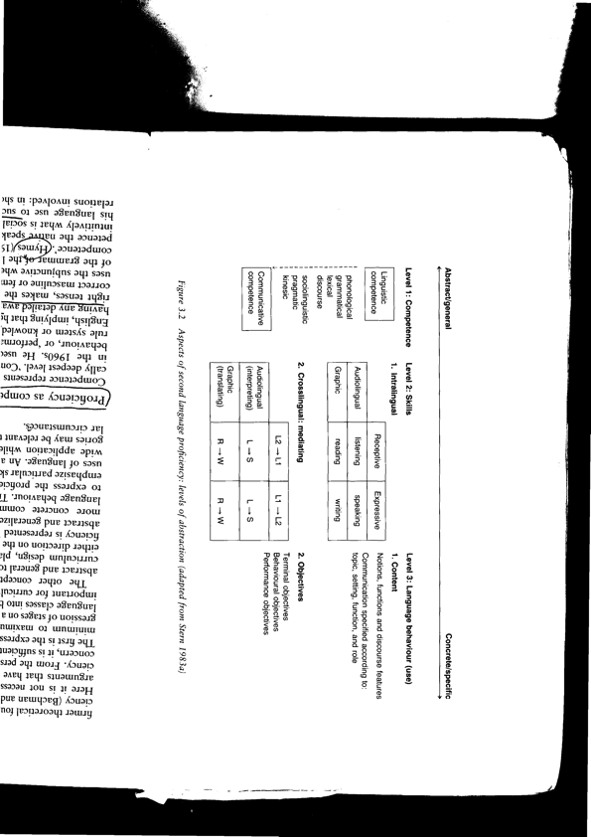
Stern, 1992, p.72

Slide 5
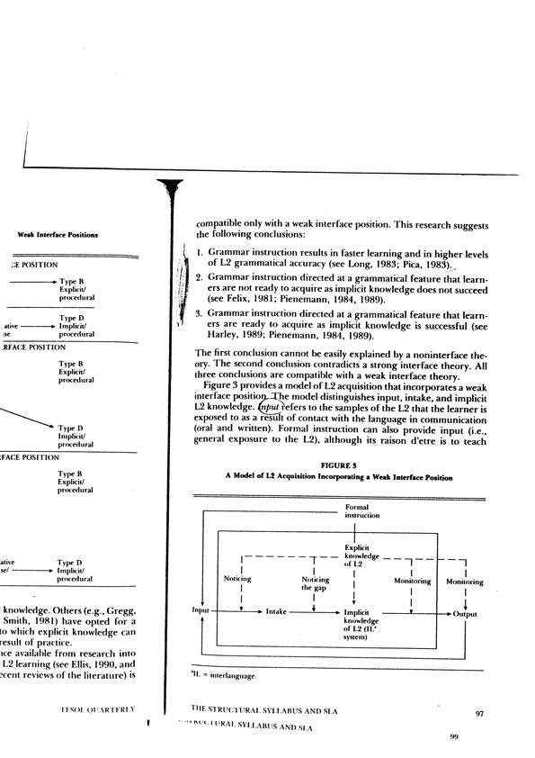
Ellis, 1993, p.97

Slide 6
Needs assessment
it is impossible to teach students everything
class time must treat prioritized content
SLE should develop both specific language skills and autonomous learning
autonomous learning is linked to the priorities that the students see as urgent needs
classroom treatment must therefore be based on the needs of the learners as they themselves identify.
                Nunan, 1988, p.3

Slide 7
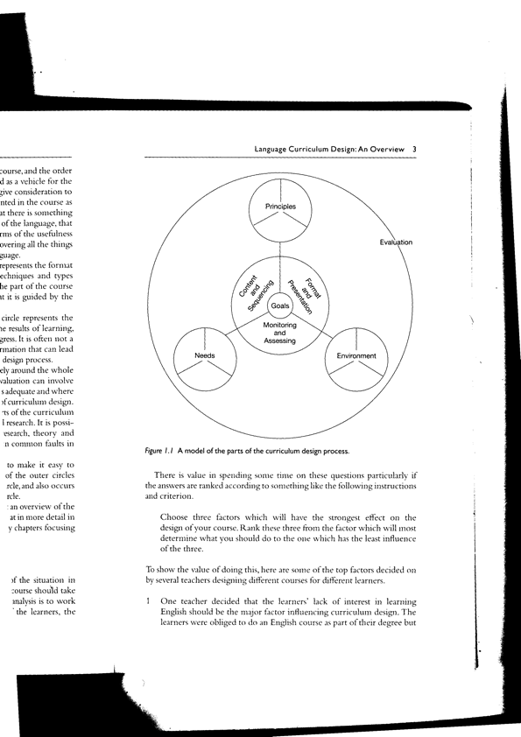
Nation and Macalister, 2010, p.3

Slide 8
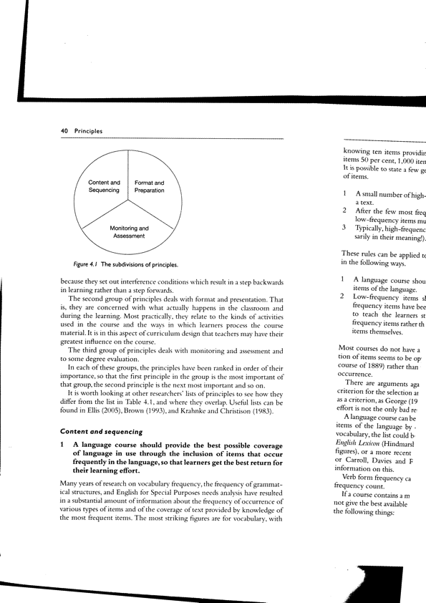
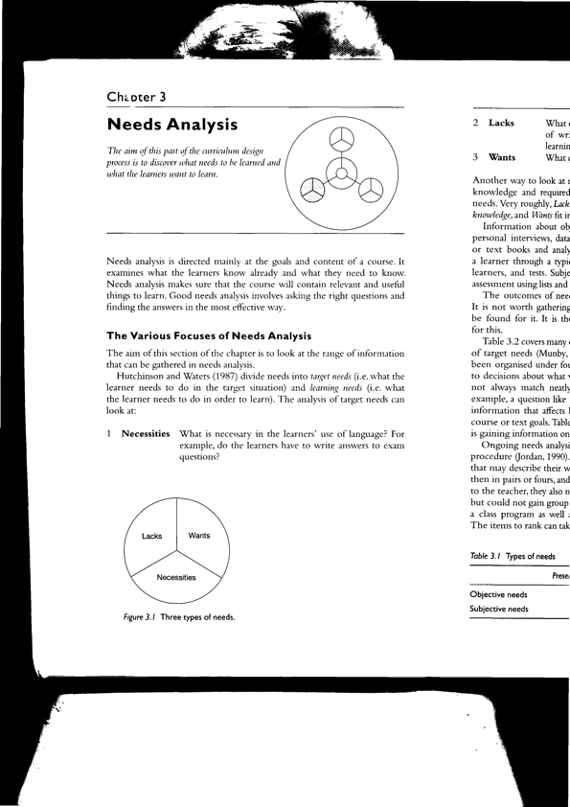
Nation and Macalister, 2010, p.40
Nation and Macalister, 2010, p.24

Slide 9
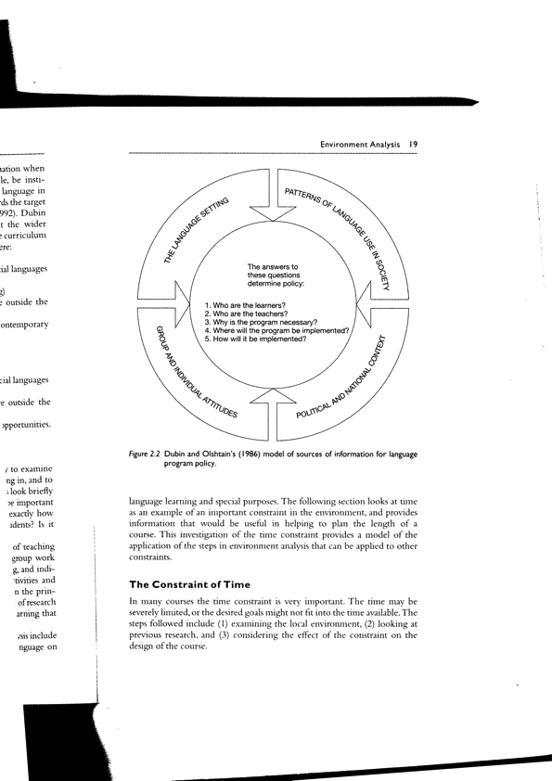
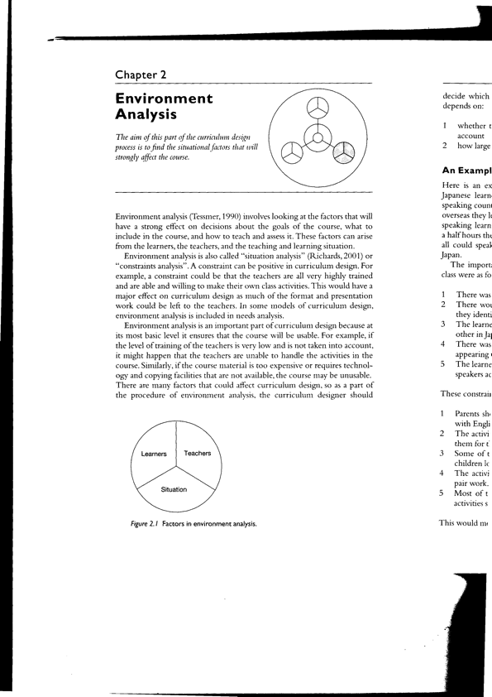
Dubin and Olshtain, 1986
Nation and Macalister, 2010, p.14

Slide 10
Dubin and Olshtain
  Curriculum Design (1986)
Ellis
  The Structural Syllabus and SLA (1993)
Nation and Macalister
  Language Curriculum Design (2010)
Nunan
  The Learner Centered Curriculum (1988)
Stern
  Issues and Options in Language Teaching (1992)

