Slide 1
Using digital technologies with (im)migrant bi/plurilingual language learners: A systematic review
Francis Bangou, Cameron Smith, Heather Kosiol, Cindy Savard,
Douglas Fleming, Carole Fleuret
1

Slide 2
01
02
03
04
05
06
Problem Statement
About the Project
RQ & Framework
Methodology
Findings
Conclusions
2

Slide 3
Problem Statement
(Im)migration
Digital Tech
Unprecedented growth in migratory flows worldwide of permanent and temporary residents (Suàrez-Oroszco, 2019)
Improves language learning competencies, motivation, and design; supports plurilingual practices (Healey, 2016; Van Laere et al., 2017)
Training
Legitimizing
Teachers report feeling unprepared to facilitate plurilingual and intercultural practice, and integrate technologies into their practices (Hubbard, 2019; Bangou et al., 2021)
While legitimizing students’ languages improves learning, policy and practice lag behind (Fleuret & Auger, 2019)
4
Notes:
With the massive migratory flows that we now observe around the world, schools are experiencing an unprecedented increase in the enrollment of children who speak a variety of languages - with potentially multi-generational residents (e.g., heritage language speakers), as well as those who have recently arrived (e.g., refugees and temporary migrants).
As a result, schools and educators are increasingly called upon to assist with bi/plurilingual students’ inclusion through the development of functional competencies in a target language.
Legitimizing students’ linguistic repertoire has positive effects in terms of one’s individual identity and social integration. Fleuret & Thibeault (2016) demonstrated that including bi/plurilingual (im)migrant students’ home languages into the classroom promotes the acquisition of the language of schooling. However, some schools have been reluctant to adopt plurilingual teaching approaches because of a range of social and political factors, even up to the present day (Fleuret, 2013).
Moreover, teachers are not adequately trained to infuse inclusive plurilingual and intercultural practices into their classrooms which leads to superficial and sporadic attempts to do so.

Slide 4
About the project
4 year SSHRC-funded project
Investigate how teachers in Anglophone and Francophone schools in Ontario use (or not) Digital technologies (DTs) to mobilize inclusive, plurilingual pedagogical practices and support (im)migrant bi/plurilingual students
Systematic reviews to ground design investigation on plurilingual education, technology, and professional learning
3

Slide 5
Research Questions
In what ways are DTs used with (im)migrant bi/plurilingual language learners?
What are the outcomes associated with technology-enhanced practices?
To what extent is this research informed by plurilingual approaches?
5

Slide 6
Our Conceptual Framework
(Im)migrant bi/plurilingual Learners
Plurilingual Approaches
Newcomers, migrants, refugees, allophones; bilingual, multilingual
(Im)migrant - newcomers, refugees, and other expatriates
Bi/plurilingual
Conceptualizations and practices that recognize the complex linguistic and cultural practices in which bi/plurilingual learners engage and promote decompartmentalized views of language competence, use, and multiple languages and semiotic systems in the language classroom.
Ex: Pluralistic approaches to language education (Candelier, 2008; Moore & Sabatier, 2014); teaching and learning practices based on translanguaging (Galante, 2020; Garcia & Li, 2014)
6
Notes:
In light of these observations, the purpose of this article is to systematically synthesize the research trends, methods, and findings addressed by journal articles that focused on the use of DTs with (im)migrant bi/plurilingual language learners with plurilingual approaches to teaching and learning
Any conceptualizations and practices that promote decompartmentalized views of language competence and use and support the use of multiple languages and semiotic systems in the language classroom
Ex: Pluralistic approaches to language education (Moore & Sabatier, 2014), Teaching and learning practices based on translanguaging (Garcia & Li, 2014)

Slide 7
Methodology
Saturn
Saturn is the planet with many rings
Generated keywords from articles and subject terms: technology, (im)migrants, L2+ education
Compiled search strings and ran searches in 5 databases, WoS, and Google Scholar
Screened 1,172 articles;
135 full review;
22 included
Graphs, thematic codes, and other analysis tools created from data
Analyzed using a template within covidence.org
7
Notes:
Cam
[read points 1-3] Upon closer reading, we realized we needed to revise and nuance our understandings as we found combinations of the keywords, yet none that deeply engaged all aspects of the inclusion criteria. Which brings us to our findings.

Slide 8
Findings
8
Notes:
Doug

Slide 9
Concepts: Bi/plurilingual (im)migrant students
L2+ Learners
Multilinguals
Plurilinguals
Meaning making, decoding, interpreting/ creating texts, learning strategies, socio-emotional effects
General or non-framing of students with multiple languages
n=11
Pushing back on monoglossic ideologies; promoting multiple languages to benefit learning
Cook (1991, 1995); Cummins (2014, 2017)
n=4
Similar framing to multilingualism (and translated as such?)
Less siloed view
Consideration for policies and practice which inhibit language use
n=2 (FR)
9
Notes:
Doug
the most common framing of (im)migrant students was through the lens of (L2+) language learners - Swedish Second Language, English as an Additional Language, etc. (n=11). These studies might discuss the processes of general meaning making, decoding language, understanding text and media in various modalities, learning strategies, as well as the sociocultural considerations affecting these students. However, this was often a very general framing of these students - in some articles, this was little more than acknowledging that these students spoke multiple languages.

Slide 10
Concepts: Language practices
Translanguaging
Critical
(Multi)literacies
Philosophical and pedagogical orientation
Democratizing; Funds of Knowledge
(Emerging) Bilinguals
n=5
Precarious and marginalized experience of newcomers
Personal and contextual factors impacting learning
Arts-based pedagogy
n=4
Plurality and complexity of communication modes, media, languages, and resources
Purpose and design, modifying language, connecting conventions with products
n=3
10
Notes:
Doug
Drawing on scholars like Garcia or Creese and Blackledge (2010), translanguaging provided 5 articles with a philosophical and pedagogical orientation. Authors drawing on translanguaging emphasized the democratizing and equitable approach to incorporating students’ languages and cultures, challenging language hegemony, boundaries, and hierarchies in schools. Pedagogically, the concept also emphasized the ways that teachers drew upon students’ linguistic and other funds of knowledge, to communicate expansively and across imagined siloes of language
All but one of the publications that used translanguaging also tended to frame participants as (emerging) bilinguals (n=4). While the term was not explicitly defined, we understood it to refer to young (im)migrant students who are continuing to learn their home language as well as one or more additional languages
Critical
Multiliteracies

Slide 11
Aims & Results
01
02
03
General technology-enhanced practices (n=5)
Technology and particular language competencies (n=9)
Second language and digital literacies (n=8)
04
05
Inclusion and identity development (n=5)
Bi/plurilingual
terminology (n=6)
11
Notes:
Cam
In our analysis of the studies, we created 4 created four categories that spoke to the general aims and results of the different studies. Those include [read 1-4].
We added one meta category as well which analyzed how bi/plurilingual terminology was used in the studies which explicitly took up those terms.

Slide 12
01 - General technology-enhanced practice
Focused on the ways in which these tools support (or not) language learning in the classroom
Interaction and engagement
Multimodal explanations
Assistive features
Feedback
Resources
The use of technology is not a given - student and teacher competencies (Collin et al., 2015; Song & Cho, 2021)
Not a simple solution or guaranteed effectiveness (Carhill-Poza & Chen, 2020; Hell & Sauro, 2021)
12
Notes:
Cam
[read slide]
Students may lack the digital skills to use educational technology for educational purposes - for example, while students may able to navigate the web or use social media, they may be less familiar with skills like researching online, evaluating information in multiple languages, or using computer functions (e.g., copy-paste, right-click, drag-and-drop) which are tied to educational tasks (Collin et al., 2015; Song & Cho, 2021). Teachers may also not feel confident using technology with (im)migrant language learners, citing a lack of training in using technology for L2+ pedagogy.
Teachers may also not feel confident using technology with (im)migrant language learners, citing a lack of training in using technology for L2+ pedagogy. Therefore, technology-enhanced tasks cannot be viewed as a simple solution to L2+ learning for (im)migrant students.

Slide 13
02 - Technology and language competencies
Technology had a positive effect on skills and knowledge development across language domains
Vocabulary acquisition
Grapho-phonological awareness
Reading ability
Semantic relationships
Oral language fluency
Writing composition
Affordance of digital versions to assist practices (Chen et al., 2017; Krulatz & Iversen, 2020)
Not always greater growth than control group, but never worse (e.g., Lavoie, 2020; Verhallen et al., 2010)
13
Notes:
Cam
[first point]
Students were able to work more efficiently and more effectively work through the digital versions of activities, which may have supported them spending more time dealing with higher order questions and procedures than their peers who did not use the digital tool.
Note: Multiple studies used specially-designed software and training programs.
While the use of digital technology did not always result in significantly greater growth than their peers using analog formats, the technology-based experimental groups did not perform worse than the control groups (e.g., Lavoie, 2020; Verhallen et al., 2010).

Slide 14
03 - L2 and digital literacies
More holistic view of L2 literacies and the ways in which students and teachers engage technology (Emert, 2013)
Ability to work with technology as a physical object, and tool which mediates digital and material worlds (Dunn et al., 2012)
Interactivity and creativity (Martínez-Álvarez, 2017)
Digital storytelling (Tour et al., 2021)
14
Notes:
Cam
This category reflects a more holistic view of L2 literacies and the ways in which students and teachers engage technology for communicative purposes
Ability to work with technology as a physical object, and tool which mediates engagement and learning in digital and material worlds (Dunn et al., 2012)
The interactivity and creative affordances of the tools allowed students to grapple with technical skills, texts, symbols, language, and culture in the pursuit of meaning-making - prompting them to think about the purpose and design of media, modifying language practices for different audiences, and connecting language conventions with literacy products
Here, digital storytelling was particularly praised for engaging language learners in a low-risk, but “contextual and socially situated use of language in digital spaces”

Slide 15
04 - Inclusion and identity development
Supporting students in understanding themselves and their experiences as newcomers (Angay-Crowder et al., 2013; Dunn et al., 2012)
Promote students’ positive self-image through reflection and playful creation with digital media (O’Mara & Harris, 2016).
Help students express themselves and communicate with peers as their language proficiency developed (Dunn et al., 2012; Krulatz & Iversen, 2020)
Sharing stories locally and globally (Crosby, 2018)
Digital media creations might not always transcend stereotypes and reductionist understandings students hold of themselves and others. (O’Mara & Harris, 2016).
15
Notes:
Francis

Slide 16
Bi/Plurilingual Terminology
Focused on participants’ bi/plurilingualism (n=3); plurilingual pedagogical practice (n=2)
Negotiate multiple literacies and positive cultural identity, codeswitching, and peer support (Angay-Crowder et al., 2013).
Relying on each other over technology (Hansen-Thomas et al., 2021)
Students may still consider the target language more important than their home languages (Krulatz and Iversen, 2020)
16
Notes:
Francis

Slide 17
Conclusions
A variety of digital technologies, in various contexts, support the development of (im)migrant plurilingual students’ overall language proficiency, literacies, engagement, as well as identity development
Results of technology use are positive or neutral across participant groups - influenced by contextual, student, and teacher factors
Anglophone literature the preferred prefix is multi- rather than pluri- ; empirical studies did not engage the conceptual differences between the two.
Need for continued professional learning and situated supports for these practices
17
Notes:
Francis

Slide 18
References
Bangou, F., Fleuret, C., Mathieu, M.P., & Jeanveaux, B. (2021). Promoting Inclusive Plurilingual Practices in Ontario’s Francophone Elementary Schools: The Views and Practices of Principals and Teachers. Journal of Belonging, Identity, Language, and Diversity, 5(2), 5-24. https://bild-lida.ca/journal/wp-content/uploads/2021/07/J-BILD_5-2_Bangou_etal.pdf
Candelier, M. (2008). Approches plurielles, didactiques du plurilinguisme : le même et l’autre Recherches en didactique des langues et des cultures [En ligne], 5(1), 1-27. http://journals.openedition.org/rdlc/6289
Fleuret, C., & Auger, N. (2019). Translanguaging, recours aux langues et aux cultures de la classe autour de la littérature de jeunesse pour des publics allophones d’Ottawa (Canada) et de Montpellier (France): Opportunités et défis pour la classe. Cahier de L'ILOB, 10, 107-136. https://doi.org/doi.org/10.18192/olbiwp.v10i0.3789
Galante, A. (2020). Pedagogical translanguaging in a multilingual English program in Canada: Student and teacher perspectives of challenges. System, 92. https://doi.org/10.1016/j.system.2020.102274
García, O., & Li, W. (2014). Translanguaging: Language, bilingualism and education. Palgrave Macmillan.
Healey, D. (2016). Language learning and technology: Past, present and future. In F. Farr and L. Murray (Eds.). The Routledge Handbook of Language Learning and Technology, (pp. 9-24). London, UK: Routledge. https://doi.org/10.4324/9781315657899
Hubbard, P. (2019). Five keys from the past to the future of CALL. International Journal of Computer-Assisted Language Learning and Teaching (IJCALLT), 9(3), 1–13. http://doi.org/10.4018/IJCALLT.2019070101
Moore, D. & Sabatier, C. (2014). Les approches plurielles et les livres plurilingues. De nouvelles ouvertures pour l’entrée dans l’écrit en milieu multilingue et multiculturel. Nouveau c@hiers de la recherche en éducation, 17(2), 32-65.
Suàrez-Oroszco, C. (2019). Humanitarianism and mass migration. University of California Press.
Van Laere, E., Rosiers, K., Van Avermaet, P., Slembrouck, S., & van Braak, J. (2017). What can technology offer to linguistically diverse classrooms? Using multilingual content in a computer-based learning environment for primary education. Journal of Multilingual and Multicultural Development, 38(2), 97-112. https://doi.org/10.1080/01434632.2016.1171871

Slide 19
Appendix
Angay-Crowder, T., Choi, J., & Yi, Y. (2013). Putting multiliteracies into practice: Digital storytelling for multilingual adolescents in a summer program.
TESL Canada Journal, 30(2), 36. https://doi.org/10.18806/tesl.v30i2.1140
Brown, S., & Allmond, A. (2021). Emergent bilinguals’ use of word prediction software amid digital composing. The Reading Teacher, 74(5), 607–616.
https://doi.org/10.1002/trtr.1988
Buchs, C., Margas, N., Cazin, C., Ramírez, M., & Fratianni, S. (2018). Favoriser l’équité dans les classes caractérisées par une forte diversité linguistique: Recours aux activités plurilingues dans une perspective coopérative. Éducation et francophonie, 46(2), 249–269. https://doi.org/10.7202/1055571ar
Carhill-Poza, A., & Chen, J. (2020). Adolescent English learners’ language development in technology-enhanced classrooms. Language Learning &
Technology, 24(3), 52–69. http://hdl.handle.net/10125/44738
Chen, Y., Carger, C. L., & Smith, T. J. (2017). Mobile-assisted narrative writing practice for young English language learners from a funds of knowledge approach.
Language Learning & Technology, 21(1), 28–41. https://dx.doi.org/10125/44594
Collin, S., Saffari, H., & Kamta, J. (2015). Les usages numériques éducatifs des élèves allophones issus de l’immigration récente: une étude exploratoire.
Canadian Journal of Learning and Technology, 41(1), 1-16. https://doi.org/10.21432/T2X03H
Crosby, C. (2018). Empowering English language learners and immigrant students with digital literacies and service-learning. The Reading Matrix,
18(2), 38–58.
Dunn, J., Bundy, P., & Woodrow, N. (2012). Combining drama pedagogy with digital technologies to support the language learning needs of newly
arrived refugee children: A classroom case study. Research in Drama Education, 17(4), 477–499.
Emert, T. (2013). “The transpoemations project”: Digital storytelling, contemporary poetry, and refugee boys. Intercultural Education, 24(4), 355–365.
Gromova, C., Khairutdinova, R., Birman, D., & Kalimullin, A. (2019). Teaching technologies for immigrant children: an exploratory study of elementary
school teachers in Russia. Intercultural Education, 30(5), 495–509. https://doi.org/10.1080/14675986.2019.1586215
Hansen-Thomas, H., Stewart, M. A., Flint, P., & Dollar, T. (2021). Co-learning in the high school English class through translanguaging: Emergent
bilingual newcomers and monolingual teachers. Journal of Language, Identity & Education, 20(3), 151–166.

Slide 20
Appendix
Hell, A., & Sauro, S. (2021). Swedish as a second language teachers’ perceptions and experiences with call for the newly arrived. CALICO Journal, 38(2),
202–221. https://doi.org/10.1558/cj.41169
Kirsch, C., & Bes Izuel, A. (2019). Emergent multilinguals learning languages with the iPad app iTEO: A study in primary schools in Luxembourg.
Language Learning Journal, 47(2), 204–218. https://doi.org/10.1080/09571736.2016.125872
Konerding, M., Bergstrom, K., Lachmann, T., & Klatte, M. (2020). Effects of computerized grapho-phonological training on literacy acquisition and
vocabulary knowledge in children with an immigrant background learning German as L2. Journal of Cultural Cognitive Science, 4, 367–383. https://doi.org/10.1007/s41809-020-00064-3
Krulatz, A. (2020). Building Inclusive Language Classroom Spaces through Multilingual Writing Practices for Newly-Arrived Students in Norway.
Scandinavian Journal of Educational Research, 64(3), 372-388.
Lavoie, C. (2020). L’effet de la tablette tactile sur l’acquisition des relations sémantiques. Canadian Journal of Applied Linguistics, 23(1), 52–70.
https://doi.org/10.37213/cjal.2020.26963
Li, J. (2009). The evolution of vocabulary learning strategies in a computer-mediated reading environment. CALICO Journal, 27(1), 118–146.
https://doi.org/10.11139/cj.27.1.118-146
Martínez-Álvarez, P. (2017). Language multiplicity and dynamism: Emergent bilinguals taking ownership of language use in a hybrid curricular space.
International Multilingual Research Journal, 11(4), 255–276. https://doi.org/10.1080/19313152.2017.1317506
Segers, E., & Verhoeven, L. (2005). Long-term effects of computer training of phonological awareness in kindergarten. Journal of Computer Assisted
Learning, 21, 17–27.
Song, K., & Cho, B.-Y. (2021). Exploring bilingual adolescents’ translanguaging strategies during online reading. International Journal of Bilingual
Education and Bilingualism, 24(4), 577–594.https://doi.org/10.1080/13670050.2018.1497008
Tour, E., Gindidis, M., & Newton, A. (2021). Learning digital literacies through experiential digital storytelling in an EAL context: An exploratory study.
Innovation in Language Learning and Teaching, 15(1), 26–41. https://doi.org/10.1080/17501229.2019.1659278
Verhallen, M. J. A. J., & Bus, A. G. (2010). Low-income immigrant pupils learning vocabulary through digital picture storybooks. Journal of Educational
Psychology, 102(1), 54–61. https://doi.org/10.1037/a0017133

Slide 21
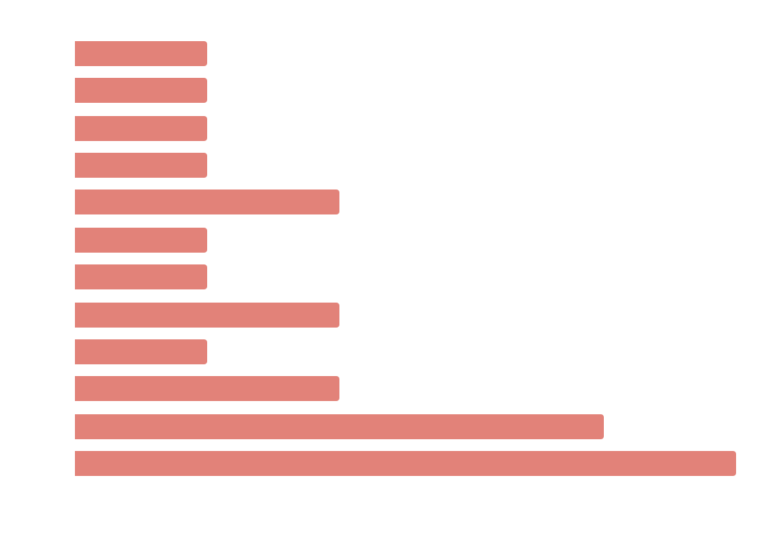
Publications
Country | Count
USA | 9
Australia | 3
Canada | 3
Netherlands | 2
Other Europe | 5
Notes:
The majority of this research was conducted in English-speaking nations: notably the USA (n=9), followed by Australia (n=3) and Canada (n=3). Other work was conducted in different European nations, including: the Netherlands (n=2), and one article each from Germany, Luxembourg, Norway, Russia, and Sweden.
Usually one or two articles published per year in this domain, except in 2020 and 2021, which showed a notable jump to five per year.

Slide 22
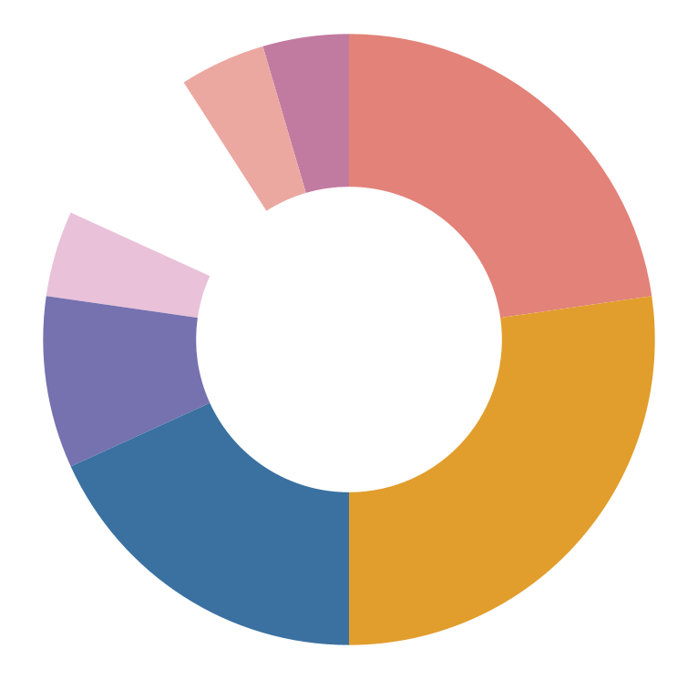
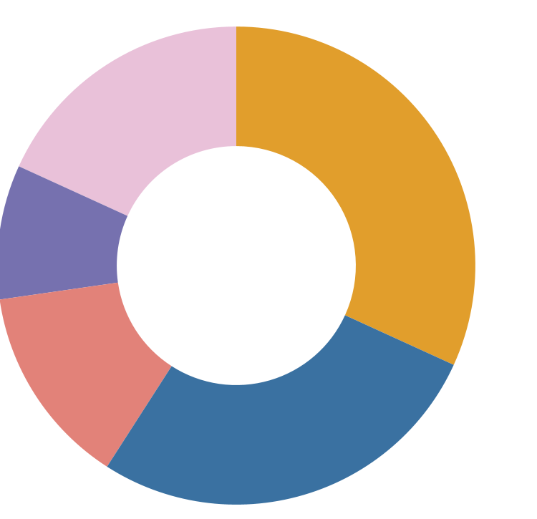
Contexts
Participants
MA TESOL (1)
Teacher
(4)
Community Centre (2)
(Computer) Lab (5)
Elementary
(7)
Summer Program (1)
EFL (1)
Kinder
(2)
ELL/ESL
(2)
Both (3)
Elementary (6)
Secondary
(4)
Secondary
(6)
Notes:
Most studies took place in primary/elementary (n=6) classrooms. This count was followed by computer labs or similar rooms (n=5) where participants would complete pre/post testing outside of the general classroom, then secondary/high school (n=4) levels. Alternative pedagogical spaces included separate ELL/ESL classrooms (in countries where English is a majority language; n=2), community centers with youth programming (n=2), an EFL classroom (where English was a foreign language; n=1), initiatives run through an MA TESOL program (n=1), and a summer L2 literacy program run in a school (n=1).
Commonly, studies had fewer than 10 focal participants (n=7) but there was a large range in participant count - with the lowest having one participant, and the highest with over 200 (M=47.3; SD=56.9).

Slide 23
Languages
Technologies
Language Learned | Count
English | 12
English + Another Language | 2
National Language(s) | 8
Technology | Count
Multiple | 12
Computers/Programs | 7
Tablets/Apps | 4
Digital Storytelling | 2
Notes:
(Im)migrant students were often learning the majority language(s) of the host region or country. Given the prevalence of Anglophone studies in this corpus, and the global uptake of the language more broadly, this meant English (n=12) was the most common L2 studied. In two studies, English learning was noted alongside another language - Norwegian (EFL) and Spanish (Bilingual ESL). Other languages of study included Dutch (n=2), French (n=2), French and German (n=1), German (n=1), Russian (n=1), and Swedish (n=1).

Slide 24
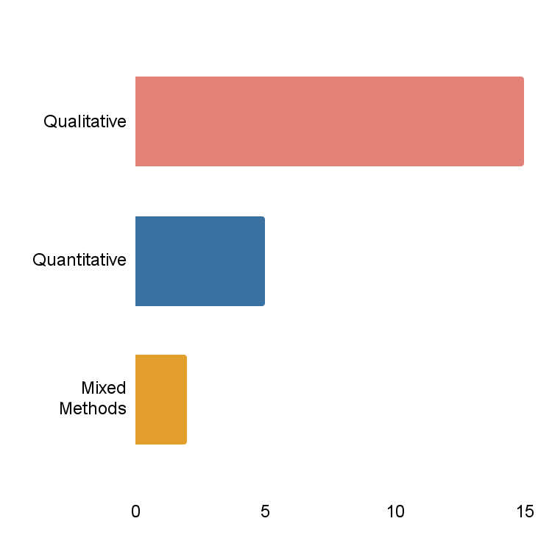
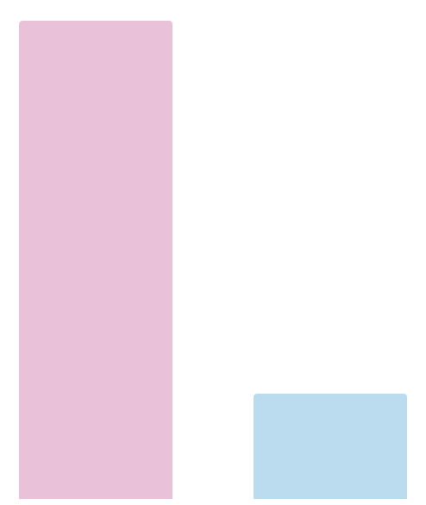
Methodologies
Frameworks
15
Qualitative
5
Quantitative
2
Mixed methods
18
4
SCT
Critical

Slide 25
How ‘new’ were newcomers?
Krulatz & Iversen (2020) | Two weeks to five months
Emert (2013) | As "little as 3 months"
Dunn et al. (2012) | Six to twelve months
Tour et al. (2021) | Less than one year
Hansen-Thomas et al. (2021) | Less than three years
Song & Cho (2021) | Less than three years
Hell & Sauro (2021) | Less than fours years
Notes:
In studies which specified working with newcomers, we were interested in understanding how ‘new’ was conceived. When specified, participants were in their host country for variable time periods.
These definitions likely reflect the demographic profile of the participants in that particular study, rather than attempts to define newcomers. Only Hell & Sauro (2021) make reference to an external definition of newcomers, in their case from the Swedish government, in framing their participants.
*Emert (2013) does not indicate the upper limit for how long these participants had been residing in the country.

