Slide 1
Deaf or Hard of Hearing Students in the Classroom
Brandon Renelli, Connor Hanak,
Heliya Mirshahi and Shazma Khimji

Slide 2
Why is this important?
A Gap: Deaf or hard of hearing students have specific difficulties with writing and reading
Throughout this course, we have discussed various topics in writing, reading, and literacy
In our other courses, we have also studied exceptionalities and ways to help all students

Slide 3
Hearing Loss/Auditory Impairments
“Hearing loss can be described as an invisible acoustic filter that distorts, smears, or eliminates incoming sounds from reaching the brain, especially sounds from a distance - even a short distance”
Cole and Flexer
Cole, Elizabeth and Flexer Carol. Children With Hearing Loss

Slide 4
So what is it?
Hearing Loss is:
Degenerative
A spectrum
Invisible
Embarrassing to some
Does not mean the person knows ASL (American Sign Language)

Slide 5
“When describing hearing loss, we generally look at three categories: type of hearing loss, degree of hearing loss, and configuration of hearing loss. With children, it is especially important to diagnose and treat a hearing loss as early as possible. This limits its potential impact on learning and development. Hearing loss can greatly affect the quality of life for adults as well. Unmanaged hearing loss can have an impact on employment, education, and general well-being.”
— American Speech-Language-Hearing Association
Notes:
Make connection between children who are born deaf and their ability to become literate English readers and writers (which will have consequences later in their lives)

Slide 6
Hearing Impaired Students
Three out of every 1000 babies are born with a hearing impairment
This means that you are likely to have a hearing impaired student in your classroom at some point during your teaching career
In some cases, a small to moderate hearing disability can cause students to miss up to 50% of class discussions
These students are also ten times more likely to be held back at least one grade than a student with normal hearing
So how does this affect their reading and writing skills?

Slide 7
Spoken Without Words
Notes:
https://www.youtube.com/watch?v=dmsqXwnqIw4

Slide 8
Reading ability: Children of deaf parents and non deaf parents
“As a general observation by age 18, deaf students do not have linguistic competence of 10 year-old hearing children in many syntactic structures of English. Studies report that less than 12% of deaf students at age 16 can read at a fourth-grade reading level or higher as a measured on the Metropolitan Reading Achievement Test.”(p.82)
However…
“Deaf children who have deaf parents (less than 10% of all deaf children) who use sign language at home are an apparent exception to the generalizations about deaf children’s reading ability, because they have a fully established language base prior to learning to read.”(p.82)
Why is this?

Slide 9
Logographic v.s phonological language
Logographic - meaning that each character represents a unit of meaning. Each character represents a whole word rather than the individual sounds (phonemes) associated with the word’s pronunciation.
disadvantage is that it is hard to learn (i.e., 5,000 words to read a newspaper, 10,000 for a college text)
advantage is that literacy is high (i.e., people who speak Mandarin and Cantonese can read the same text and communicate through writing even though they cannot carry on spoken conversation due to some phonological radicals which indicate pronunciation)
These logographic effects transfer to the treatment of English alphabetic words when English is learned after reading fluency has been achieved in Chinese

Slide 10
What does this mean for deaf/HH readers & writers?
“...the critical feature of initial input is that it is consistent, adequate, and interactive, not whether it is auditory or visual...higher level cognitive processes and intellectual abilities depend on information input, not speech input. If the input to the child does not carry information in a usable format, there is no information transmission.”(89)

Slide 11
Capitalizing on primary communication
“..the most efficacious coding strategy will be the one which is congruent with the primary communication mode.” (89)
Phonographic coding capitalizes on the primary mode of communication of hearing children
Graphemic coding capitalizes on the primary mode of communication of deaf children
Yet still...
“In the United States, deaf children are still taught to read using speech-and letter-sound associations, even when other techniques are also used. (89)
Thus...
Experimental studies of deaf readers are outcomes of this tradition and are not in themselves evidence for the way reading should necessarily be taught.
Notes:
Language does not impede on oral communication. In fact, deaf children who sign earlier are stronger even in early intensive English programs.
Capitalizing on primary communication means ASL would be the primary language, and English secondary. This is interesting because...

Slide 12
Socioeducation performance
Studies overwhelmingly report better overall achievement for deaf students of deaf parents, compared to deaf students of hearing parents, although there are differences on some measures and in some no difference at all. (Moore & Stevenson)
Superior in:
reading
speech reading
written language
self image
Overall academic achievement
No difference in:
speech
psychosocial development (1964-1974)

Slide 13
Learning gaps for deaf/HH writers
Writing sequence:
“Their connections are stilted and do not contain the connecting words that skilled writers use to allow the thoughts or events to be framed with reference to other thoughts, events, or time frames.” — Study by Brasel and Quigley on socioemotional development (p.82-83)
Deaf writers order their description of events in the same order that they actually happened
Lacks complexity and creativity in terms of temporal sequence
Notes:
“What differentiates deaf children’s use of overgeneralization from hearing children’s is its long-term persistence and its extension to larger syntactic domains.”(84) - Limited input, isolation, structures being taught.(86)

Slide 14
Learning gaps for deaf/HH writers
Subject, verb, object - "Reading Surface Order” (RSO) - strategy is useful for basic sentences but otherwise may produce incorrect results.
Overgeneralization: The truck(S) hit(V) the car(O)
The car(O) was hit(V) by the truck(S)
Tenses: “The girl helped her mother to packed the picnic basket.”
Subject/object deletion: “Jon washed the car and Mary waxed the car.”
“Jon washed the car and Mary waxed.”

Slide 15
Sentence Structures
Subject Verb Object sentence structures are easiest to process
Sentences that are ‘disturbed’ from this pattern are harder to process
Don’t have access to intonations
Impacts reading abilities and written expression
Easy: The students (S) are reading (V) some books (O).
Harder: Are (V) the students (S) reading (V) some books (O)?
To ask questions, a strategy is to use Do.
Statement: The students (S) study (V) physics (O).
Question: Do the students (S) study (V) physics (O)?
Rochester Institute of Technology

Slide 16
5 W’s Types of Questions
In general, these types of questions are harder for all students at a younger age
Deaf/hard of hearing students are better at yes/no questions
In American Sign Language, there is no word for ‘did’
For who: easier if the who is in the subject rather than object position
Easier: Who runs the company?
Harder: Who did the manager hire?
When and where type questions tend to be harder than who questions
Students can identify the correct type of question needed
When writing, they may omit helping verbs (e.g. do, did, is, will) or make errors in verb formation (do for does)

Slide 17
Which question would be hard for the deaf/HH student?
Whose order did you fill? or Whose order arrived late?
Who did they recruit for that management position? or When did that company become a corporation?
Who did you say switched to an automated system of accounting? or Who did you say we set up an automated system of accounting for?
Who entered those expenses in the ledger? or Who did you tell about those expenses?
From whom did the lawyer collect the filing fees? or Who collected the filing fees for the lawyer?
Notes:
2nd is easier - whose order in the 2nd is in the subject position
2nd is easier - who is in the object position for the 1st
1st is easier - in the 2nd, who is in the object position
1st is easier - in the 2nd, who is in the object position
2nd is easier - for this one, who is in the subject position

Slide 18
Hearing Aids in the Classroom
The most common hearing aid in the classroom is an FM system which attaches to their hearing aid
This system requires the teacher to wear a headset which directly transmits the teacher’s voice to the FM system
Make sure the student can hear all other students answering questions
Don’t forget to take off/mute the mic when speaking to students individually or speaking with colleagues
Some students may also have a captionist - this is much more rare

Slide 19
Classroom Implications
Teachers must be cautious of their “action zone” or the part of the room where they direct their attention most often
Typically this would be the middle of the classroom where the teacher focus’ their attention
Hearing Impaired students benefit from standard classroom activities such as note taking just as much as any other student
Their impairment may slow them down however, so more time should be given

Slide 20
Classroom Strategies
Communication:
Face the student when you speak
Don’t talk with your back to class or looking at a computer
When writing on the board, finish writing, give the students a chance to process, then talk
Speak clearly, write legibly
Include written versions of the lesson and visuals wherever possible
Class discussions - call the student’s name that is speaking and wait for the deaf/hard of hearing student to face the person speaking
Can even use a ball or talking stick
Repeat comments or questions by students that aren’t wearing an FM
Visual:
Avoid standing in front of a bright window or a shadow
Minimize arm/hand movements

Slide 21
Classroom Strategies
Pace:
Don’t overwhelm the students with too much material
Check-in with students to ensure they are keeping up
Pause before changing topics or indicate that are you doing so
Hearing students can simultaneously receive voice and images - not always true for hard of hearing students
General tips:
Don’t refer to items as ‘this’ or ‘that’
Avoid extraneous noise where possible
Seating - semi-circles work best
For fire alarms - strobe lights can be put in place that go off when it rings
For labs - do a dry run
For testing, tap the student (or set up a signal) for timing announcements

Slide 22
Activities Page
Hearing Loss simulator
http://www.starkeycanada.ca/hearing-loss-simulator
http://www.beltonehearingtest.com/

Slide 23
Case Study: Problem in School Boards
Student in Shazma’s and Heliya’s practicum last year (Grade 8 student)
His mom had come in for a meeting and we were allowed to sit-in
Apparently, the FM system that he has for school has to be collected 3 weeks before school is over
His mom was furious because that means for the last 3 weeks of school, he is basically unable to participate - he has a hearing aid but needs the FM to be able to participate in class
Thoughts?

Slide 24
ASL Music Interpreter

Slide 25
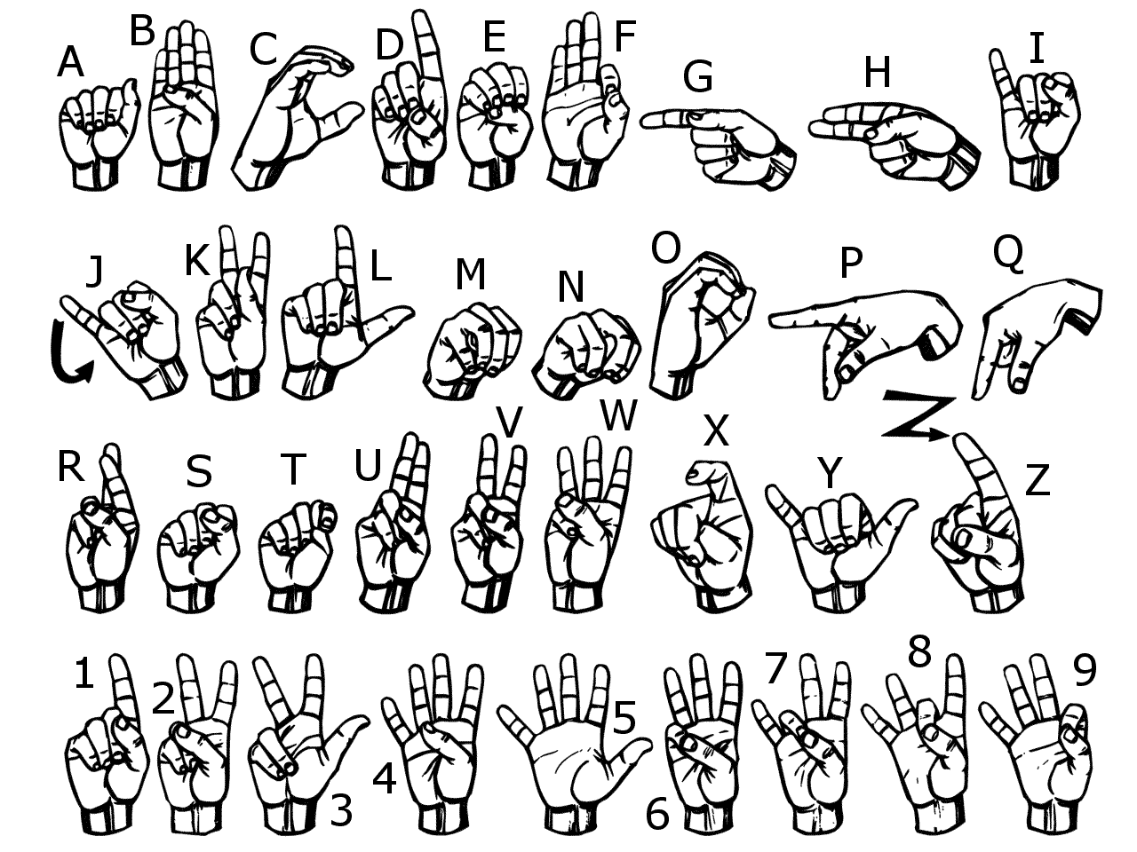
Let’s Learn ASL!

Slide 26
Resources
Saur, Rosemary E., Mary Jane Popp, and Morton Isaacs. "ACTION ZONE THEORY AND THE HEARING-IMPAIRED STUDENT IN THE MAINSTREAMED CLASSROOM." The Journal of Classroom Interaction 19, no. 2 (1984): 21-25. http://www.jstor.org/stable/23868759.
Kluwin, Thomas N. "Keeping Secondary School Hearing Impaired Students on Task." The Journal of Educational Research 78, no. 1 (1984): 45-50. http://www.jstor.org/stable/27540092.
Stover, Dana L., and Norman Pendegraft. "Revisiting Computer-Aided Notetaking: Technological Assistive Devices for Hearing-Impaired Students." The Clearing House 79, no. 2 (2005): 94-97. http://www.jstor.org/stable/30182118.
"What is Hearing Loss?" American Speech-Language-Hearing Association. Accessed March 23, 2017. http://www.asha.org/public/hearing/What-is-Hearing-Loss/.
Boon, Olivian. "Notetaking for Hearing and Hearing Impaired Students." Journal of Reading 32, no. 6 (1989): 532-36. http://www.jstor.org/stable/40030438.
Cole, Elizabeth Bingham, and Carol Ann Flexer. Children With Hearing Loss. San Diego: Plural Publishing Inc. 2016.
Ronnie B.Wilbur. “The Use of ASL to Support the Development of English Literacy.” Journal of Deaf Studies and Dead Education. 5:1. Purdue University: Winter 2000.

