Slide 1
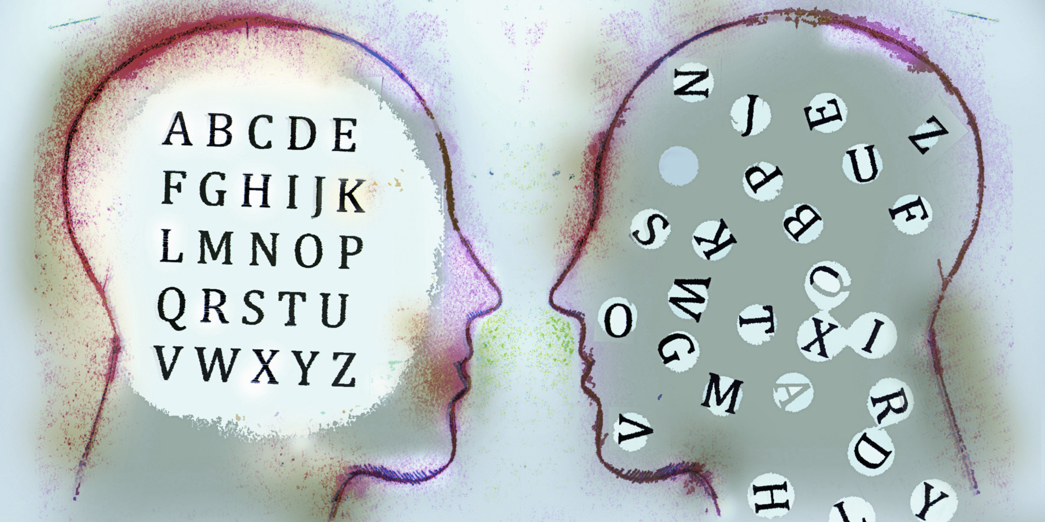
Dyslexia
What it is and how it affects literacy
By Graham Ford, Lily Frampton and Christopher Zannetos

Slide 2
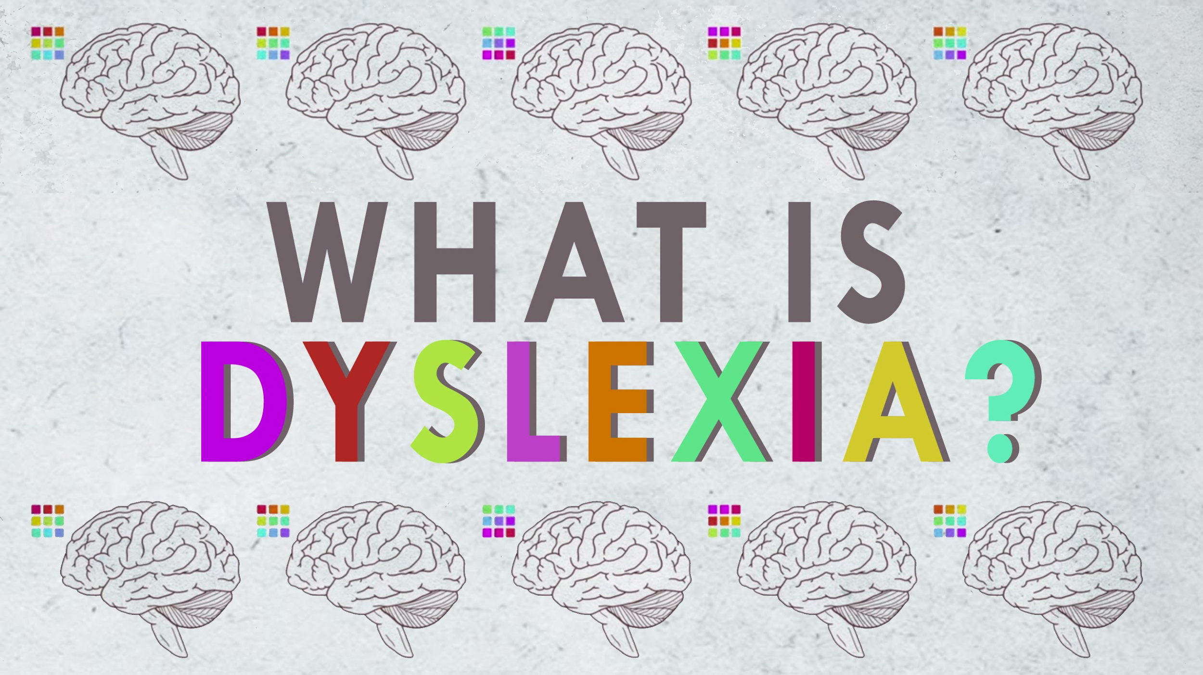
Definition
According to Gabrieli:
Characterized by a difficulty in understanding and using alphabetic or logographic principles to acquire accurate and fluent reading skills.
Reduced vocabulary and strategies needed for text comprehension.
Reduced motivation to read.
Generally diagnosed by a notable difference between an individual's’ reading ability and their IQ (Intelligence Quotient).
dys·lex·i·a
dəsˈleksēə/
Noun
a general term for disorders that involve difficulty in learning to read or interpret words, letters, and other symbols, but that do not affect general intelligence

Slide 3
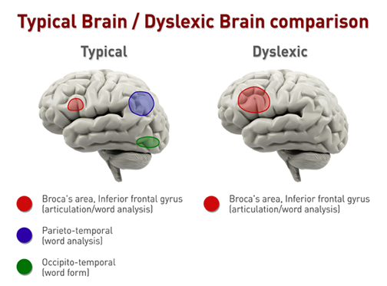
The Cause
Dyslexia is a heritable trait. It is coded on the short arm of chromosome 6. It has been tied to an autoimmune deficiency that affects neural growth in the second trimester of prenatal development. This causes variations of neural pathways that are not seen in non-dyslexics and higher symmetry to the brain. (John Stein* and Joel Talcott)

Slide 4
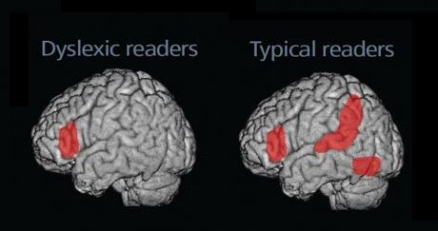
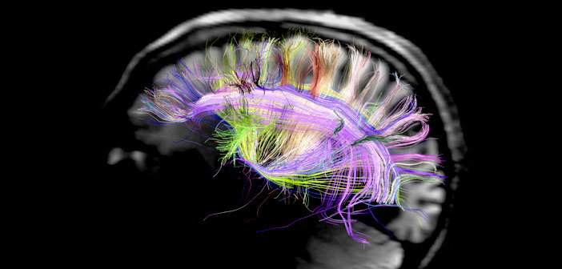
The Neurological Background
In the brains of dyslexics the parieto-temporal and occipito-temporal regions of the brain are not tied to the inferior frontal gyrus. This means that dyslexics struggle to decode the phonemes but have to rely on whole word recognition. (John Stein* and Joel Talcott)

Slide 5
Dyslexia and Neural Plasticity
Dyslexic brain formation is recognizable within days after birth on brain scans. As it is heritable this means we can have extremely early recognition. Thanks to our growing understanding of neural plasticity this means that with early interventions we can help reestablish the connection. (John D. E. Gabrieli, et al.)
Fig. 1. Brain activation differences in dyslexia and its treatment [from (36)]. Functional magnetic resonance imaging activations shown on the left hemisphere for phonological processing in typically developing readers (left), age- matched dyslexic readers (middle), and the difference before and after remediation in the same dyslexic readers (right). Red circles identify the frontal region, and blue circles identify the temporo-parietal region of the brain. Both regions are hypoactivated in dyslexia and become more activated after remediation.

Slide 6
Signs and Symptoms
Ten to fifteen percent of the US population has dyslexia, yet only five out of every one hundred dyslexics are recognized and receive assistance. Approximately 60% of individuals diagnosed with attention deficit hyperactivity disorders are also dyslexic, however, their learning and language differences are often unrecognized because only the behavioral aspects of ADHD are addressed. (http://www.dyslexia-add.org/)
Students who struggle to read out loud.
Students who regularly spell phonetically.
Students who appear to have normal intelligence but struggle with reading, writing, numerical representation.
Students whose literacy processing speed seems to vary greatly from their abilities in other areas.
Overall we need to be aware of the prevalence of this and make every effort to ensure early recognition and assistance is given.

Slide 7
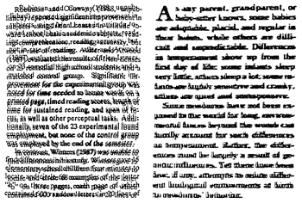
Types and Severity
Visual Dyslexia: Difficulty in recognizing written sequences of letters (or even letters themselves, in some cases)
Auditory Dyslexia: Difficulty in processing spoken words (especially new words) and pronouncing them

Slide 8
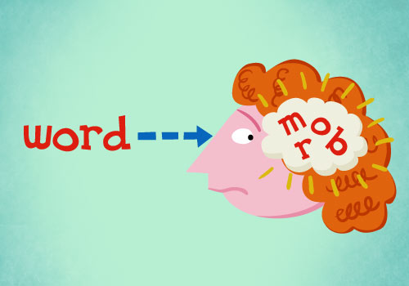
Types and Severity Continued
Dyslexia: Difficulty isolating phonemes, which result in difficulty distinguishing certain words (Ex: cat and cut, prescribe and describe, etc)
The severity of the different types can be classified as mild, moderate, severe, or profound. Someone with mild dyslexia may only confuse certain letters, whereas someone with profound dyslexia may not be able to decode written letters at all, relying on context clues and memorizing how different words look.

Slide 9
Treatment Options
Early intervention is key. Studies have shown that early intervention can actually bring dyslexic individuals up to average levels. Unfortunately this needs to occur early while literacy skills are still developing.
Treatment differs from individual to individual based on the severity of their dyslexia. In general, treatment often consists of a program that teaches phonic recognition, building up to whole word shape recognition.

Slide 10
How to Address In the Classroom
http://opendyslexic.org/ : Newly developed font to increase readability for readers with dyslexia.
https://itunes.apple.com/us/app/openweb-dyslexia-friendly/id519348697?mt=8 : Free app that customizes a student’s ipad or iphone font to OpenDyslexic.
Provide notes for dyslexic students so they have more time to read the text being shown to the class.
Text-to-speech technology (like Reading Pens, text-to speech software, audiobooks, etc.) that help them associate the proper sounds with the text they’re reading.
Where possible, print handouts on pastel-coloured paper rather than white.
Learning cursive script helps with handwriting and spelling, since all the letters are connected together. Readers are less likely to flip letters since they appear differently.

Slide 11
Resources for Teachers
https://homeschoolingwithdyslexia.com/resources/
https://homeschoolingwithdyslexia.com/teaching-writing/
https://www.dyslexiamaterials.com/home.html
https://empoweringwriters.com/ten-tips-for-teaching-writing-to-your-dyslexic-students/

Slide 13
Decoding Activities
http://www.pbs.org/wgbh/misunderstoodminds/experiences/readexp1a.html
http://mpowerednz.com/wp-content/uploads/2014/10/from-enchanted-gates-grade-3-macmillan-and-company.jpg (an example of what a short paragraph may look like to a dyslexic student who has difficulty distinguishing spacing)

Slide 14
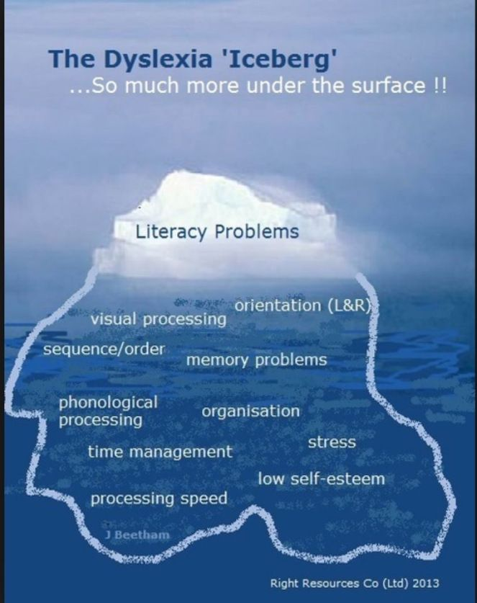

Slide 15
Bibliography
http://opendyslexic.org/
https://itunes.apple.com/us/app/openweb-dyslexia-friendly/id519348697?mt=8
http://www.nhs.uk/Conditions/Dyslexia/Pages/Introduction.aspx
http://www.neuronlearning.com/research/dyslexia-visual-or-auditory
http://study.com/academy/lesson/phonological-dyslexia-definition-examples.html
Usha Goswami, Phonological Representations,Reading Development and Dyslexia: Towards a Cross-Linguistic Theoretical Framework, Institute of Child Health, University College London, UK
John D. E. Gabrieli, Dyslexia: A New Synergy Between Education and Cognitive Neuroscience, www.sciencemag.org SCIENCE VOL 325 17 JULY 2009
John Stein* and Joel Talcott, Impaired Neuronal Timing in Developmental Dyslexia—The Magnocellular Hypothesis, Copyright ? 1999 John Wiley & Sons, Ltd.
http://www.dyslexia-add.org/
https://homeschoolingwithdyslexia.com/resources/ https://homeschoolingwithdyslexia.com/teaching-writing/
https://www.dyslexiamaterials.com/home.html
https://empoweringwriters.com/ten-tips-for-teaching-writing-to-your-dyslexic-students/

