Slide 1
Epistemic Dependency in Global ELT: Problematizing the Reproduction of Educational Inequalities
6th Saarbrücken International Conference on Foreign Language Teaching
Communication across Borders – Teaching, Learning and Speaking the Languages of the World
27 - 29 October 2021
Eugenia Vasilopoulos PhD
Douglas Fleming PhD
Faculty of Education
University of Ottawa
Canada
EDUCLANG Research Group https://www.educlang.ca/en/home
Notes:
G

Slide 2
Overview
West China Program
Participants and local context
Epistemic dependency and the WCP Curriculum
Findings from the WCP
Methodological Problematics with program evaluation in Global ELT research
Diffractive Data Analysis: Response-able Reading
Data Vignettes
Implications for Global ELT research
Notes:
G

Slide 4
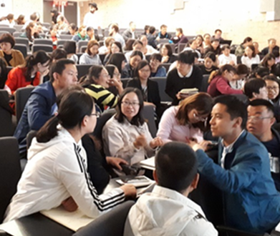
West China Project (WCP) 2015-2018
The WEST CHINA PROJECT at the UNIVERSITY of OTTAWA
Notes:
D
West China Project: Collaboration between Chinese Scholarship Council, Chinese Ministry of Education, Beijing Language and Culture University, and University of Ottawa
Study-abroad teacher professional development program that included pre-departure training in BLCU (for one month) and intensive in-class training plus socio-cultural immersion in Canada (three months)
Part of a larger initiative by the Chinese government to reform English language education in Western China which involved thousands of in-service language teachers and partner universities in the UK, US, Canada, Australia, and New Zealand (Wang, Clarke & Webb, 2019) in a wide-scale effort to improve teachers’ English language proficiency, knowledge of second language pedagogy, and cultural awareness (Wang, 2014).
From 2015-2018, 243 English language teachers from the Western Chinese provinces of Yunnan and Gansu participated in the program at the University of Ottawa

Slide 5
Participant Demographics
Notes:
D

Slide 6
Local Teaching Context and Conditions
Overcrowded classes
Limited resources (esp. IT)
Centralized curricula using Beijing-based texts
Teacher-centered methodology
Grammar and writing focus
Preparation for standardized tests (esp. written university entrance examinations)
Challenging working conditions
Policy: adopt speaking focus and communicative methodologies
Rural Yunnan and Gansu:
Very little interest in English or higher education
Highly multicultural and multilingual
Low S-ES
Generational change
Notes:
D

Slide 7
Teaching and Research to Un-do Epistemic Dependency
Dynamics of marginalized groups from China (Outer circle nation/periphery) in a state-sponsored program, travelling to Canada (Inner circle nation/Centre) to learn English
Curriculum designed to redress dominant ideologies and the unidirectional transmission of knowledge through a socio-culturally responsive ELT training curriculum that contended with the impact of Global English “on the formation of individual identities of English language learners, teachers, and teacher educators around the world” (Kumaravadivelu, 2012, p. 9).
Epistemic Dependency sustained through ideology (native speaker norms), terminology (EFL, ESL, EIL, etc.) and Western-dominated knowledge production (including center-based methods and notions of cultural competence) that are disseminated globally through the text-book and ELT industries
Notes:
D

Slide 8
WCP Curriculum
3-month residence stay at the University of Ottawa
Funded by the Chinese Scholarship Council, participation by visiting Chinese scholar, and curriculum developed in concert with the Chinese Embassy and the Beijing Foreign Languages and Culture University
Early morning lectures on critical perspectives in SLA theory and research (10hrs/week)
Late morning workshops for English acquisition (10hrs/week)
Afternoon workshops on SLA methods inspired by Post-Method Pedagogy (Kumaravadivelu, 2006)(15 hrs/ week)
Led by the Faculty of Education with assistance from the Official Language and Bilingualism Institute
Classroom observation facilitated by the Ottawa Catholic School Board and local First Nation (KItigen Zibi)
Cultural exchanges; field-trips; conversation practice; computer lab work
Staff: Faculty; PhD students, undergraduates; manager
Notes:
D
Early morning lectures on topics such as:
ESL/EFL theory
Creating and adapting teaching materials
Functional and structural linguistics
Problematizing the place of grammar
The value of bilingualism
Decentralized curriculum decision-making
Student-centered approaches
Anti-racism and language learning
Critical multiculturalism
Alternate forms of educational leadership
Critical curriculum theory
Problematizing Canadian culture, history and citizenship
English, globalization and post-colonial discourses
These lectures went far beyond what Beijing officials mandated.

Slide 9
Data Collection
Notes:
D

Slide 10
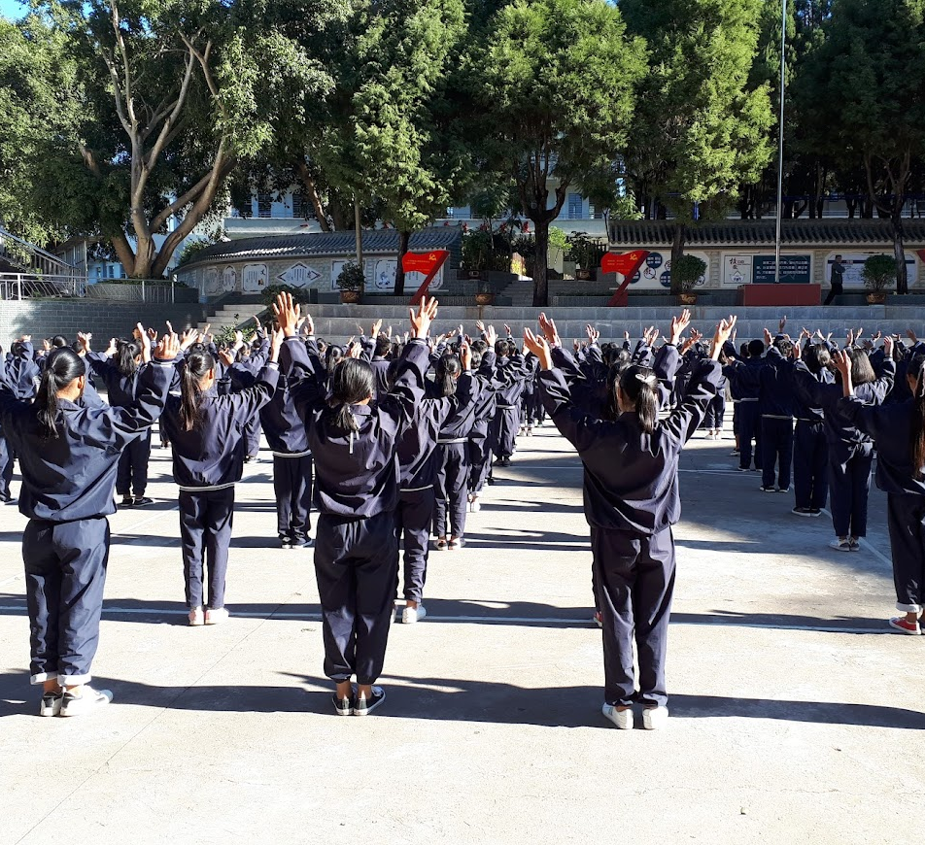
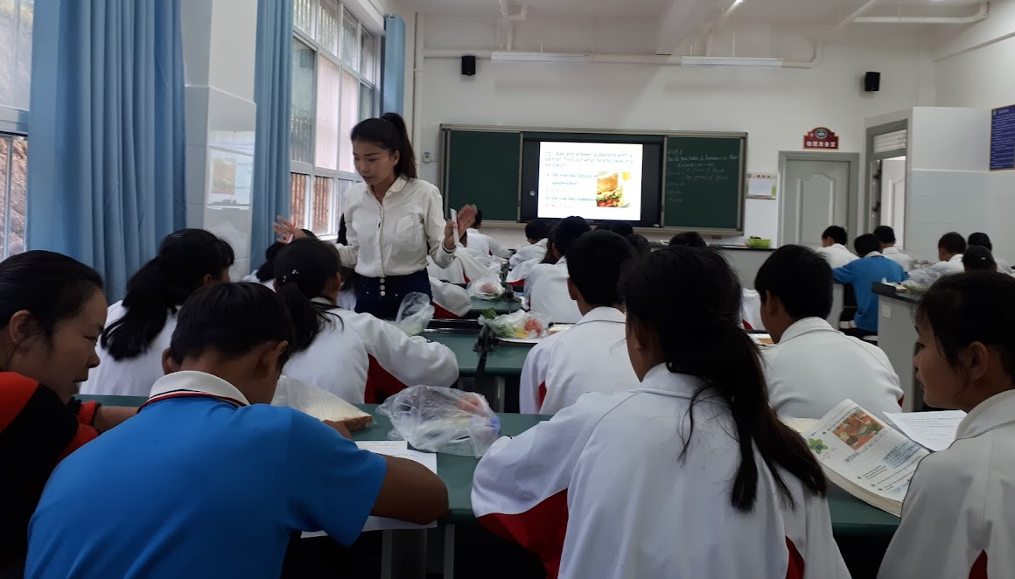
Notes:
D
Photos taken in China (during your trip with Gloria), You can explain that a bit.
It soon became clear that there were tensions between local officials and those based in highly ranked universities and Beijing. Of course, at various times we were “trotted out” in order to enhance the prestige of local officials.
Interference by accompanying senior uOttawa faculty and staff who used the occasion to ingratiate themselves with highly ranked Chinese universities at the expense of continuing the productive relationships with local school boards and regional governments and lower ranked post-secondary institutions. While these uOttawa faculty were present during the first week of our trip, Gloria and I held model lessons in which we demonstrated how English lessons should be taught. It was only after we were out of the clutches of these parasites that we were able to dialogue meaningfully with local teachers and gather data.
So, colonisation is a complex phenomena with a multitude of tensions and contradictions.

Slide 11
 | During /After Program (Canada) | After Return (China)
Benefits | Improved English language proficiency (perceived and real) Increased confidence as an EFL teacher Awareness of the existence of new teaching methods; Development of communities of practice; Inter-cultural experience | Increased student enthusiasm for English class Implementation of activities that are more communicative in nature Transformative experience-lasting impact on perceptions of language education, teacher role and responsibility Promotion/leadership positions within their schools/districts
Challenges | Limited interaction with local Canadians Lectures required scaffolding and differentiated instruction Applicability and appropriateness of content/methods/tools esp. technology Improved alignment between local curriculum/materials/assessment and methodologies | Varying degrees of institutional support in rural areas; Effects on curriculum of standardised testing; Minimal parental support; Overcrowded classes and limited resources (esp. IT); Centralized curricula using regional models; Low student motivation; Low socio-economic status *Challenges linked to local conditions/structures
Notes:
D

Slide 12
Methodological Problematic 1: Cause-Effect of Program Evaluation Research
A cause-effect relationship between the training program and reported/observed post-program outcomes (Kiely, 2019)
Largely conclusive findings: e.g. Li, Zhang and Edwards’ (2016) review of Chinese sponsored in-service ELT PD programs in the UK reports: “changes in participants teaching philosophy and teaching practices, enhancement in competences such as their English proficiency, lesson planning and implementation and cultural awareness, as well as assumption of new leadership roles and enhanced interest in research” (pg. 191).
Findings from non-government sponsored programs are less positive. (e.g. Yukari, 2017; Nguyen & Walkinshaw, 2018)
To Global ELT language teacher program evaluation:
How do we report research that presumes cause-effect linearity, fixed identities and trajectories without reinforcing the center-periphery dichotomy?
Notes:
G
Ex. Japanese teachers (Yukari, 2017) and Vietnamese teachers (Nguyen & Walkinshaw, 2018) found less positive impacts: in both cases the approach to teaching and the specific forms of practice encountered and promoted in training contexts in Inner Circle countries did not fit well with requirements and expectations in schools in Japan and Vietnam

Slide 13
Methodological Problematic 2: Objectivity and Authenticity of Data
Absence of third-party researchers for program evaluation whereby the dual role-played by the instructors, of teacher and researcher may cast doubt on researcher objectivity and authenticity of the data (Wang et al. 2019).
Authenticity in terms of measure of reliability and validity PLUS the broader social implications of research
Domination of knowledge production in the center that sustains the positionality of the periphery: need a center to have a periphery (Morgan, 2013)
How can we do Global ELT study-abroad research that is critical of our subject positions?
Notes:
G
Differing definitions of authenticity, but both are compatible with our intended meaning here:
1) An important issue for qualitative research is that of authenticity. In establishing authenticity, researchers seek reassurance that both the conduct and evaluation of research are genuine and credible not only in terms of participants' lived experiences (validity and reliability) but also with respect to the wider political and social implications of research. Authenticity involves shifting away from concerns about the reliability and validity of research to concerns about research that is worthwhile and thinking about its impact on members of the culture or community being researched. Authenticity, then, is seen as an important component of establishing trustworthiness in qualitative research so that it may be of some benefit to society (Givens, Sage Handbook; Guba & Lincoln)

Slide 14
Diffractive Data Analysis: Response-able Reading
Exploring how we can undo epistemic dependency through relational ontologies
Relational ontology (Barad, 1997) accounts for the socio-material-affective entanglement between participants, researchers, affective, material, structures and realities
Methodological, this involves a different way of reading participant interview data: ethico-onto-epistemological approach (Barad, 1997)
Diffractive readings entail close respectful responsive and response-able (enabling response) attention to the details of a text
Recognizes that ‘realities’ are constructed AND actively reproduce in the social world: “meaning is bounded in the materiality of ‘things’ and the practices within which concepts are performed, contextually and historically” (Zembylas & Bekerman, 2013, p. 9)
Notes:
G
[D]iffractive readings must therefore entail close respectful responsive and response-able (enabling response) attention to the details of a text; that is, it is important to try to do justice to a text. It is about taking what you find inventive and trying to work carefully with the details of patterns of thinking (in their very materiality) that might take you somewhere interesting that you never would have predicted. It’s about working reiteratively, reworking the spacetimemattering of thought patterns; not about leaving behind or turning away from. (Juelskaer and Schwennesen (2012, 13; our emphasis)

Slide 15
Response-able Methodologies
Response-able methodologies involve careful attentiveness, responsibility/accountability, rendering each other capable and the ability to respond.
Attentiveness involves reading the fine details of texts care-fully to ascertain what is and what is not being expressed.
Response-able readings of texts are ethical practices. Not simply a critique to deconstruct and label “wrong”
An ethics predicated on entanglement (and essentializing) that brings interpretation back to the reader/audience and their capacity to respond (not by labeling true/false/right/wrong) (Murris & Bozalek, 2019; Bozalek & Zembylas, 2017)
To guard against research findings presented as fixed interpretations that can perpetuate epistemic dependency
Notes:
G
Responsibility or accountability follows from attentiveness and allows us to answer the question: Once due attention has been paid to a text, what should be done with regard to it, what commitments to ourselves and the texts are we willing to take on (Barad, 2007)?
ex. What interpretation do I give this text? How do I represent this data in my research?
Response-able readings of texts are ethical practices. Not simply a critique to deconstruct and label “wrong”
An ethics predicated on entanglement (and essentializing) that brings interpretation back to the reader/audience and their capacity to respond (not by labeling true/false/right/wrong) (Murris & Bozalek, 2019; Bozalek & Zembylas, 2017): what does the reader make of this data?
Research findings presented as fixed interpretations can perpetuate epistemic dependency

Slide 16
Utility of Response-able Methodologies to WCP Research
Towing the party line and a dominant discourse of gratitude for the opportunity to study abroad
Group surveillance through the presence of party official as supervisors present in class and in focus group interview
Providing interview/focus group questions in advance and data collection through participant organized grouping to ease initial concerns about anonymity and confidentiality
Self-censorship regarding local conditions and policies, and ambivalence towards the enactment of systematic change (blocked possibility of transformation outside of the classroom)
Dominant discourse of singing from the choir book
Notes:
D
Response-able reading reveals what might not be directly expressed in the data (i.e. silences and tensions aside from the more obvious intended outcomes of what we wanted to see).
Centre/periphery relationships should not be conceptualized simplistically as being exclusively in terms of those BETWEEN nation states. These relationships are also evident WITHIN nation states. We could easily characterize the centralized Beijing-based power structures in China as a modern form of colonization of the regional and ethnic minorities in China by the Han majority.
We argue that the struggles we had with Beijing authorities over the need to encourage teacher and student-based pedagogy are evidence of this. Beijing authorities consistently expressed a preference for receptive expert-mentor relationships between WCP facilitators and the visiting teachers. These authorities went so far as to mandate “demonstration lessons” half way through the final year of the program in which program facilitators taught model lessons as they should be taught in China. This led to the absurd situation in which facilitators with only a marginal understanding of local Chinese conditions told teachers how to adapt the program materials to their classrooms.

Slide 17
Vignette 1: Bibles, turtle, rabbit, squirrel
Ethnic-linguistic-religious diversity were untouched despite the rich diversity among participants
Interviewer: What did you learn from the school visits1 or from the teaching at the university?
Noreen: Yeah, I can see you can put the Bible is your classroom. But in China, you can’t put
anything that's related to the religion. You can’t and you really take some turtle, rabbit, squirrel,
into your classroom. It is a happy world for the children. In China, you see the conditions.
Especially here, not very good. Even if we want to some activities, the space is not enough. Too
many students, but the space is very limited. And some, sometimes we'd like to use some scenes
(art) that we all make. It makes a class, very interesting. We can have the material. (Gansus Focus Group 2, 1:43)
What meaning can be given?
Notes:
G

Slide 18
Vignette 2: “I want to be honest with people.
Unspoken tensions about program content and program delivery in data collection
Interviewer (I): Did you find it (training in Beijing University of Language and Culture prior to leaving China) helpful?
Luke (L): A little.
I: Ok. How so?
L: (Long pause…silence)
I: It doesn’t matter, you don’t have to tell me. So, you said a little. Can you tell me a little more about your experience there?
L: I don’t know (laughing….pause).
I: Ok. That’s ok. (laughing).
L: Because I want to be honest with people. Most people answer this questions, I guess, well they will say I think it was a great help for them, but to be honest, I don’t think so….I think Beijing was to make us, to train us to be a student. To train us to sit for 8 hours…. Yes, but don’t forget, not only are we students, but we are also teachers. Sometimes I want to be a student, sometimes I want to be a teacher too. So sometimes I am a student, but outside of class, equal relations you and I, we have to learn from each other, we have respect for each other. If I find that i am not interested in what you teach, you should change your teaching style maybe (August 16, 2016. L interview, 38:48)
What meaning can be given to the hesitant response and the shift in subject positions?
Notes:
G

Slide 19
Vignette 3: “You should learn something from China.”
Minority voices resisting and contesting imposed identities
I: If you can maybe say in one sentence or a few sentences, your overall experience here in the program.
L: It’s a wonderful experience for me. It is the first time for me to go abroad, especially to go to a developed country. You gave us the opportunity to come here, it will change our idea of education for kids of course.
I: Do you think your students will appreciate your new teaching?
L: Yes of course. We have to learn something, but you should learn something from China. Why, you know why?... It mentioned from the TV report last year, the UK needs the 40 math teacher. You know why? They have to learn something from China. You know most teacher, they need something, you know most young people are good at doing math. (August 16, 2016. L interview, 43:20).
Where do micro-counter narratives fit in broader program evaluation reporting which emphasizes dominant themes in relation to project objectives?
Notes:
G

Slide 20
Response-able Reporting of Global ELT Research
Research findings presented as dominant themes and fixed interpretations highlight a linear relationship and a unilateral uncontested transmission of knowledge from center to periphery
For critical researchers, it is a question of ethics and un-doing dominant discourses and non-essentializing subject positions
Response-able methodologies allows researchers to focus on messy data, and differences in the data rather than similarities, prevalence, or intended outcomes
Doing so allows us to problematize essentialized concepts in Global ELT
Notes:
G

Slide 21
Thank you!
For questions and comments, please email us!
evasilop@uottawa.ca
dfleming@uottawa.ca
Notes:
G

Slide 22
References and Bibliography
Barad, K. (2007). Meeting the universe halfway: Quantum physics and the entanglement of matter and meaning. Durham: Duke University Press.
Bozalek, V., & Zembylas, M. (2017) Towards a response-able pedagogy across higher education institutions in postapartheid South Africa: An ethico-political analysis. Education as Change, 21(2), 62–85.
Kumaravadivelu, B. (2012). Individual identity, cultural globalization and teaching English as an international language: The case for an epistemic break. In L. Alsagoff, W. Renandya, G. Hu, & S. L. Mckay (Eds.), Teaching English as an international language: Principles and practices (pp. 9-27). New York: Routledge.
Kumaravadivelu, B. (2006). TESOL methods: Changing tracks, challenging trends. TESOL quarterly, 40(1), 59-81.
Kiely, R. (2019). Evaluating English language teacher education programmes. In The Routledge handbook of English language teacher education (pp. 82-95). Routledge.
Farzi, R., Romero, G. & Fleming, D. (2021). Global English teaching: The multicultural and multilinguistic context of EFL teachers of rural China. In Selvi, A.F. & Yazan, B. (Eds.), Language teacher education for global Englishes: A practical resource book (pp.38-43). New York: Routledge.
Fleming, D. (2020). Decolonialization in the concrete: Honoring the expertise of local teachers in English as a foreign language contexts. In W. Tao & I. Liyanage (Eds.), Multilingual education yearbook 2020 (pp.81-94). Melbourne: Deakin University Press (pp.81-94).
Fleming, D. (2020) Problematizing language: English as an international language, the native speaker and Deleuze’s use of the notion of becoming. In The magic of language: Productivity in linguistics and language teaching (T. Tinnefeld, Ed.), Saarbrücken Series on Linguistics and Language Methodology. Vol 11. Saarbrücken: Die Deutsche Nationalbibliothek (pp.109-120).
Li, D., Zhang, X., & Edwards, V. (2016). Innovation and change in English teaching in the western provinces of China: The impact of overseas training. In Educational Development in Western China (pp. 191-215). Brill Sense.
Murris, K., & Bozalek, V. (2019). Diffracting diffractive readings of texts as methodology: Some propositions. Educational Philosophy and Theory, 51(14), 1504-1517.
Morgan, B. (2015). Language Teacher Education and the Developing World: Exploring'Horizons of Possibility'for Identity and Agency. Linguistics & the Human Sciences, 11(1).
Nguyen, X. N. C. M. and Walkinshaw, I. (2018) ‘Autonomy in Teaching Practice: Insights from Vietnamese English Language Teachers Trained in Inner-Circle Countries’. Teachers and Teacher Education, 69 21–32.
Phillipson, R. (2012). Linguistic imperialism. The encyclopedia of applied linguistics, 1-7.
Wang, F., Clarke, A., & Webb, A. S. (2019). Tailored for China: did it work? Reflections on an intensive study abroad programme for Chinese student teachers. Teachers and Teaching, 25(7), 800-820.
Vasilopoulos, E., Romero, G., Farzi, R. & Fleming, D. (2018, September). International English teacher professional development in the interests of decolonization and peace. Critical Inquiry in Language Studies. doi: 10.1080/15427587.2018.1520599
Yukari Takimoto, A. (2017) ‘A Visit to Purgatory: Cultural Mismatch Between a Japanese International Teacher Candidate and her American Supervisors and Mentor Teachers’. Teaching and Teacher Education, 68 200–209.

