Slide 1
Equities In Physical Activity and Sport

Slide 2
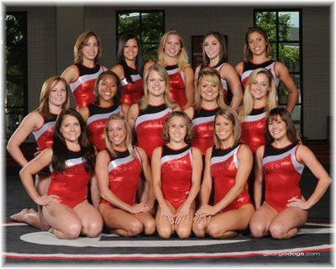
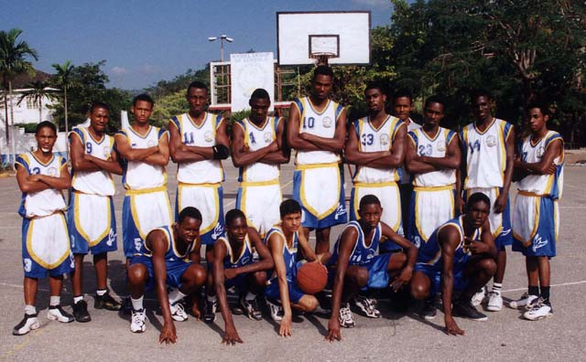
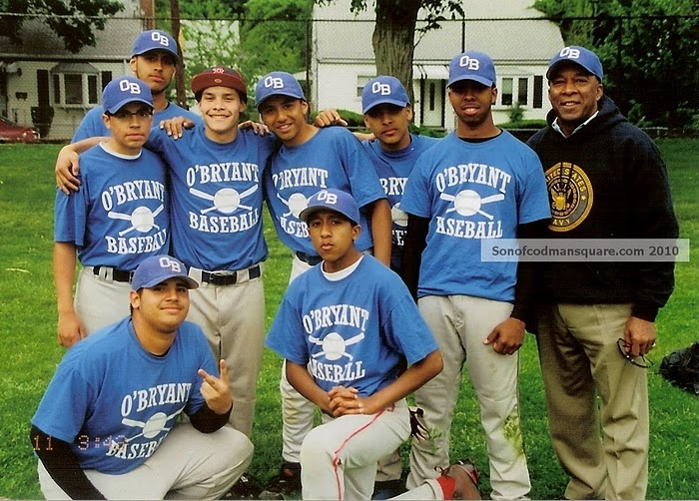
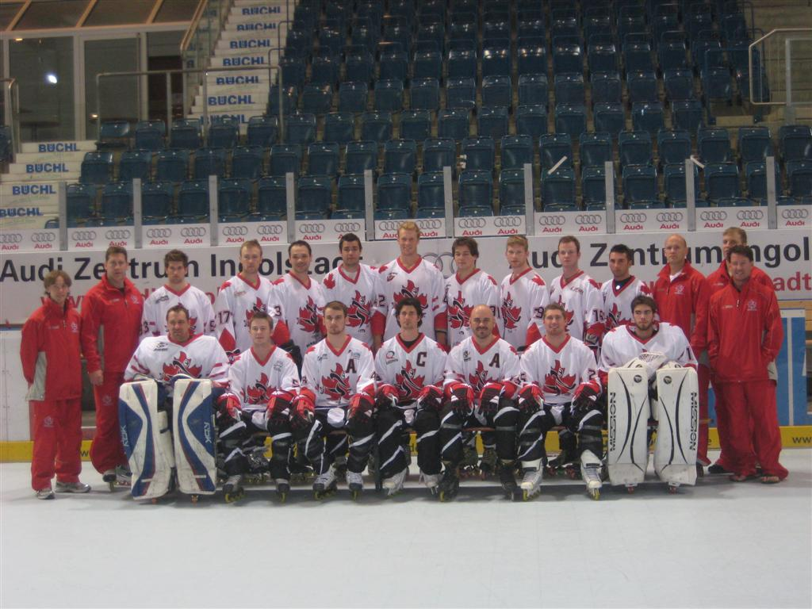
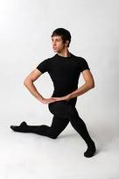
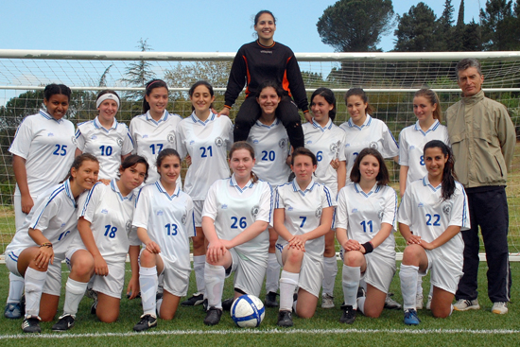
Main Issues of Focus
SEXISM GENDER RACISM CLASSISM
Stereotypes

Slide 3
Related Articles
L. Harrison, L. Azzarito and J. Burden. Perceptions of Athletic Superiority: A View from the Other Side
L. Powell, S. Slater, F. Chaloupka and D. Harper. Availability of Physical Activity–Related Facilities and Neighborhood Demographic and Socioeconomic Characteristics
P. Velija and G. Kumar. Physical Education and the Embodiment of Gender
H. Larson, B. Fagrell and K. Redelious. Queering Physical Education. Between Benevolence towards girls and tribute to masculinity

Slide 4
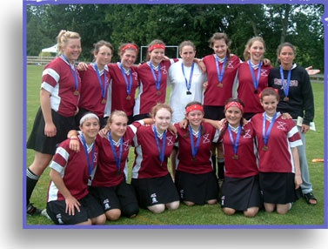
Perceptions of Athletic Superiority: A View from the Other Side
Teachers and coaches promote stereotypical views of racial Physical Education
Racial physical superiority vs. intellectual inferiority
Race in sport under researched
Some races are more likely to be put in certain sports
Socialists: the difference is social environments and not genetics
Avoidance of certain sports ex. 13 year old basketball player
White culture shy’s certain people away from professional sport
Coaches opinions are directly being implemented in Physical Education
The sense that one of the only ways for African Americans to achieve is through sport

Slide 5
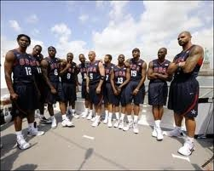
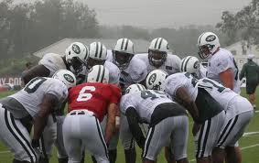
Some Quick Stats
78% of the NBA comprises of African Americans, 67% of the NFL and 63% of the WNBA
In this articles qualitative research only 5/25 respondents stated that they didn’t quit sport because of racial inferiority
Only 7/25 interviewed did not think race effected their sport performance

Slide 6
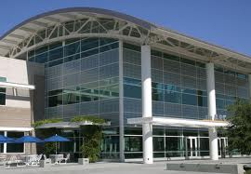
Availability of Physical Activity–Related Facilities and Neighborhood Demographic and Socioeconomic Characteristics
Multivariate analyses were conducted to assess the availability of 4 types of outlets:
(1) physical fitness facilities
(2) membership sports and recreation clubs
(3) dance facilities
(4) public golf courses.
physical activity–related facilities were less likely to be present in lower-income neighborhoods and in neighborhoods with higher proportions of racial minority

Slide 7
Physical Education and the Embodiment of Gender
PE is a subject that reinforces dominant ideologies about gender
Focus on the body, physical skills and unique opportunities for social interaction
Differences between bodies in relation to performance means that gender and sexuality becomes visible
Ratio of male to female involvement in PE = 2:1
Interviews
girls are not allowed to play certain sports (net ball, football, rugby)
girls prefer activities that help them keep fit (ex: aerobics), but “male” games dominate
limited opportunity for variety prevents females from selecting PE

Slide 8
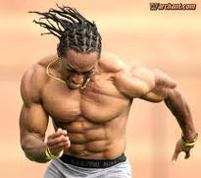
Queering Physical Education. Between Benevolence towards girls and tribute to masculinity
teachers are aware of male dominance (in numbers and influence on activity choice) but perceive this as normal or natural
teachers choose to promote activities favored by the majority, therefore leaning on traditional ideas about gender in relation to sport
they do not challenge gender stereotypes
teachers manage male dominance rather than challenge it and have avoided developing teaching strategies to work with such issues

Slide 9
Educational Resources
http://www.youtube.com/watch?v=qdUklkGYhrI
http://www.youtube.com/watch?v=ONtNAKA97v8&feature=related

