Slide 1
Presented By: Puja Patel, Emily Langevin, Aliya Abdur-Rahim, & Brianna Miller
EDU 5190 Introduction to Research in Education

Slide 2
Objectives
By the end of this presentation you will know more on…
1) The definition of Ethnographic research, when to use it and how it developed
2) The three types of Ethnographic designs
3) Some characteristics of Ethnography
4) The potential ethical issues in conducting Ethnographic research
5) The steps for conducting Ethnographic research
And hopefully much more!

Slide 3
Presentation Preview
•Introduction + KWL chart
•Defining, Using and History of Ethnographic Research Emily
•Three Types of Ethnographic Designs Aliya
•Ethnographic Research Video
•Steps in Conducting Ethnographic Research Brianna
•Group Activity
•Ethical Issues in Ethnographic Research Puja
•Conclusion- Wrap up KWL chart

Slide 4
Defining Ethnographic Design
•A qualitative research approach that analyzes, describes,
and interprets a culture-sharing group.
•Observable aspects of a culture-group:
Political structure
Economics
Language development and patterns
Rituals
Relationships/Interactions

Slide 5
When To Use Ethnographic Design
Purpose: To understand a bigger issue by closely studying a culture-sharing group.
•When you have access to a culture-sharing group & approval
•Ability to be an observer or participant
•Document collection & detailed records
•Interest in adding knowledge and studying cultural themes
Ex. Theme: Persistence in distance education course (Garland, 1993)

Slide 7
Development of Ethnography Research

Slide 8
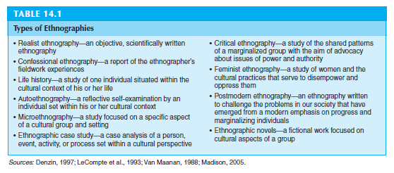
WHAT ARE THE TYPES OF ETHNOGRAPHIC DESIGNS?

Slide 9
THREE TYPES OF ETHNOGRAPHIC DESIGNS
The realist ethnography
The case study
The critical ethnography

Slide 10
Realist Ethnography
A realist ethnography is an objective account of the situation, typically written in the third-person point of view, reporting objectively on the information learned from participants at a field site.
Definition
In this ethnographic design:
It is an objective, scientifically written ethnography
Narrates the study in the third person voice reporting what is observed (facts)
Research reports objective data free from personal bias, judgement, and/or goals
Researcher produces the participants’ views through closely edited quotes and has final word on interpretation
Characteristics and Roles of Researcher
Wolcott (1974, 1994) used a realist approach to ethnography to study the activities of a committee appointed to select a principal. This study addressed the process a school selection committee experienced as they interviewed candidates.
Example
John W. Creswell Educational Research: Planning, Conducting, and Evaluating Quantitative and Qualitative Research, fifth edition

Slide 11
Case Study Ethnography
A case study is an in-depth exploration of a bounded system (e.g., activity, event, process, or individuals) based on extensive data collection (Creswell, 2007).
Definition
In this ethnographic design:
a single individual, several individuals separately or in a group, a program, events, or activities
be selected because it’s unusual
represent a process consisting of a series of steps that form a sequence of activities
Researcher develops understanding of the case by collecting multiple forms of data
Researcher locates the “case” or “cases” within their larger context
Characteristics and Roles of Researcher
An example of a case study is the research by Kos (1991) of four middle school students who have reading disabilities.The study examined what factors contributed to the development of reading disabilities in adolescents.
Another example is the case study by Padula and Miller (1999) of four women who
had reentered the university as full-time doctoral students.
Example
John W. Creswell Educational Research: Planning, Conducting, and Evaluating Quantitative and Qualitative Research, fifth edition

Slide 12
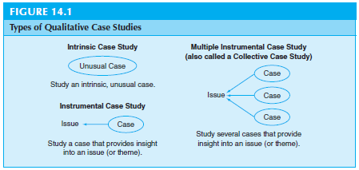
Types of Qualitative Case Studies

Slide 13
The Critical Ethnography
Critical ethnographies are a type of ethnographic research in which the author is interested in advocating for the emancipation of groups marginalized in our society (Thomas, 1993).
Definition
In this ethnographic design:
studies involve social issues of power, empowerment, inequality, inequity, dominance, repression, hegemony, and victimization.
Used to advocate for the emancipation of marginalized groups
Seeks to advocate for change to help transform society
Critical ethnographers are self-conscious, reflexive, and self-aware
Critical ethnographers actively collaborate, participate, negotiate with participants
Characteristics and Roles of Researcher
The critical ethnographic study of one principal in an “inclusive” elementary school (Keyes, Hanley-Maxwell, & Capper, 1999) illustrated many of these features. The overall purpose was to describe and define the role of administrative leadership in an inclusive school for students with a high incidence of disability classifications (e.g., cognitive, emotional, learning, speech, and language)
Example
John W. Creswell Educational Research: Planning, Conducting, and Evaluating Quantitative and Qualitative Research, fifth edition

Slide 14
Qallunaat! Studying the white people

Slide 15
STEPS IN CONDUCTING AN ETHNOGRAPHY
STEP 1
Identify Intent and the type of Design and relate intent to your research problem
STEP 2
Discuss how you plan to receive approval and gain access to study sites and participants
STEP 3
Collect appropriate data, emphasizing time in the field, multiple sources of information, and collaboration
STEP 5
Write and report your research consistent with your design
STEP 4
Analyze and interpret your data within a design

Slide 16
R E A L I S T
Cultural-sharing group
Detailed description
Identifying a cultural theme
STEP 1
STEP 2
STEP 3
STEP 4
STEP 5
Approval from Review Board
Locate research site
Identify a Gatekeeper
Considerable time at the site
Enter site slowly and build rapport
Observations & record notes
Read through data
Description of cultural setting, establishing context for studied group
Develop themes about culture-sharing group and Interpretation of cultural theme
Remain in the background
Keep Biases out, and identify how exploration of the cultural theme advances knowledge.

Slide 17
STEP 3
Plan of action for change based on your findings
Discuss how you and participants changed
STEP 1
Relates to developing an in-depth understanding
Understanding an event, activity, process, or one or more individuals
C A S E - S T U D Y
STEP 4
Read through data
Describe the case(s) in detail
Develop issues or themes about the case(s)
Within-case followed by a cross-case analysis
STEP 2
Receive approval from Institutional Review Board
Locate research site
Identify # of cases to look at
Identify gatekeeper
Guarantee provisions for respecting the site
STEP 5
Report based primarily on description of the case
Choose to be objective or Subjective
Include your biases
Generalize to other cases

Slide 18
C R I T I C A L
STEP 1
Address inequities in our society or schools
Action and advocacy
Identify “critical” issue you wish to explore
STEP 2
Receive approval from Review Board
Locate a research site
Identify gatekeeper
Guarantee provisions for respecting the site
STEP 4
Read through data
Description of cultural setting
Themes related to “critical” issues
Identify needed changes
Advocate for specific changes
Advance a plan for change
STEP 3
Collaborate with participants
Collect multiple forms of data that individuals are willing to provide
STEP 5
Report as a call to action
Include specific plan of action for change based on your findings
Discuss how you and participants changed

Slide 19
HOW DO WE EVALUATE AN ETHNOGRAPHY?
Identify a cultural issue to study
Select a group to observe or interview over time
Noting shared patterns of behavior, language, and beliefs that the group has developed over time
Need to describe both the group and themes
Provide evidence of being reflexive

Slide 20
Ethical Issues Conducting Ethnography
Primarily come up when doing fieldwork because of issues collecting data
Ryan (2009)
Negotiating how to get access to the people and sites being studied
How long to stay in the field
How to interact with the participants respectfully
Madison (2005)
Open and transparent about gathering data
Respect towards causing no harm, preserving dignity, and ensuring privacy
Negotiate limits related to these factors
Creswell, J. Educational research: Planning, conducting and evaluating quantitative and qualitative research (5th ed.). Toronto: Pearson.

Slide 21
Activity
“Who Am I” Starting where you are
1. Form groups of three for three roles: interviewer, interviewee and recorder
2. Formulate three questions drawing from the above segment from Madison’s Critical Ethnography
3. Carry out the interview rotating roles
4. Discuss a genre for disseminating the responses
Recall the “ethno” and the “graphy” in the practice of ethnography

Slide 22
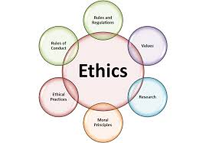
Ethical Issues Conducting Ethnography
Ethical responsibilities to the scholarly community
Not deceiving or misrepresenting participants or readers (e.g., fabricating evidence, falsifying or plagiarizing) failing to report misconduct
Other researchers should not be barred from entering the site
Ethnographers need to give back and provide remuneration to those being studied
Need to be aware of negative influence of their publications and presentations will have on the population they study
Did we have permissions to use stories?
Creswell, J. Educational research: Planning, conducting and evaluating quantitative and qualitative research (5th ed.). Toronto: Pearson.

Slide 23
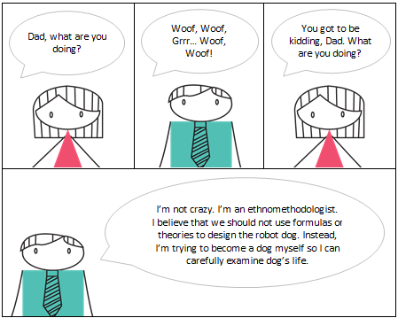
Ethics and the Social Dimension of Research Activities
Paoletti (2014)
Many ethical issues are described as confronting the researcher quite unexpectedly
Argues that reflecting on the social dimension of research activities, and on their impact on the social setting being studied, can provide a useful standpoint from which to make ethical decisions
Ethnomethodological studies can provide some useful analytical instruments for acquiring such an awareness
Such analytical practices can provide instruments to gaining awareness on the social dimension of research activities
Paoletti, I. (2014). “Ethics and the Social Dimension of Research Activities” Human Studies. 37(2), 257-277.

Slide 24
Ethics and the Social Dimension of Research Activities
Paoletti (2014)
Being aware of how participants use the data collection process can be relevant in taking decision over ethical matters
The research process became a means for research participants to protest in relation to some problems in their organizations
Ethical guidelines should be based on the empirical study of the actual research situation, considering how ethical procedures are implemented in relation to the specific circumstances
Researcher’s personal moral responsibility towards the participants in the research and the research setting
Paoletti, I. (2014). “Ethics and the Social Dimension of Research Activities” Human Studies. 37(2), 257-277.

Slide 25
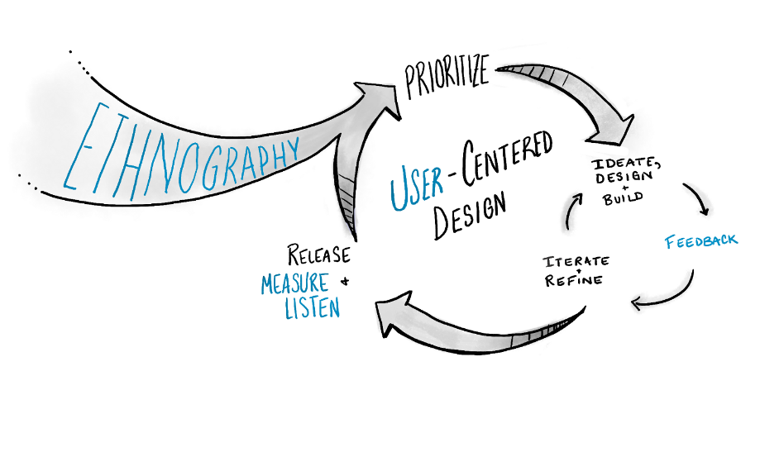
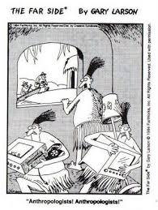

Slide 26
Works Cited
Creswell, J. Educational research: Planning, conducting and evaluating quantitative and qualitative research (5th ed.).
Toronto: Pearson.
Paoletti, I. (2014). “Ethics and the Social Dimension of Research Activities” Human Studies. 37(2), 257-277.

