Slide 1
Experimental Design
Ragu, Nickola, Marina, & Shannon

Slide 2
By the end of this lesson, you will be able to:
R
Define experimental research, describe when to use it, and how it developed
Identify the key characteristics of experiments
State the different types of experimental designs
Realize possible ethical issues in experimental research
Explain the steps in conducting an experiment
Evaluate the quality of experimental study

Slide 3
What is an experiment?
R
Testing an idea (or practice or procedure) to determine if it affects an outcome or dependent variable
Can students really multitask? An experimental study of instant messaging while reading
Bowman, Levine, Waite, & Gendron (2010)
Notes:
decide on an idea to experiment, assign people to to experiece it, and figure out if people who experienced it did better, worse, or other than those who did not experience it

Slide 4
When do you use it?
M
Experiments are used to establish possible cause and effect between independent and dependent variables
The experimenter attempts to control all variables that influence the outcome except for the independent variable
Then, when the independent variable influences the dependent variable, one can conclude that the independent variable probably caused the dependent variable

Slide 5
When did experiments develop?
M
Began in the late 19th and early 20th centuries
Since the 1980’s, experiments have grown in complexity and sophistication with the use of computers and improved statistical procedures

Slide 6
The key characteristics of experiments
M
Random assignment
Control over extraneous variables
Manipulation of the treatment conditions
Outcome measures
Group Comparisons
Threats to validity

Slide 7
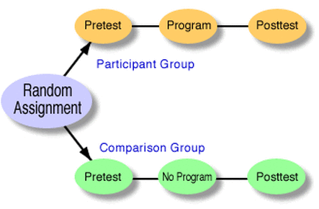
Random assignment
R
The process of assigning individuals at random to different groups in an experiment
Distinguishes a “true” experiment from a less-than-rigorous “quasi experiment”
Bias in the personal characteristics of individuals are distributed equally among groups

Slide 8
Control Over Extraneous Variable
R
Pretests and Posttests
measuring an attribute or characteristic used for assessing participants
advantages and disadvantages?
Covariates
statistically controls aspects of the experiment
relates to the dependent variable but not the independent variable
Matching of Participants
identify personal characteristics that may influence the outcome and assign individuals with that characteristic equally across the groups
Homogenous Samples
selecting people who vary little in their personal characteristics (age, abilities, gender, race)
Blocking Variables
dividing participants into subgroups (age, gender, race) and analyze the impact of each group subgroup on the outcome
Notes:
Extraneous variables: in random assigning individuals, we control for extraneous variables influence between new practice and the outcome; any influences in selecting participants, procedures, statistics or design likely to affect the outcome and provides a different explanation for our results than expected; all experiments have some random error that can’t be controlled, but can try to control extraneous factors
Pretest, posttest: eg assess students’ attitudes towards smoking before and after course
Advantages/Disadvantages:: time and effort to administer, raise student’s expectations about outcomes, pretest may influence experimental treatment, test scores affect post test scores (participants anticipate questions)
Covariates: eg remove students with parents who smoke from the experiment
Matching participant: eg boys and girls distributed equally (10 boys, 4 girls -.> 5/2, 5/2)
Blocking variables:

Slide 9
Manipulation of treatment conditions
M
In experiments, treatment variables are independent variables that the researcher manipulates to determine their effect on the dependent variable
Participants are assigned to different groups/conditions; the most basic research design has an experimental/treatment group and a control group
Participants in the experimental group experience something different than in the control group to examine whether or not the treatment condition influenced an outcome or a dependent variable

Slide 10
Outcome measures
M
The outcome is the dependent variable that is the presumed effect of the treatment variable
It is the effect predicted in the cause-effect equation stated in a hypothesis

Slide 11
Group comparisons
R
The process of a researcher obtaining dependent variable scores for individuals or groups and comparing the means and variance both within and between groups

Slide 12
Threats to validity
M
Threats to internal validity
A study that has good internal validity has ensured that other independent variables or confounding variables did not cause the results.
For instance, maturation (individuals developing or changing during the experiment) is a threat to internal validity
Threats to external validity
Problems that threaten the ability to generalize the results to other persons, settings, etc.
For example, a researcher may not be able to generalize findings to past and future situations

Slide 13
Learn them well...

Slide 14
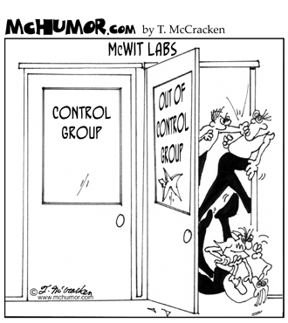
ACTIVITY TIME
http://www.timeanddate.com/stopwatch/

Slide 15
Outline
The Experiment
Groups were randomly assigned (pretend)
The treatment group is given redbull while the control group were not.
All individuals are given the same jigsaw puzzle to put together.
They were timed to see how long it took to finish the puzzle.
Discussion Questions
Identify the independent (treatment and control group), dependent, and controlled variables.
Assess the experiment using the key characteristics of experimental design as a starting point:
Random assignment
Control over extraneous variables
Manipulation of the treatment conditions
Outcome measures
Group Comparisons
Threats to validity

Slide 16
Variables… Have you learned them well enough?
Hypothesis: The consumption of Red Bull shortens the time an individual requires to complete a puzzle.
Independent Variable
Whether or not individuals consumed Red Bull
Dependent Variable
The time it to put the puzzle together
The time was observed and measured
Controlled Variable
All of the participants were tested with the same puzzle
All of the participants were given the same amount of Red Bull

Slide 17
Types of experimental designs
M
Between-group designs
True experiments: involves random assignment of participants to groups or units
Quasi experiments: involves the use of an intervention, but no random assignment
Factorial designs: involves one or two groups, but the researcher tests for the interaction of two or more independent variables
Within-group or individual designs
Time-series experiments: studying a single group and collecting more than one outcome measure
Repeated-measures experiments: involves only one group, but the researcher tests more than one intervention by alternating administrations of the experimental treatment
Single-subject experiments: examines one or more individuals at a time by establishing a baseline behaviour, administering the intervention, and determining the long-term impact when the intervention is given and withdrawn

Slide 18
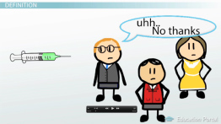
Potential Ethical Issues
R
Withholding experimental treatment from some individuals who might benefit from receiving it
When do you conclude an experiment?
Will the experiment provide the best answers to the problem?

Slide 19
Evaluating an Experiment
M
Key elements:
The experiment has a powerful intervention
Participants gain from involvement in the intervention
An adequate number of participants per group were selected in a systematic way
Valid, reliable, and sensitive measures were used
Extraneous factors were controlled
Threats to internal and external validity were addressed

Slide 20
Steps in conducting an experiment
R
Is it the best design?
Form a hypothesis
Select the experimental unit and participants to be involved
Possible randomly assigning individuals to groups
Conduct the experiment
Analyze and report the results
Evaluate the success of the process

