Slide 1
FORMAL and INFORMAL Language
Jena Racher, Mackenzie Densham, and Hamish Inksetter
How languages evolved, why we have language rules, and what the future might look like.
~
Slang: The benefits and dangers of utilizing it in the classroom
~
Social Media: how new forms of communication are changing language in our present society.
Notes:
Hey guys, I added subtitles that relate to our different areas of focus. You know 100% more about your content than I do, so feel free to make changes. Also, do you think this is OK as it is? I worry it might be a big wordy.

Slide 2
Formal vs Informal Conventional vs Unconventional
To teach language we need to know how and why it began, how it evolved, how it continues to change, and what holds it together.
What is meant by ‘formal’ or ‘conventional’ in terms of language?
What is the impact of this on our teaching practice?

Slide 3
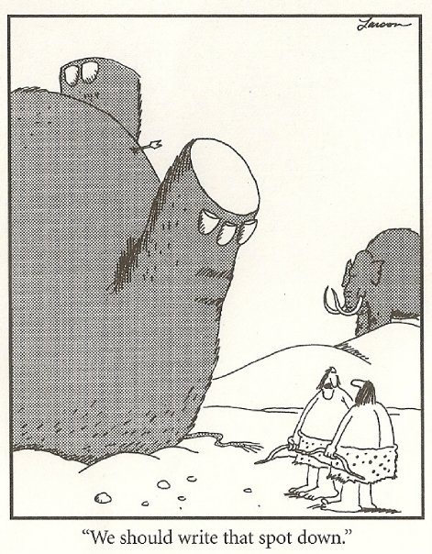
Origins of Language
Earliest writing: 5000 years ago
Emergence of language: between 50,000 and 250,000 years ago
  100,000 years ago = most common estimate

Slide 4
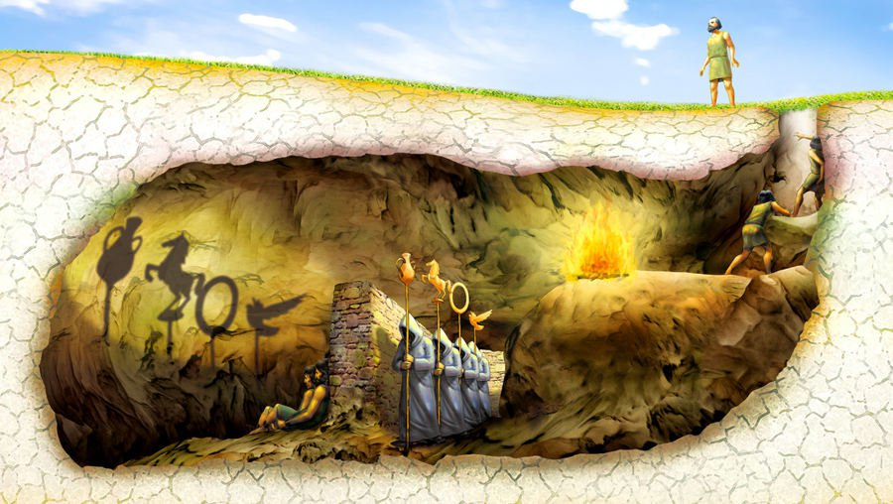
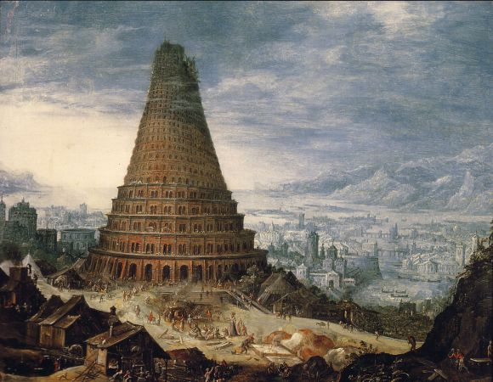

Beliefs about the origins of language before the modern period

Slide 5
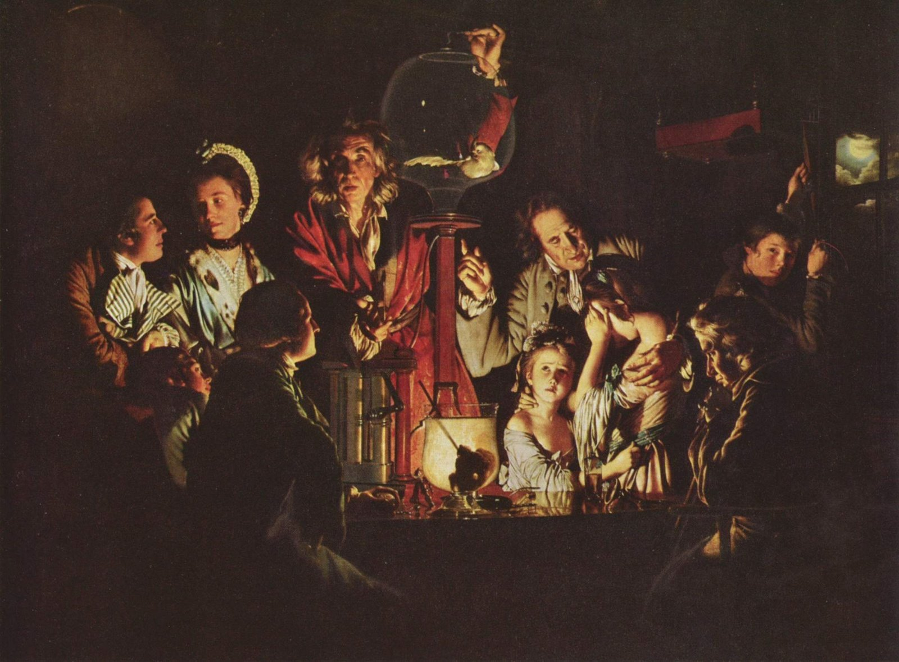
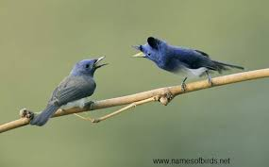
Early modern theories about the origins of language

Slide 6
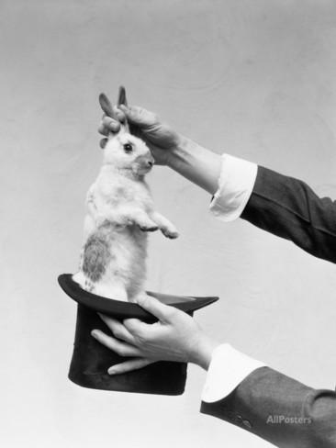

Debates surrounding the origin of language
Did language emerge quickly? Has it always been messy and complex?
Did language emerge slowly? Did it start off simple and grow complex over time?

Slide 7

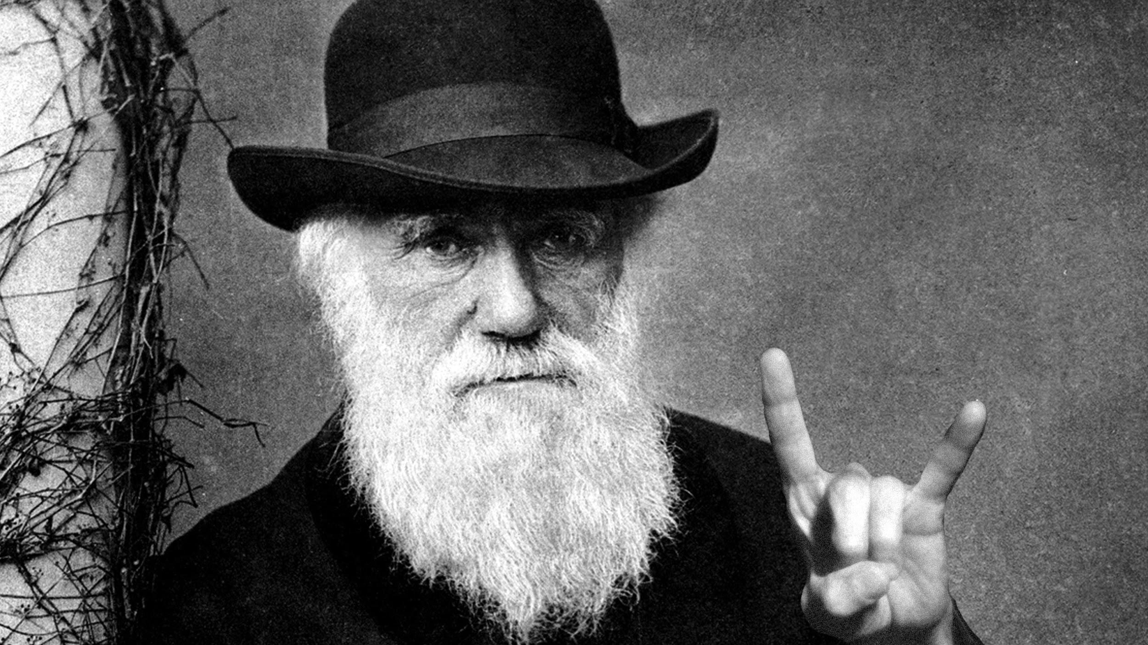
Descartes vs Darwin
Language as beautiful yet static
Operates through basis of assumption that communication occurs, and seeks to explain how
Focuses on abstract linguistic universals
Engages with the familiar ‘nature vs nurture’ debate
Language as messy and dynamic
Seeks to answer why communication occurs, and why languages are different
Focuses on the physical realities of human brain development
Recasts the nature/nurture debate in the framework of a developmental system that has evolutionary stability

Slide 8


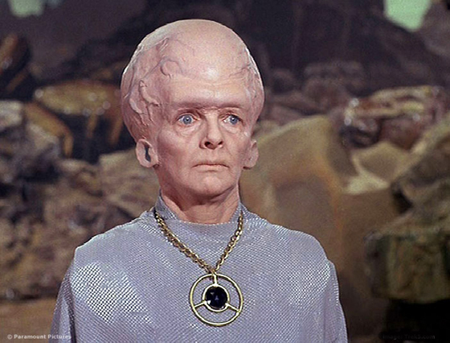
Related Origin-of-Language Theories
Catastrophic Evolution of Language
Gesture Theory
Neuro Biological

Slide 9
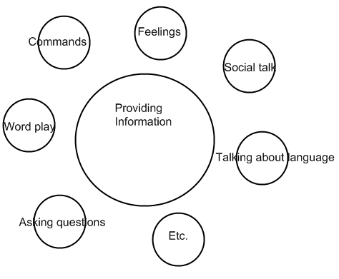
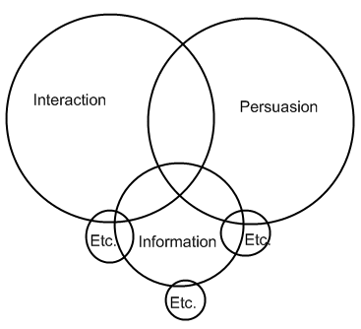
But what is language? What is it for?

Slide 10
What are the universal traits of language?
Some specific language patterns are repeated, but are not universal
  ‘M’ sounds for ‘Mother’; ‘R’ sounds for ‘Snore’
Is language infinit?
Chomsky’s theory of ‘Setting Parameters’
Is music the true universal language?
  “Music is the most direct and mysterious way of conveying and evoking feeling. It is a way of connecting one consciousness to another. I think the nearest thing to telepathy is making music together.” Oliver Sacks (quoted in The Making of Language, 2011)

Slide 11
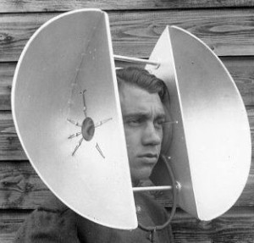
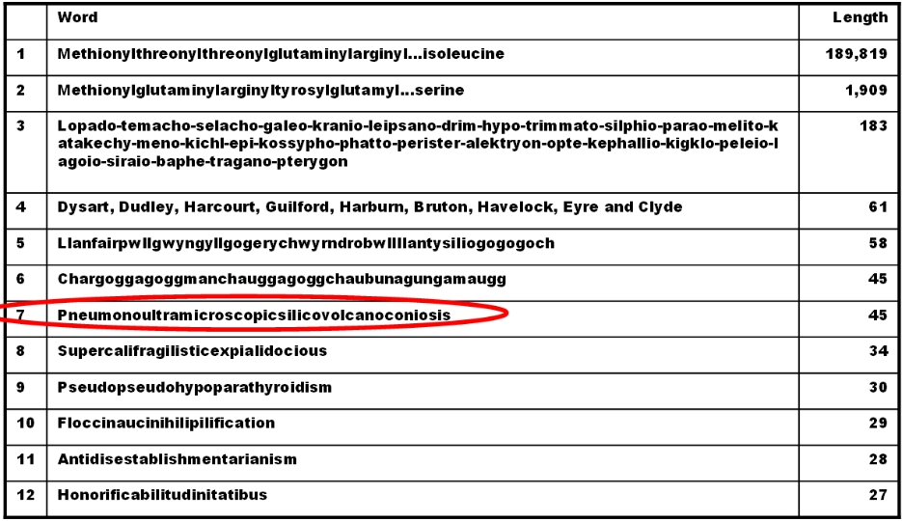
Common Limitations on Language
Filters
(physical limitations, such as pitch, vocal capacity)
Preference
(word length affecting memory, and ease of use)

Slide 12
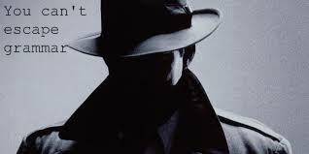

GRAMMAR
Grammar IS universal
Language needs rules in order for us to understand one another
Grammar is not a product of writing
  Grammar rules were sophisticated in pre-colonial non-textual societies
Two building blocks of most languages: NOUNS and VERBS
Three components of language: Phonology, Syntax, and Semantics

Slide 13
Origins of Grammar
“In the beginning was the word. But by the time the second word was added to it, there was trouble. For with it came syntax, the thing that tripped up so many people.”
-John Simon, Paradigm Lost
“Grammatical form, in which speech is naturally coded into some kind of subject-verb-object form (though not necessarily in that order), bears so close a resemblance to the natural way of thinking about the world that it is difficult to believe that the two are unconnected.”
-Robin Dunbar, “Theory of mind and the evolution of language” (1998)

Slide 14
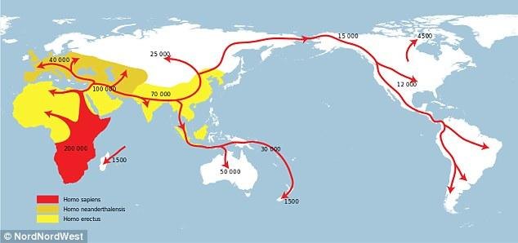
Grammar, like language, is adaptive and ever-changing

Slide 15


Slide 16
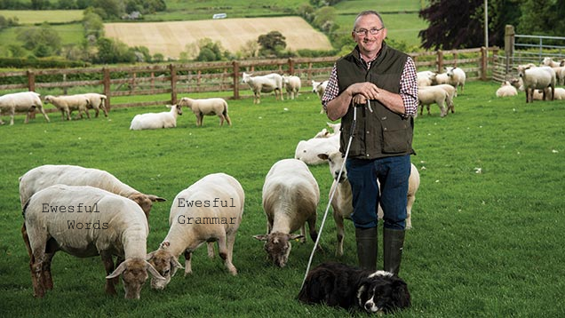
Is the evolution of language a result of natural selection, or domestication?

Slide 17
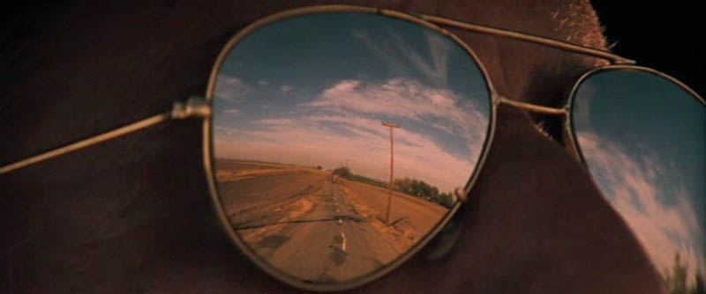
Grammar as a Reflection of Worldview
How our language is structured will affect the way we see the world
  How we see the world will impact the adaptations in our grammar
As conditions in life change, so to will worldview, and with it forms of language.

Slide 18
Lets Recap...
If language is constantly changing through adaptative evolution, then...
What are conventions?
Are all languages equal?
Is there such thing as a language that is ‘incorrect’ or ‘improper’?

Slide 19
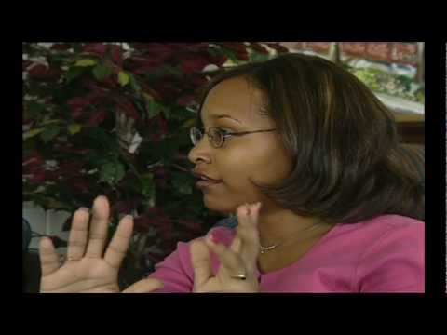
Case Study: African American Language (aka Ebonics)
https://www.youtube.com/watch?v=aQrtB7cZDrA

Slide 20
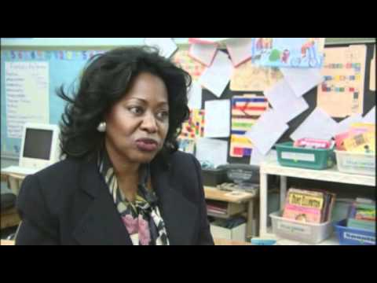
Case Study: African American Language (aka Ebonics)
https://www.youtube.com/watch?v=xX1-FgkfWo8

Slide 21
“We are like mariners who have to rebuild their ship on the high seas, without ever being able to strip it down in dock and construct it afresh from the best available components.”
-Otto Neurath, 'Protocol statements' (1932)
(quoted in The Seeds of Speech, 1996, p. 148)
“...we, as humans, have an impossible responsibility [...] of managing something, our language, that we can never understand completely, something so complex that much of what is important about it is always likely to elude us. We have no choice but to attempt something we're very likely to fail at, through sheer ignorance and stupidity. It matters what we all think justice is, what we all think a convention is, what we all think truth and power and beauty are, but as individuals, we aren't completely competent to decide what any of those words should mean. [...However] We humans are not puppets dancing at the end of strings held by maladaptive memes - we’re gardeners, domesticators, and creators, the ambitious rivals to Nature itself.”
-Daniel Cloud, The Domestication of Language (2015), p. 248-249

Slide 22
Defining Slang
“Very informal language patterns or vocabulary used by particular groups, or in special contexts, or to reflect trends”
Ontario Ministry of Education. (2007). The Ontario Curriculum, Grades 11 and 12: English. Retrieved March 25, 2017, from http://www.edu.gov.on.ca/eng/curriculum/secondary/english1112currb.pdf

Slide 23
Slang: Contextually Appropriate?
“...one of the major stumbling blocks is the assumption among many linguists that thanks to their elusive nature which is characteristic of subcultures, being mostly oral and short-lived, slang terms are considered peripheral to language. To these linguists and scholars, slang is nothing more than a quirk, a linguistic deviancy substituted for what is regarded as ‘standard’ and therefore can not be neatly classified by a system of discrete labels”.
J., Amari. (2010). The Fifth International Conference on Historical Lexicography and Lexicology. Retrieved March 20, 2017, from https://ora.ox.ac.uk/objects/uuid:fd2d4042-0f65-4037-bfd3-230c6193bc1d

Slide 24
The Paradoxical Nature of Allowing Students to Use Slang
If slang is difficult (or impossible) to quantify and define:
  How do we as teachers give our students parameters for success?
    A rubric? A checklist of approved words?
    What are the rules for breaking the rules?
Should slang be confined to assignments centred around investigating slang, or can slang be incorporated into the larger bulk of schoolwork that students are completing?

Slide 25
Slang in the Ontario Grades 11 and 12: English Curriculum
Comprehension | Application
ENG3U - Reading 3.1: Automatically understand most words in a variety of reading contexts ETS4C - Literature 2.5: Identify various elements of style used in texts and explain how they help communicate meaning and enhance the effectiveness of the text | ENG3E - Writing 2.2: Establish a voice, modifying language and tone to suit form, audience, and purpose ENG4C - Writing 3.2: Build vocabulary for writing by reviewing and refining word choice as appropriate for the purpose ENG4E - Writing 3.4: Use grammar conventions to communicate their intended meaning clearly and fluently EWC4U - Writing 4.2: Provide constructive feedback to peers

Slide 26
Other Curriculum Links
The Ontario Grades 9-12: Classical Studies and International Languages expectations include:
Conducting research to identify the meaning of slang encountered in a blog
Comparing the use of slang with the use of the standard target-language form
Identifying jargon and slang
Composing a rap containing common target-language slang
Creating a personal lexicon of words, including slang in online messaging

Slide 27
The Ontario Grades 1-8: Language Curriculum...
Does not talk directly about slang
Involves the use of idioms, formal vs informal language use and comprehension, and other such expectations in which slang could be incorporated.

Slide 28
The Benefits of Slang for ESL Students
“...[Zhang] stands in front of her classmates reading from a sheet of paper. She’s practiced the lines over and over under her breath. ‘You can count on one thing,’ she said, forming each word carefully. ‘If a critic thinks a movie is a bomb, it’ll be a smash hit.’”
“She’s among thousands of students who come to the United States with hopes of picking up what they can’t get back home: the idioms, the catchphrases – the slang.”
J., Huang. (2013, December 27). English learners demand slang; teachers try to keep up. Retrieved March 25, 2017, from http://www.scpr.org/blogs/multiamerican/2013/11/04/15109/english-language-learners-demand-slang-teachers-tr/?slide=3

Slide 29
Creative Use of Slang in the Classroom
Slang can be used as a tool to promote learning in all students, whether ELL or native speakers. It can also be used as a hook in order to motivate students who might otherwise be disengaged, or find language lessons to be unrelatable.
One resource for teachers that demonstrates the versatility of slang in the classroom is ‘http://eslhiphop.com/’, which:
engages students through pop-culture music
teaches students by dissecting pop-culture slang
also focuses on grammar - not just for ESL students

Slide 30
Slang: Potentially Harmful
According to Professor Lassiter at the University of Pennsylvania:
"Admissions officers have...shared that a lot of the [admission] essays they're encountering now are deeply rooted in this technological culture of cut-off sentences where you're writing like you speak, [and] after the first few sentences, college admissions professionals toss them to the side."
R., Lytle. (2011, June 13). How Slang Affects Students in the Classroom. Retrieved March 21, 2017, from https://www.usnews.com/education/high-schools/articles/2011/06/13/how-slang-affects-students-in-the-classroom

Slide 31
TL;DR Version
Slang comprehension and use are a part of the Ontario curriculum
Slang can be a contextually valuable tool inside of the classroom
Problems arise when students are unable to distinguish between slang, and formal language - whether read, written or spoken
  Students should learn the rules of, and gain competence in using formal language before bending or breaking the rules
    Manipulation of the rules should be deliberate, not from a place of ignorance and incompetence

Slide 32
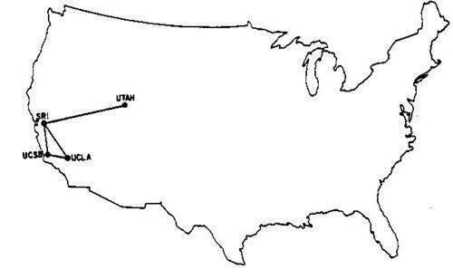
The Internet and Social Media!
Where did we come from? Where will we go?
1969:

Slide 33
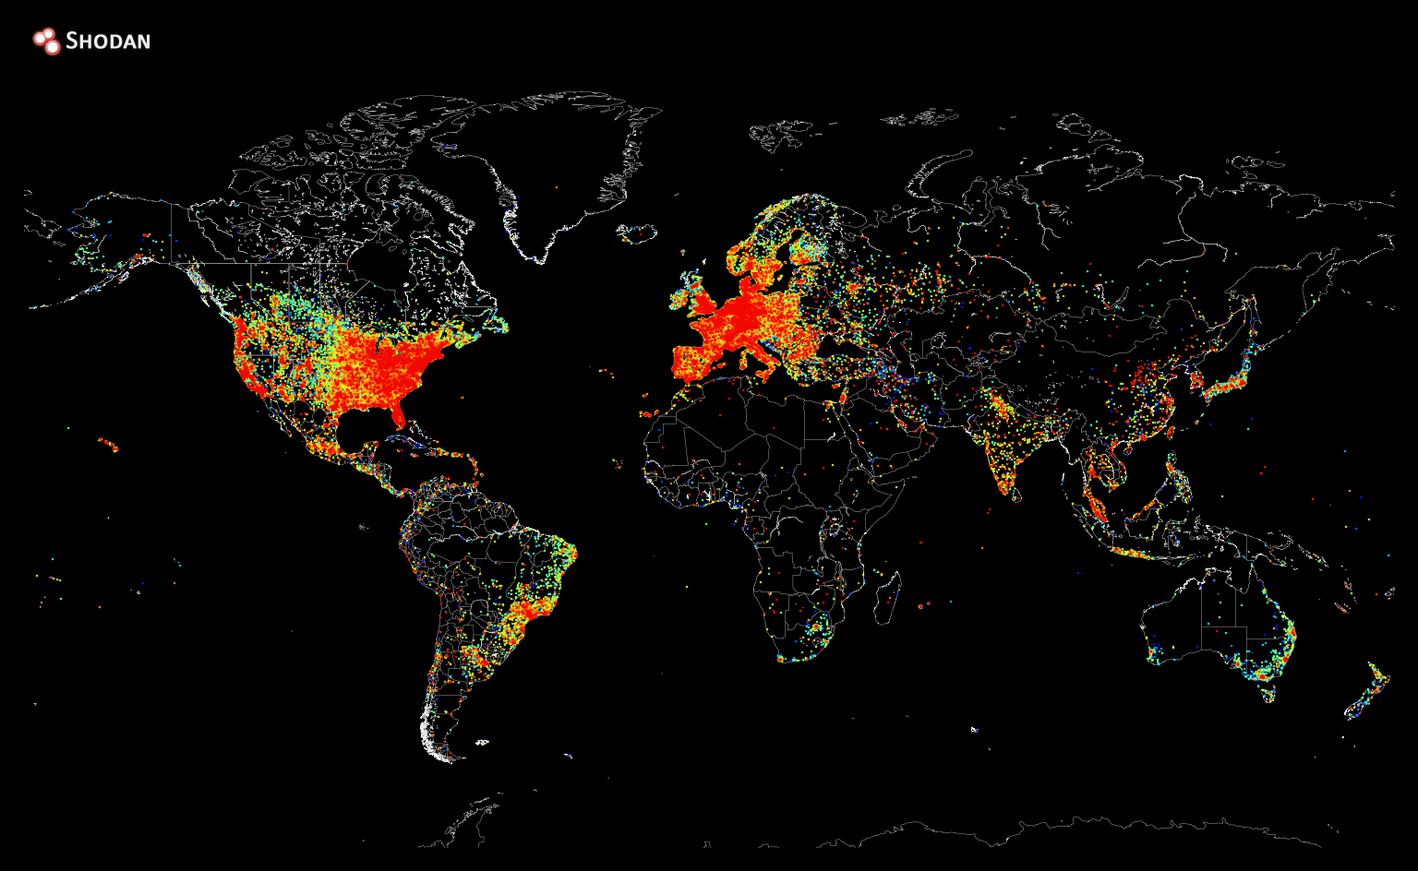
Today: This is a map of all the devices connected to the internet
Notes:
This is cool.

Slide 34
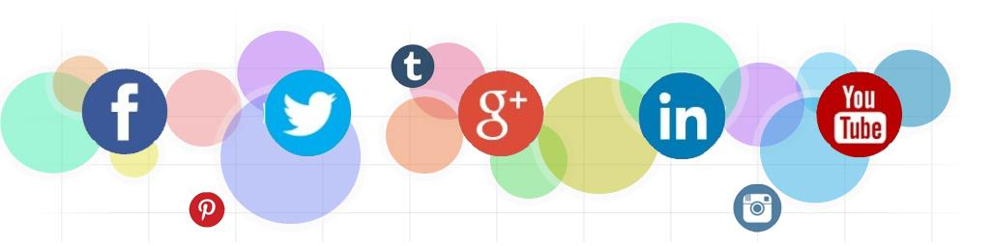
Social Media is ever-growing and expanding!
How do we define social media?
“Social media is the collective of online communications channels dedicated to community-based input, interaction, content-sharing and collaboration.”
We all probably know, or most likely are on, a social media platform! Facebook, Skype, Snapchat, Linkedin, Twitter and even if you think you are not, Blackboard and Prof. Fleming’s Blog are all consider ‘social media’ because it allows people to connect and to share
Rouse, M. (2016, September). What is Social Media? Retrieved March 20, 2017, from http://whatis.techtarget.com/definition/social-media

Slide 35

Social Media is Impacting the World
I don’t need to convince you that Social Media is important.
9 out of 10 teenagers have at least one social media account
“Forty-five per cent of eight to 11 year olds use social networking sites. For the eight to 11 year olds we found that the top four sites were YouTube, Moshi Monsters, Club Penguin and Facebook, with the most popular activities being playing games, private messaging, posting comments and posting their own status updates. In other words, they ‘like’, they post, they share just the same as their older counterparts. And they value it, very much. In fact, the proportion of eight to nine year olds who rated the internet as ‘very important’ had doubled since 2009”
Hughes, B. (2016, April 01). How Social Media is Reshaping Today's Education System. Retrieved March 20, 2017, from https://www.entrepreneur.com/article/273044
Kids online: The statistics. (n.d.). Retrieved March 20, 2017, from http://www.kidsmatter.edu.au/health-and-community/enewsletter/kids-online-statistics

Slide 36
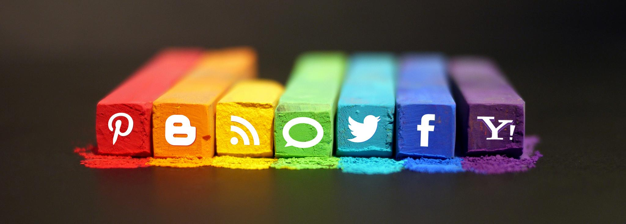
The Canadian Stats for Social Media:
WeAreSocial did a survey review of many countries and their use of social media, they worked with the GlobalWebIndex, and statistic government agencies in each country, to come up with the growth changes and uses of social media through the population.
The following pictures show the growth and population of Canadians who use social media:
Rosabel, D. (2016, January 27). Digital in 2016. Retrieved March 23, 2017, from http://wearesocial.com/sg/special-reports/digital-2016

Slide 37
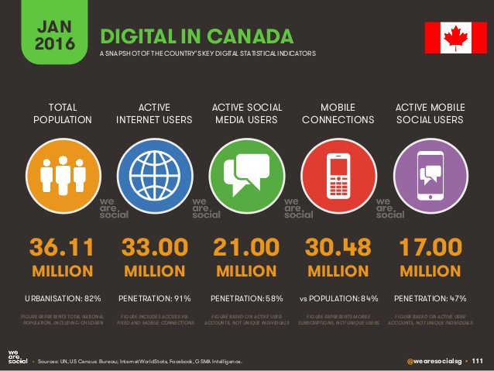

Slide 38
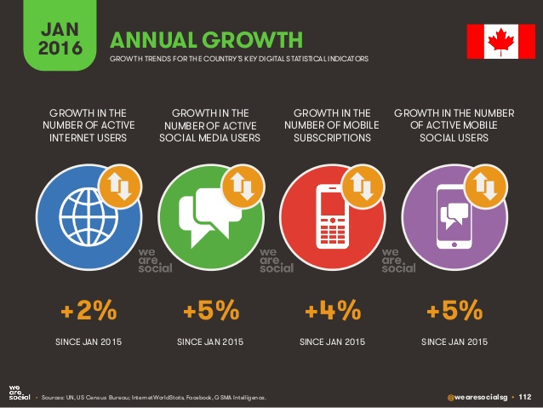

Slide 39
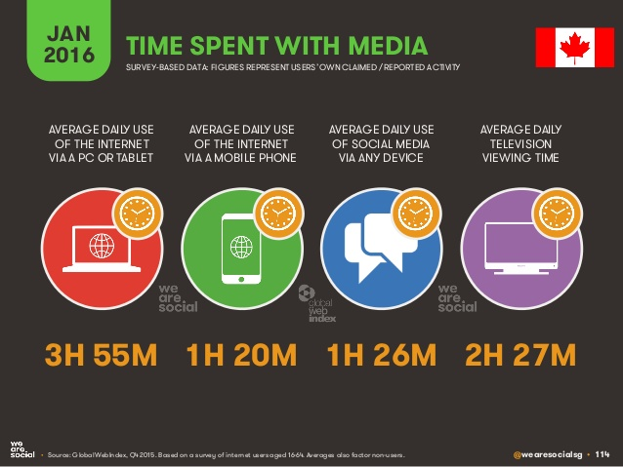

Slide 40
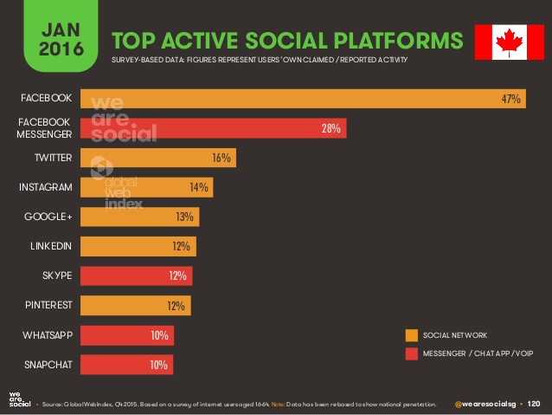

Slide 41
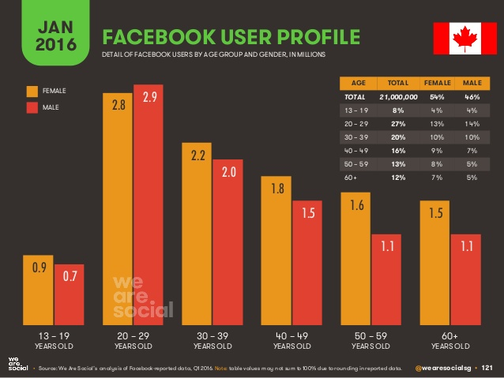

Slide 42
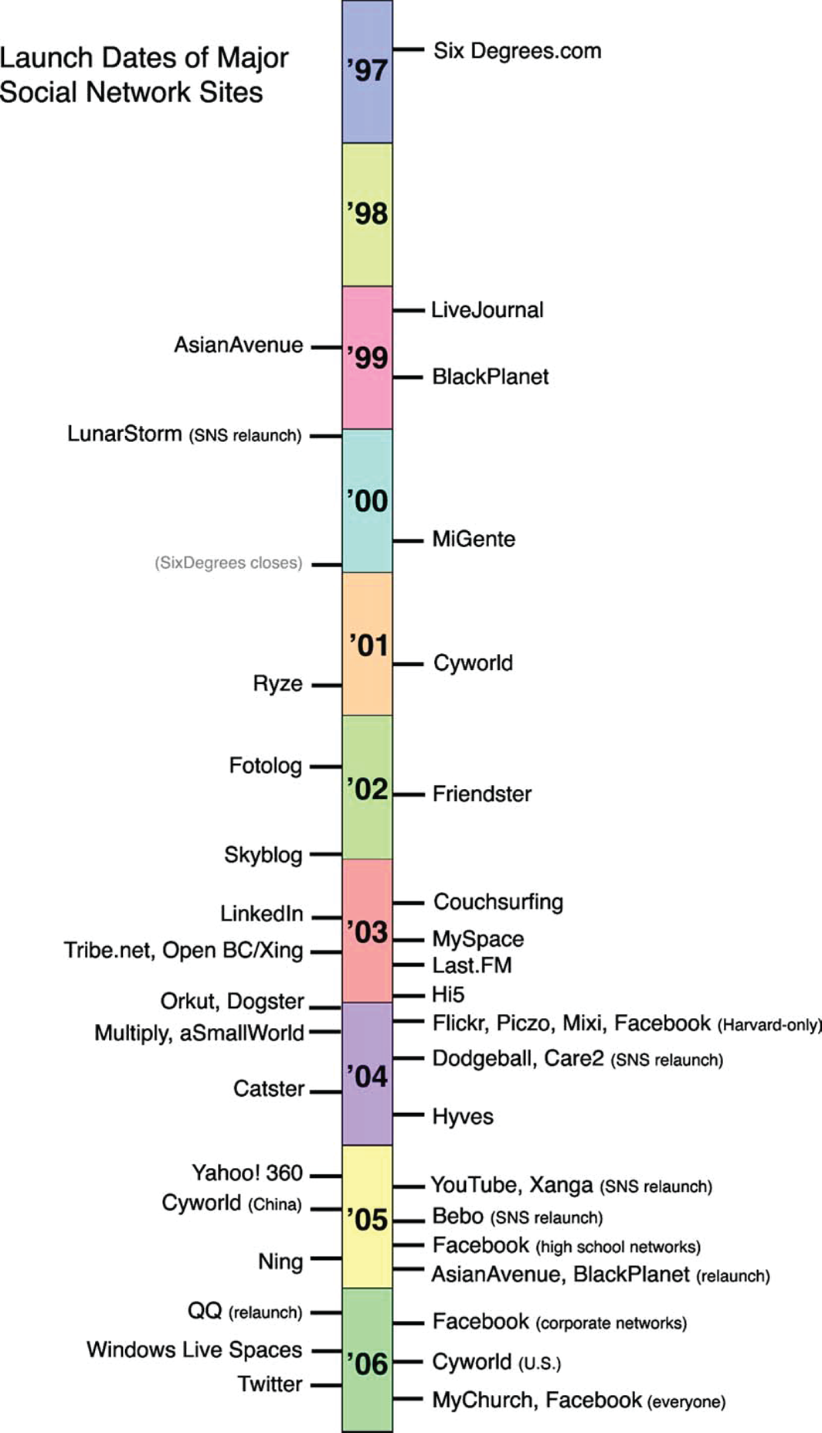
Brief History of Social Media
The real beginnings started with the old snail mail to send letters
Started in Britain with SixDegrees.com (which was a networking sites to see who you were connected to, nonmembers could accept their relationship, first to be able to create profiles and search for other members)
After, many different sites followed this but with specific members in mind
Next Ryze, which was taken over by Tribe.net but we now use LinkedIn (for business)
Next was the rise of meeting sites (Match.com and Friendster.com)
2003: The Social Media Boom! (Everything from interest-sites, traveling sites and religious affiliates, many have came and failed but others have survived)
MySpace was the first to be able to reach a large audience across the world
Boyd, D. M., & Ellison, N. B. (2007, December 17). Social Network Sites: Definition, History, and Scholarship. Retrieved March 22, 2017, from http://onlinelibrary.wiley.com/doi/10.1111/j.1083-6101.2007.00393.x/full

Slide 43
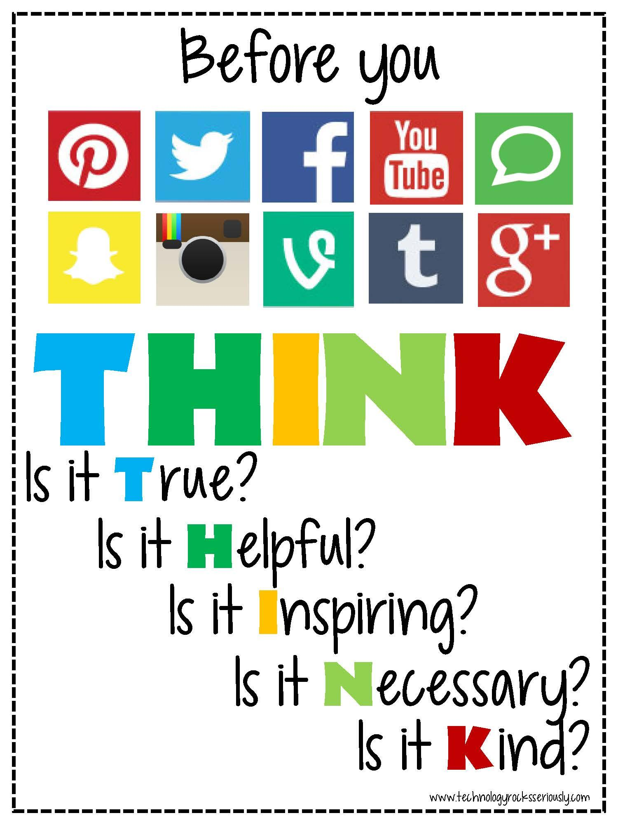
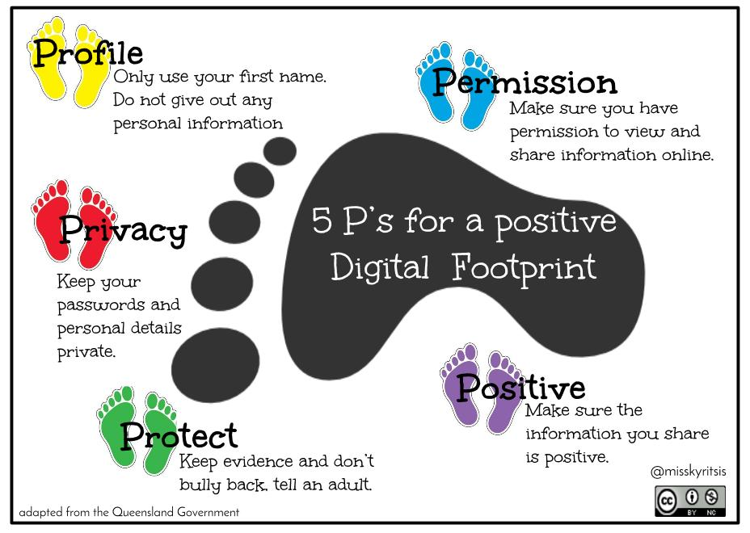
DANGER!
Before you decide to throw social media into your classroom, be sure to first talk to your students about the dangers of being online and the severity of cyberbullying. There is no one way to talk about it, but there are a lot of resources out there to help you with your own diverse classroom.

Slide 44
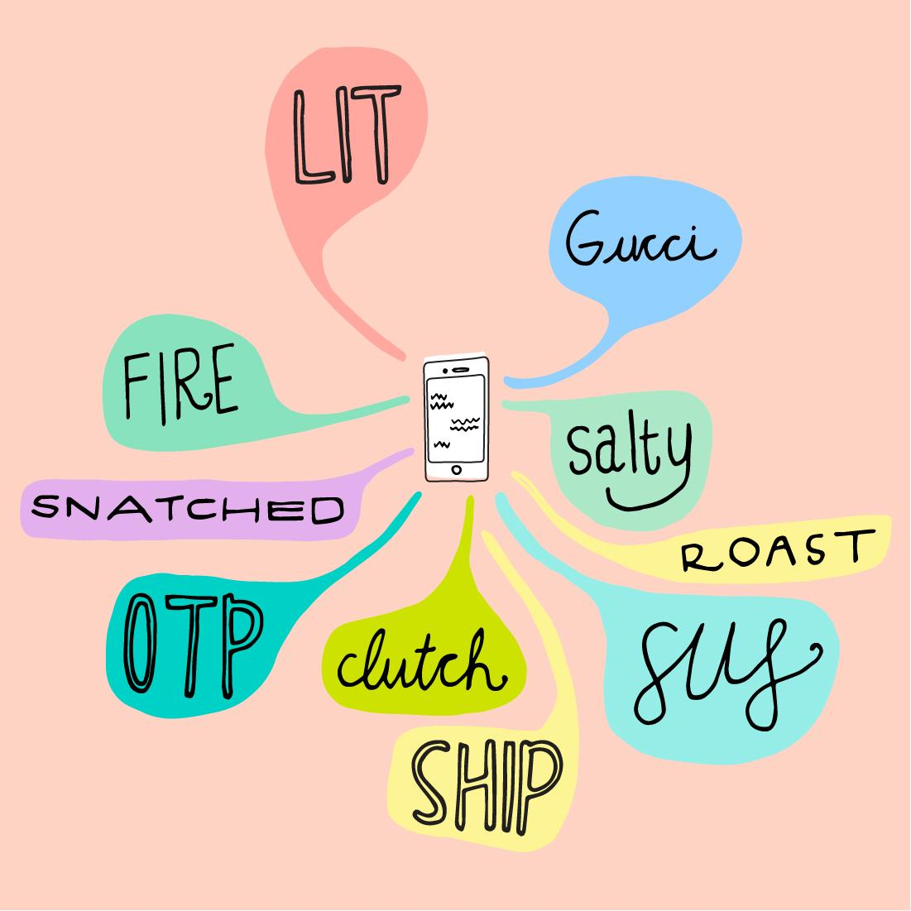
Social Media Language
Shorter character counts and shorter time to read, means users have to shorten their words to get their point across
“social media is an emotion-rich language… various sentiment related expressions, such as emoticons (“:d”, “X- 8”), interjections (“bwahaha”, “brrrr”), acronyms (“lol”, “lmao”), etc.,”
People spell words wrong both on purpose and not on purpose, but more and more words are added to the dictionary that social media users have created to get their point across faster
Lui, F., Weng, F., & Jiang, X. (2012). Proceedings of the 50th Annual Meeting of the Association for Computational Linguistics. A Broad-Coverage Normalization System for Social Media Language, 1035-1044. Retrieved March 22, 2017, from http://www.anthology.aclweb.org/P/P12/P12-1109.pdf

Slide 45
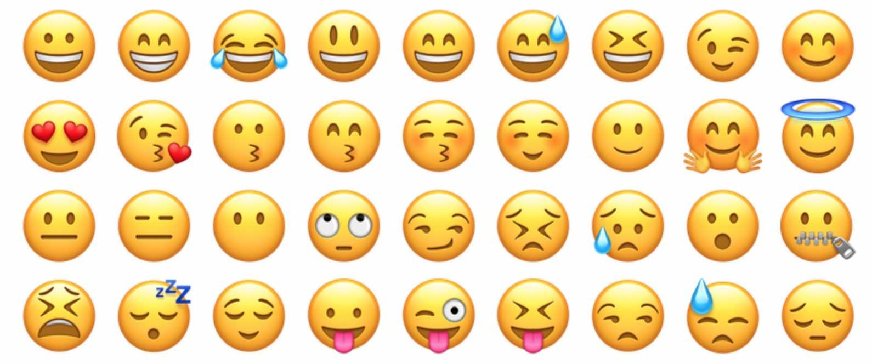
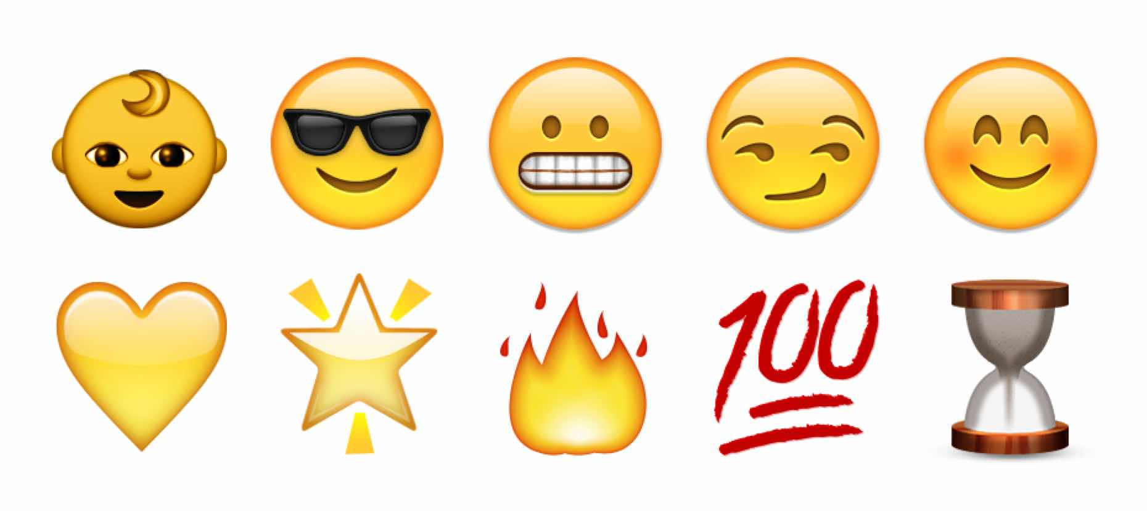
Emoji’s: What are they?
Japanese for emotion and picture! “any of various small images, symbols, or icons used in text fields in electronic communication (as in text messages, e-mail, and social media) to express the emotional attitude of the writer, convey information succinctly, communicate a message playfully without using words, etc.”
Emoji dictionary: https://emojidictionary.emojifoundation.com/
Emoji. (n.d.). Retrieved March 26, 2017, from https://www.merriam-webster.com/dictionary/emoji

Slide 46

SHOULD WE USE THEM IN THE CLASSROOM?

Slide 47
YYAAAASSSSSSSS QUEEN! (The pros of SML)
ELL: use of emoticons to connect would be easy for the learner
Easy way to connect to your students with something that they are most likely already using and know, increase participation
It is a great collaboration tool for students to connect to each other and their community, they can connect to professionals as well for help (homework or otherwise)
As a teacher, it is great for connecting to parents, students, community and colleagues
Create a blog to prepare them for the future (many workplaces use a blog now, getting hired because of a blog)
The Ontario Language Arts curriculum has a Media Literacy section, but it is outdated and does not talk about social media (LOL its got CD! #throwback!)
5 pros and cons of social media in the classroom for educational use. (2016, May 30). Retrieved March 21, 2017, from https://www.schooliseasy.com/2014/02/social-media-in-the-classroom/

Slide 48
Ughhhh SMH hundo P not down (the cons of SML)
Safety and Cyber Bullying is always a concern with students in an online platform
Inappropriateness can easily arise
If rules and standards are not set up, students can become distracted in the classroom or use it for personal use
Social Media Language is hard to understand for ELL students because most of it is based on what the word sounds like
Unfortunately, incorporating technology cost money and some schools don’t have it, or some students may not have access to social media and will not know the culture of it
5 pros and cons of social media in the classroom for educational use. (2016, May 30). Retrieved March 21, 2017, from https://www.schooliseasy.com/2014/02/social-media-in-the-classroom/

Slide 49
How to use them in the classroom?
In general:
Blogging or vlogging instead of journaling
Statuses, tweets or snaps instead of Exit/Entrance Slips
Create a Facebook Profile for a character or person they are studying
Use Skype to go on a class field trip without leaving the classroom!
Connect to parents!
Tweet to professionals to get more research!
Create polls easily!
Create stories through snapchat, twitter or Facebook
Help students understand the business world and how to create a resume on Linkedin
Writers, S. (2016, October 13). 100 Inspiring Ways to Use Social Media In the Classroom. Retrieved March 23, 2017, from http://www.onlineuniversities.com/blog/2010/05/100-inspiring-ways-to-use-social-media-in-the-classroom/

Slide 50

Geography and Mathematics
Learning Probability Through Twitter:
One teacher used Tweets as a hook for teaching probability to his grade 4/5 class. He tweeted out to the world,
“Explore with the children the language that they have used in the session. Ask: Is the same vocabulary used in other countries? Ask Twitter network to respond to: “What is the probability that it will snow where you are?” Explore the responses and discuss the reasons for any differences.”
In result they learned the geography, slang and culture of each responses’ country!
Barrett, T. (n.d.). Plan, Tweet, Teach, Tweet, Learn, Smile. Retrieved March 27, 2017, from http://tbarrett.edublogs.org/2008/03/07/plan-tweet-teach-tweet-learn-smile/

Slide 51
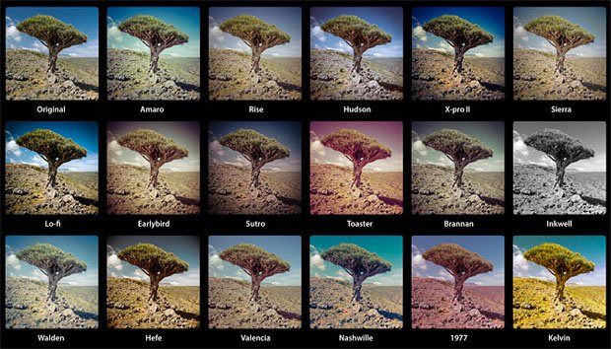

Art
Use Instagram and Snapchat to help teach about Photography. You can use the filters to teach about the elements and principles of art.
Ontario Ministry of Education. (2009). The Ontario Curriculum, Grades 1-8: The Arts. Retrieved March 25, 2017, from http://www.edu.gov.on.ca/eng/curriculum/elementary/arts18b09curr.pdf

Slide 52
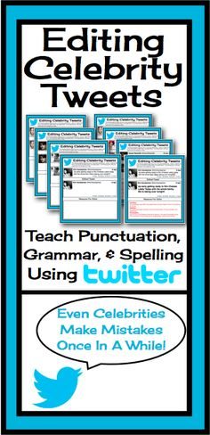
English
Use there :( eng by edtin it
  Collect various different celebrity tweets and have the students edit them to be correct english. You can teach them both proper editing techniques, grammar and spelling! It is also a great activity to teach them about social media language and why it isn’t proper english

Slide 53
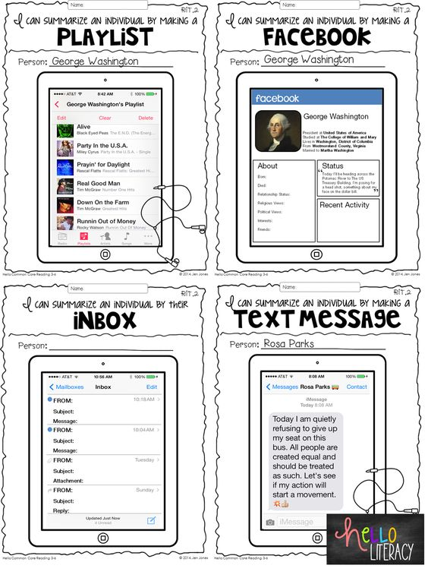
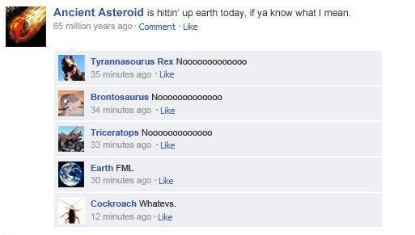
History!
Instead of biographies, create playlist and facebook accounts of historical people
Have your students create statuses of important historical events and have them ‘like’ and ‘comment’ on them by the historical people who were around

Slide 54
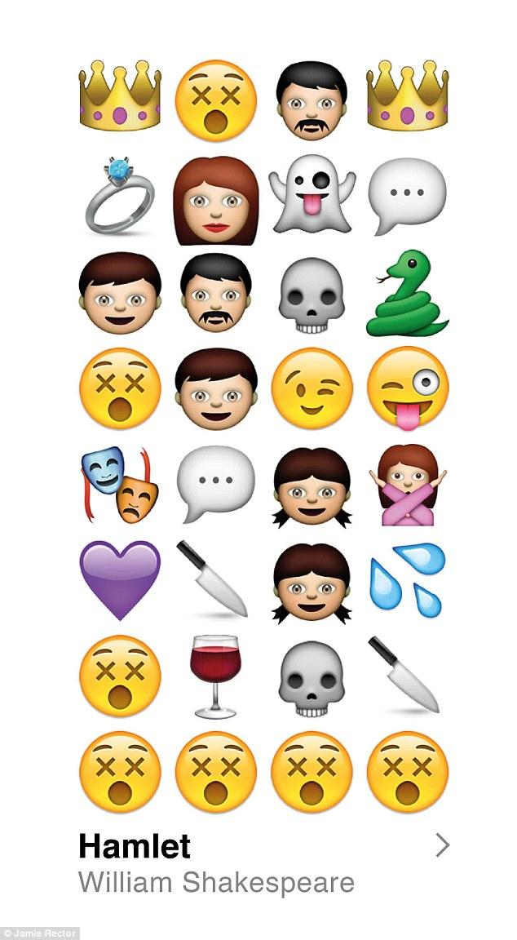
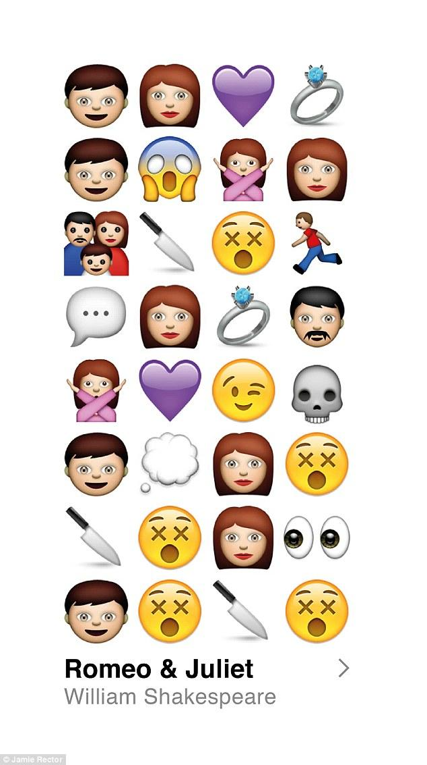
Emoji Activity
Using only 5 (or less) emoji’s give a summary of a well-known Fairy Tale.
You could use this for anything. Use the Emoji’ Summary to assess student’ comprehension and understanding in History (give a summary of the Seven Year War), Geography (create a story to describe the effects of global warming), Science (describe the effects of an experiment), Dramatic Arts (summarize a play), or could be used as an Exit Slip for the student to describe how the class went.

Slide 55
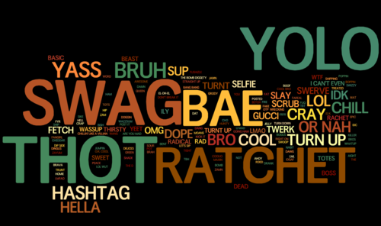
Kahoots!!
https://play.kahoot.it/#/?quizId=db192121-a636-48ef-8c97-4450ed0a08c8

Slide 56
References
5 pros and cons of social media in the classroom for educational use. (2016, May 30). Retrieved March 21, 2017, from https://www.schooliseasy.com/2014/02/social-media-in-the-classroom/
“African American English” (video). Uploaded on April 15, 2011. YouTube. Retrieved from: https://www.youtube.com/watch?v=aQrtB7cZDrA .
Aitchison, Jean (1996). The Seeds of Speech. Cambridge: Cambridge University Press.
Andresen, Julie Tetel (2014). Linguistics and Evolution: A Developmental Approach. New York: Cambridge University Press.
Barrett, T. (n.d.). Plan, Tweet, Teach, Tweet, Learn, Smile. Retrieved March 27, 2017, from http://tbarrett.edublogs.org/2008/03/07/plan-tweet-teach-tweet-learn-smile/
Beaken, Mike (2011). The Making of Language. 2nd Ed. Edinburgh: Dunedin Academic Press.
Bickerton, Derek (1998). “Catastrophic evolution: the case for a single step from protolanguage to full human language.” Approaches to the Evolution of Language: Social and Cognitive Bases. Ed. James R. Hurford et al. Cambridge: Cambridge University Press.

Slide 57
References
Boyd, D. M., & Ellison, N. B. (2007, December 17). Social Network Sites: Definition, History, and Scholarship. Retrieved March 22, 2017, from http://onlinelibrary.wiley.com/doi/10.1111/j.1083-6101.2007.00393.x/full
Cloud, Daniel (). The Domestication of Language: Cultural Evolution and the Uniqueness of the Human Animal. New York: Columbia University Press.
Dunbar, Robin (1998). “Theory of mind and the evolution of language.” Approaches to the Evolution of Language: Social and Cognitive Bases. Ed. James R. Hurford et al. Cambridge: Cambridge University Press.
“DYSA African American English (or Ebonics) in the classroom” (video clip from documentary, Do you Speak American?). Uploaded May 8, 2012. YouTube. Retrieved from: https://www.youtube.com/watch?v=xX1-FgkfWo8
Emoji. (n.d.). Retrieved March 26, 2017, from https://www.merriam-webster.com/dictionary/emoji
Hughes, B. (2016, April 01). How Social Media is Reshaping Today's Education System. Retrieved March 20, 2017, from https://www.entrepreneur.com/article/273044

Slide 58
References
J., Amari. (2010). The Fifth International Conference on Historical Lexicography and Lexicology. Retrieved March 20, 2017, from https://ora.ox.ac.uk/objects/uuid:fd2d4042-0f65-4037-bfd3-230c6193bc1d
J., Huang. (2013, December 27). English learners demand slang; teachers try to keep up. Retrieved March 25, 2017, from http://www.scpr.org/blogs/multiamerican/2013/11/04/15109/english-language-learners-demand-slang-teachers-tr/?slide=3
Kids online: The statistics. (n.d.). Retrieved March 20, 2017, from http://www.kidsmatter.edu.au/health-and-community/enewsletter/kids-online-statistics
Lui, F., Weng, F., & Jiang, X. (2012). Proceedings of the 50th Annual Meeting of the Association for Computational Linguistics. A Broad-Coverage Normalization System for Social Media Language, 1035-1044. Retrieved March 22, 2017, from http://www.anthology.aclweb.org/P/P12/P12-1109.pdf
Ontario Ministry of Education. (2007). The Ontario Curriculum, Grades 11 and 12: English. Retrieved March 25, 2017, from http://www.edu.gov.on.ca/eng/curriculum/secondary/english1112currb.pdf
Ontario Ministry of Education. (2009). The Ontario Curriculum, Grades 1-8: The Arts. Retrieved March 25, 2017, from http://www.edu.gov.on.ca/eng/curriculum/elementary/arts18b09curr.pdf

Slide 59
References
Rickford, John R (2012). “What is Ebonics (African American English)?” Linguistic Society of America. Retrieved from: http://www.linguisticsociety.org/content/what-ebonics-african-american-english
Rosabel, D. (2016, January 27). Digital in 2016. Retrieved March 23, 2017, from http://wearesocial.com/sg/special-reports/digital-2016
Rouse, M. (2016, September). What is Social Media? Retrieved March 20, 2017, from http://whatis.techtarget.com/definition/social-media
R., Lytle. (2011, June 13). How Slang Affects Students in the Classroom. Retrieved March 21, 2017, from https://www.usnews.com/education/high-schools/articles/2011/06/13/how-slang-affects-students-in-the-classroom
Writers, S. (2016, October 13). 100 Inspiring Ways to Use Social Media In the Classroom. Retrieved March 23, 2017, from http://www.onlineuniversities.com/blog/2010/05/100-inspiring-ways-to-use-social-media-in-the-classroom/

Slide 60
