Slide 1
Franco Canadian Identity?
SLL from an immigrant child’s perspective...

Slide 2
What is Canadian Identity?
Please, take out your mobile devices
or laptops and go to:
kahoot.it Canadian Identity Kahoot

Slide 3
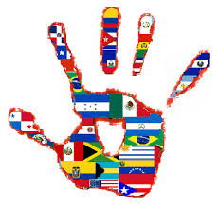
What is Culture?
The way that a given society defines, organizes and conducts itself, that distinguishes it from others. (James, 1995)
Cultural identity refers to a collective self-awareness that we as a people embody, which reflects the racial, ethnic and gender groups of its’ members (James, 1995).
A subculture is expressed by a “group of people within a larger socio-political structure who share cultural (and often linguistic or dialectal) characteristics which are distinctive enough to distinguish it from others within the same culture” (Hoopes and Pusch, 1981)

Slide 4
Aspects of cultural identity:
Individual: An individual’s identity is influenced by age, gender, ability, religion, ethnicity, sexual orientation and social status. These are not static but change throughout our lives as our awareness of both self and society increase, and we interact with one another.
Collective: James states that the group with the most economic and political power will determine the culture of the collective (James, 1995).
Bidimensional: two independent dimensions underlying people’s cultural identity; individuals may have independent identities with respect to their cultures of origin and to their societies of settlement ( Berry, 1997).

Slide 5
Consequences of immigration
The experience of acculturation by groups and individuals (Sam & Berry, 2006)
The emergence of culturally plural societies (Kymlicka, 1995)
In such societies, individuals and groups need to work out how to live together, adopting various strategies that will allow them to achieve a reasonably successful adaptation to living interculturally (Berry, Phinney, Sam & Vedder, 2006).

Slide 6
Official policy of multiculturalism: October 8th 1971
(T)here cannot be one cultural policy for Canadians of British and French origin, another for the original peoples, and yet another for all others. For although there are two official languages there is no official culture, nor does any ethnic group take precedence over any other … A policy of multiculturalism within a bilingual framework commends itself to the government as the most suitable means of assuring the cultural freedom of Canadians ... (cf Palmer 1975)
Multiculturalism Act (Bill C-93) passed in July 1988 emphasizes the promotion of positive race relations and cross-cultural understanding in a society where multiculturalism is a “fundamental characteristic of our evolving Canadian heritage and identity”.

Slide 7
Acculturation, and issues raised within bidimensional framework:
Acculturation is defined as a process which minority groups and immigrants go through in response to overt or systemic pressures from the dominant group to adopt, conform or adjust to dominant values, customs, behaviours and psychological characteristics
(Sodowsky, Lai & Plake, 1991: 195)
The degree to which people wish to maintain their heritage culture and identity.
The degree to which people seek involvement with the larger society.
(Berry,Phinney,Sam & Vedder, 2006)

Slide 8
Four types of acculturation and attitudes:
Assimilation: there is little interest in cultural maintenance combined with a preference for interacting with the larger society. (+ dominant / - minority)
Separation: when cultural maintenance is sought while avoiding involvement with others. (+ minority / - dominant)
Marginalisation: when neither cultural maintenance nor interaction with others is sought. ( - dominant / - minority)
Integration: when both cultural maintenance and involvement with the larger society are sought. (+ minority / + dominant)
(Rudmin 2003)

Slide 9
The unidimensional approach, where individuals must choose between the two poles of acculturation strategies and cultural identities, does not capture the complexity of how youth work out their new lives in their new societies
A two-dimensional approach is most appropriate for understanding these preferences. Identifying more with one’s ethnic group is not conceptually, nor empirically, opposed to identifying with one’s national society.
There is support for the two forms of adaptation: psychological well-being and sociocultural competence are conceptually and empirically distinct among immigrant youth, and they have different predictors.
The pattern of relationships between how youth acculturate and how well they adapt largely replicates the findings with adult immigrants. Those seeking to integrate adapt better than those who are marginalised, with assimilation and separation ways falling in between.
It is more difficult to adapt well when one’s ethnicity is being questioned.
(Berry & Sabatier 2010).

Slide 10
Statistics Canada: Language Minorities
Two dominant linguistic perspectives
Video: Portrait of Official-Language Minorities in Canada
Decline in student numbers in English school boards in Quebec.
Beyond the reasons presented in the video, could there be other reasons for this decline?
Is this an example of acculturation?

Slide 11
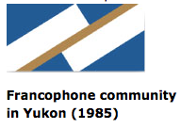
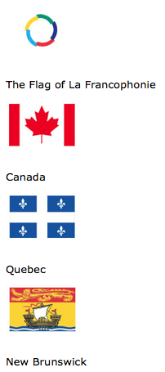
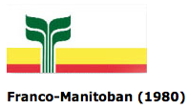
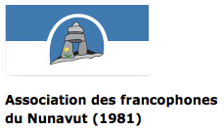
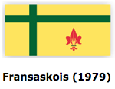
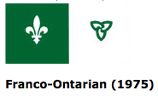
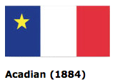
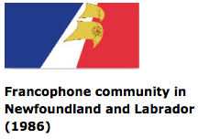
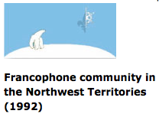
The majority of Francophones live in Quebec, but almost one million are found in Canada's other provinces and territories.

Slide 12
Overview of Francophone Perspective
Francophone Quebecers do not define their identity as one of many ethnic identities in Canada. They conceive of it as a national identity based on the French language, which is imbued with great symbolic value. This is why language carries such heavy emotional baggage and why there is widespread agreement among francophones that French should be promoted in institutions and in public space. But is language the only basis for the Quebec identity?
(Magosci 1999, p.326)
Video: Francophone Perspective (0:08-4:54)

Slide 13
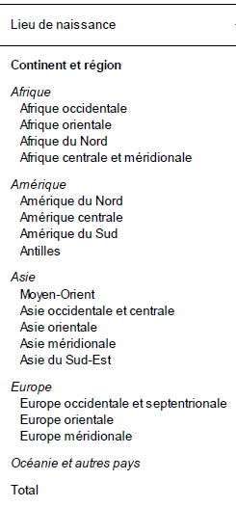
Statistics
Data from the Ministry of Immigration, Diversity and Inclusion in January 2015.
484 867 immigrants in Quebec between 2004 and 2013
In 2015, 75.5% are still in Quebec (366 226 people)
Many of them are located in the Montreal region (74.6%)
Source : Ministère de l'Immigration, de la Diversité et de l'Inclusion, Direction de la planification, de la recherche et des statistiques, Banque de données sur la présence.
Notes:
Ministère de l'immigration, Diversité et Inclusion Québec. (2015). Portraits régionaux 2004-2013 Caractéristiques des immigrants établis au Québec et dans les régions en 2015. Québec: Direction de la planification, de la recherche et des statistiques.
Ministère de l'immigration, Diversité et Inclusion Québec. (2015). Présence en 2015 des immigrants admis au Québec de 2004 à 2013. Québec: Direction de la recherche et des statistiques.

Slide 14
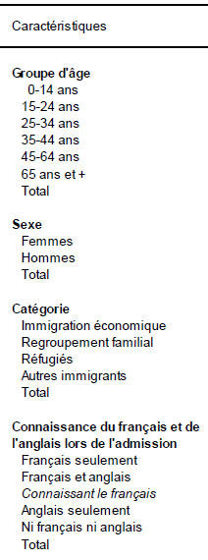
First Language
General Information
Age Group
Sexe
Social Category
Linguistic Knowledge

Slide 15
Retrieved from: http://www.immigration-quebec.gouv.qc.ca/en/living-quebec/common-values/french-language.html

Slide 16
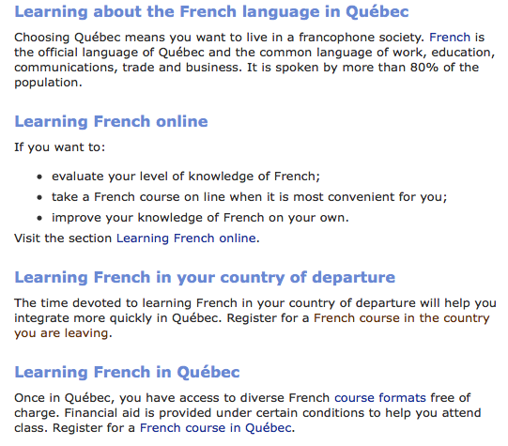
How is Québec helping immigrants learn the French Language?
Retrieved from: http://www.immigration-quebec.gouv.qc.ca/en/french-language/index.html

Slide 17
Linguistic school boards:
In 1997, the governments of Quebec and Canada, amended the constitution to eliminate all denominational rights and privileges within Quebec education. (Bill 109)
July 1998 Quebec’s 137 Roman Catholic and 18 Protestant school boards were replaced by 60 French language and 9 English language School boards.
Prior to 1960’s, religious ‘cleavage’ was the divisive factor in Quebec.
Language has now become the dominant divisive factor
Since 2000, the education system has been plagued with protest from Francophone parents, who challenge the Charter of French Language as removing the right for their children to attain full bilingualism.

Slide 18
Eligibility
A certificate of eligibility is generally issued to children :
who have received the major part of their elementary or secondary school instruction in English in Canada;
whose brother or sister did the major part of his or her elementary or secondary studies in English in Canada;
whose father or mother did the major part of his or her elementary studies in English in Canada;
whose father or mother attended school in Québec after August 26, 1977, and could have been declared eligible for instruction in English at that time
Under the Charter of the French language, children in the following three situations are eligible :
children who are residing in Québec permanently and who qualify for a certificate of eligibility for instruction in English
children who are residing in Québec permanently and who are entitled to receive instruction in English under a special authorization
children who are living in Québec temporarily and who qualify for a temporary authorization to receive instruction in English
Therefore, French Language Education is MANDATORY for all immigrants to the province of Quebec!
Notes:
http://www.education.gouv.qc.ca/en/parents-and-guardians/instruction-in-english/
http://www.education.gouv.qc.ca/en/parents-and-guardians/instruction-in-english/eligibility/

Slide 19
Quebec Language Education
French elementary schools:
100% French language from K-3
90% French language from 4-6 (ie. English for one hour per day 3 or 4 days per week) Therefore “core English”.
English elementary schools:
Bilingual = 50/50% English & French language from K-6
Immersion = 70/30% French & English from K-4 60/40% French & English from 4-6
Francais Plus = 92% French 8% English in K 82% French & 18% English in cycle 1 77% French & 22% English in cycle 2 45% French & 55% English in cycle 3

Slide 20
“Accueil” in French language school boards:
Intensive French language learning to prepare students to enter ‘mainstream’ classes.
Focuses solely on French
Isolated from all other subject areas and mainstream classes.
Originally intended to be a one-time, 10 month program.
Classes no more than 20 students, loosely grouped by age, prior education and linguistic proficiency.
Integration requires passing a Provincial French examination (14+).
“Accueil” classroom students at the kindergarten & grade one level transition to full integration for grade two.
Population needs determine the availability of “acceuil” classrooms within French Language elementary schools.
“Accueil” students from grade one to six receive resource support services (special needs) while attending regular classes.
“Accueil” students are often required to repeat the process in order to successfully meet requisite language needs.

Slide 21
Natural language learning?
“In natural language learning, the learner is surrounded by fluent speakers of the target language, but in the formal classroom, only the teacher (if anyone) is fluent. In natural learning, the context is the outside world, open and stimulating; in formal learning, it is the closed four walls of the classroom. In natural language learning, the language used is free and normal; in the formal classroom it is carefully controlled and simplified. Finally, in the natural learning situation, attention is on the meaning of the communication; in the formal situation, it is on meaningless drills” (Norton, 2013).
Therefore natural language learning occurs only in mainstream, inclusive schooling and society at large.

Slide 22
What does this mean for the child’s identity?
Acculturation is the process of cultural and psychological change that follows intercultural contact (Berry, 2003).
Cultural changes include alterations in a group’s customs, and in their economic and political life (Berry, Phinney, Sam & Vedder, 2006).
Psychological changes include alterations in individuals’ attitudes toward the acculturation process, their cultural identities (Phinney, 2003), and their social behaviors in relation to the groups in contact.
The eventual adaptations also have core psychological features, including a person’s well-being and social skills that are needed to function in their culturally complex daily world (Ward, Bochner, & Furnham, 2001).

Slide 23
Successful adaptation following migration?
Individuals should seek ways to follow the integrative path as much as possible.
Differing contexts:
In more public areas of life (such as in school, and in the general community), a form of integration that approaches assimilation may allow a better fit with the larger society and its institutions, especially when attitudes in the larger society are intolerant of the maintenance of heritage cultural practices in public.
In more private contexts, such as family and ethnocultural communities, a form of integration that approaches the separation orientation may allow for a better fit with co-ethnics in daily interactions.
Variable outcomes to acculturation, including both psychological and sociocultural adaptation.
These variations in the way of acculturating require some degree of flexibility and the ability to mix and match strategies. In our conceptualisation of integration, such blending and merging are possible ways of obtaining the best of both worlds, especially when there are two or more worlds to be enjoyed and mastered.
(Berry, Phinney, Sam & Vedder, 2006)

Slide 24
Impact?
Older students frequently view French as getting in the way of their social, academic and even linguistic integration (Allen, 2006)
More than 40% of younger immigrant students are multilingual.
Multilingual youth consider French to be the most important language within the local context, and English-French bilingualism as the most valuable capital to acquire (Lamarre & Dagenais 2004).
Identity is often complex, contradictory, ambiguous and dynamic (Lamarre & Dagenais 2004).
“Every time language learners speak, read or write the target language, they are not only exchanging information with members of the target language community, they are also organizing and reorganizing a sense of who they are and how they relate to the social world. As such, they are engaged in identity construction and negotiation” (Norton,2013).

Slide 25
Discussion Questions:
Integration is a process which works in two directions. It requires immigrant students to adapt and adhere to common values … but it also requires an openness to diversity in the social and scholastic milieu of the host society. (Ministère de l’Éducation du Québec, 1998, p. 2)
What does it mean to be ‘open to diversity’ and how much openness is required for this integration to be distinct from assimilation?
Are immigrant children classified as objects rather than subjects of integration?
Is Canadian identity determined by linguistics or is this an element of sub-culture?

Slide 26
Just to make things even more complicated….
Recognition of the specifically francophone nature of the host society in the North American context is a central element of the approach one must take in order to integrate immigrant students. Furthermore it is important, in an inclusive approach, to make evident the multiple contributions of all members of the Quebec society, regardless of their origin. (MEQ, 1998, p. 29)
According to Bill 118, which was adopted by the PQ government in 2000 after public school boards were deconfessionalized, activities sponsored by schools must be inclusive, pluralistic and educational. “They (schools) should not only introduce young people to the basic values of Quebec society and culture, but they should also make them aware of the richness of diversity.”

Slide 27
Draft Bill 60
“Charter affirming the values of State secularism and religious neutrality and of equality between women and men and providing a framework for accommodation requests”
The Association of Suburban Municipalities describes this bill as “succeeding at breeding division amongst Quebecers”, and “inherently contrary to our own values and the values of the communities we represent..”
EMSB states “If enacted, Bill 60 will force individuals to choose between government employment and a desire to wear religious apparel. (They) value the diversity of students and staff, and respect their personal and religious rights which are guaranteed both by the Canadian and Quebec Charters of Rights. EMSB cannot be party to proposed legislation which, if passed, runs contrary to what is taught with regard to respect for individual rights and religious freedoms”.
How do we rationalize this proposed legislation with Canadian identity as a multicultural society? What are future impacts for Quebec immigrant’s identity?

Slide 28
References:
Allen, D. (2006). Who's in and who's out? Language and the integration of new immigrant youth in Quebec. International Journal of Inclusive Education, 10(02-03), 251-263.
Berry, J. W., & Sabatier, C. (2010). Acculturation, discrimination, and adaptation among second generation immigrant youth in Montreal and Paris. _____International journal of intercultural relations, 34(3), 191-207.
Berry, J. W., Phinney, J. S., Sam, D. L., & Vedder, P. (2006). Immigrant youth: Acculturation, identity, and adaptation. Applied psychology, 55(3), _____303-332.
Berry, J.W. (2003). Conceptual approaches to acculturation. In K. Chun, P. Balls- Organista, & G. Marin (Eds.), Acculturation: Advances in theory, _____measurement and applied research (pp. 17–37). Washington, DC: APA Press.
Berry, J.W. (1997). Immigration, acculturation and adaptation. Applied Psychology: An International Review, 46, 5–68.
Bezeau, L. Moving From Denominational to Linguistic Education in Quebec David Young, Eastern Shores School Board.
Cook, S., (2007). Patriotism, Eh? The Canadian Version. In Pledging Allegiance (pp.145-151). New York: Teachers College Press.
Hoopes, D., & Pusch, M. (1981). Definition of terms. In M. Pusch (Ed.), Multicultural education: A cross-cultural training approach (pp. 2-8). Chicago: _____Intercultural Press.
James, C., (2007). Negotiating school: Marginalized students’ participation in their education process. In Enomoto, R. and Johnson G. (Eds.), Race, _____Racialization and Antiracism in Canada and Beyond (pp. 17- 36). Toronto: University of Toronto Press.
James, C., (1995). Ch.1: Culture: A social structure. In Seeing ourselves: Exploring race, ethnicity and culture (pp. 1-22). Toronto: Thompson _____Educational Publishing.
Kymlicka, W. (1995). Multicultural citizenship. Oxford: Oxford University Press.
Lamarre, P., & Dagenais, D. (2004). Language practices of trilingual youth in two Canadian cities. Trilingualism in family, school and community, _____53-74.
Magocsi, P. R. (1999). Encyclopedia of Canada's People (pp. 323-329), Toronto, University of Toronto Press.
Norton, B. (2013). Identity and language learning: Extending the conversation. Multilingual matters.
Phinney, J. (2003). Ethnic identity and acculturation. In K. Chun, P. Organista, & G. Marin (Eds.), Acculturation: Advances in theory, measurement, _____and applied research (pp. 63–81). Washington, DC: American Psychological Association.
Rudmin, F. W. (2003). Critical history of the acculturation psychology of assimilation, separation, integration, and marginalization. Review of general _____psychology, 7(1), 3.
Sam, D.L., & Berry, J.W. (Eds.) (2006). Cambridge handbook of acculturation psychology. Cambridge: Cambridge University Press.
Sodowsky, G. R., Lai, E. W. M., & Plake, B. S. (1991). Moderating effects of sociocultural variables on acculturation attitudes of Hispanics and Asian _____Americans. Journal of Counseling and Development: JCD, 70(1), 194.
Ward, C., Bochner, S., & Furnham, A. (2001) The psychology of culture shock. Hove: Routledge.

