Slide 1
Gender and Language
ESL
American Sign Language (ASL)
Verbal Bullying towards LGBTQ
Hip-Hop

Slide 2
Gender and ESL
“One of the many important facets of social identity…in framing students’ language learning experiences, trajectories and outcomes”
(Norton & Pavlenko, 2004, p. 504)
2 issues in ESL:
1) Representation in text books
2) Barriers female students face

Slide 3
Representation of Gender in Textbooks
Areas of gender bias (Sunderland, 2000)
Literacy practices
Language tests
Performance on test
Self esteem
Learning styles & strategies

Slide 4
ESL text books in 1970’s -1980’s
3 main biases:
exclusion
subordination and distortion
degradation
Linguistic analysis
verbs
dialogue

Slide 5
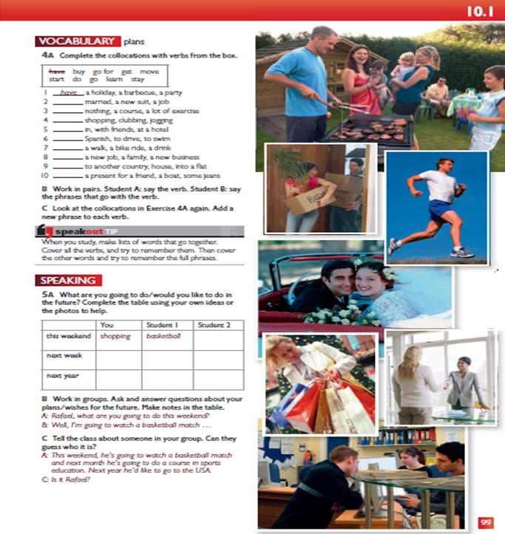
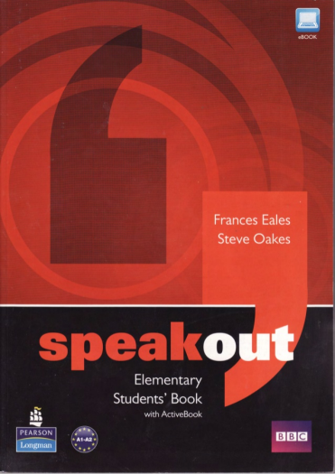
The 1990’s
Decline of content and linguistic analyses of gender in language text books
Speak Out Elementary, Unit 10

Slide 6
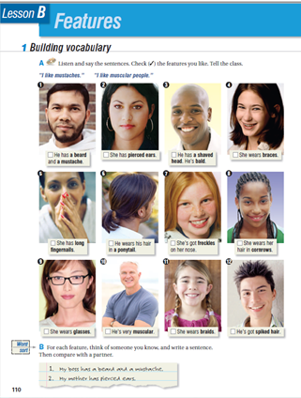
STRATEGIES
Teacher awareness
Treatment of text

Slide 7
Issues for Women in ESL studies
Access to the classroom
Domestic responsibilities
Transportation and safety
Employment priority
Silencing of Students
Inequality in curriculum/textbooks
Cultural background
Perception of students
Power relationship between teachers and students

Slide 8
How to Better Support Learners
provide explicit opportunities
understand cultural gender functions
become conscious of the signals sent by students
flexible curriculum

Slide 9
American Sign Language As A Language

Slide 10
American sign language is not universal

Slide 11
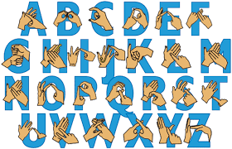
American Sign language vs. British sign Language

Slide 12
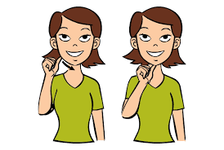
Gender Signs IN asl – Boy & girl

Slide 13
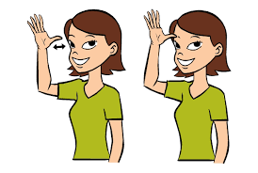
Asl – Mother & father

Slide 14
Asl - Thank you

Slide 16
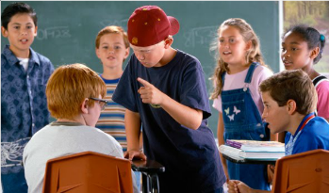
The definition of verbal bullying
The definition of verbal bullying is when an individual uses verbal language (e.g., insults, teasing, etc) to gain power over his or her peers.
Although students today are taught that hate speech—such as the use of religious, racial, or ethnic slurs—is intolerable, homophobic name-calling and anti-gay taunts, such as “fag” or “you're so gay,” are rampant in most schools and are often tolerated by adults.

Slide 17
LGBTQ
Among the findings of the 2009 Canadian Climate Survey on Homophobia:
59 per cent of LGBTQ high school students reported they were verbally harassed, compared to seven per cent of non-LGBTQ students.
25 per cent of LGBTQ students indicated being physically harassed due to their sexual orientation, compared to eight per cent of non-LGBTQ students.
31 per cent of LGBTQ students reported personal harassment on the internet or via text messaging, compared to eight per cent of non-LGBTQ students.
73 per cent of LGBTQ students reported they felt unsafe at school, compared to 20 per cent who did not.
51 per cent of LGBTQ students reported they did not feel accepted at school, compared to 19 per cent of non-LGBTQ students.

Slide 19
video
How the worst moments in our lives make us who we are | Andrew Solomon
https://www.youtube.com/watch?v=RiM5a-vaNkg&t=19s

Slide 20
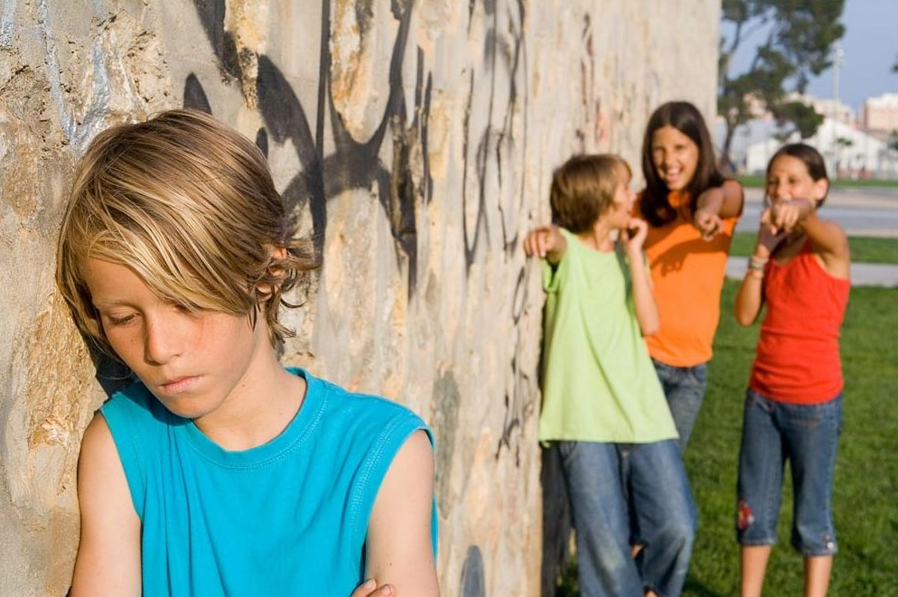
Reasons for Adolescent pejorative slang and the naming of others
social function
peer rivalry
group bonding

Slide 21
Research Q : “What words do people at school use for slagging someone off? Write down as many words as you can”.
the author identified the eight basic categories with a ninth category for those items falling into none of the first eight:
(1) Homophobic (e.g. queer, poof, ginger, lesbian);
(1) Homophobic (e.g. queer, poof, ginger, lesbian);
(2) Racist (e.g. nigger, Paki, Somalian);
(3) Top-5 (i.e. cunt, wanker, motherfucker, bastard, and all fuck derivatives);
(4) Sexist (e.g. slag, slut, whore, cow, bitch, slapper);
(5) Phallocentric (e.g. dickhead, prick, sheepshagger);
(6) Scatalogical (e.g. shit, arse-wipe, turd, scatty);
(7) Others—Social-Personality (e.g. loner, sad, pompous, stupid);
(8) Others—Physicality (e.g. fat, ugly, smelly);
(9) Uncategorized (e.g. jackass, dustbinman/woman, paedophile, and other unknown,
local items not found in the dictionaries).

Slide 23
Finding
In fact, the vast majority of all the homophobic items reported referred to male homosexuality; comparatively few (only 14%) specifically female homophobic pejoratives were reported, with “lesbian” being the most common of these. Interestingly, Sutton (1995) also reports no female homophobic items in her study of “ugly names” for women. This absence is possibly in keeping with the relative paucity of such terms more generally, and very likely related to broader issues of gendered inequality such as the even greater marginalization (or “silencing”) of lesbians (Dynes, 1990; Hughes, 1998).

Slide 24
Sex differences and gendered naming practices
Boys used more pejoratives than girls.
Girls are more tolerant.
Boys are more sensitive to homophobic slurs.

Slide 25
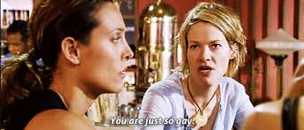
Attention
from “The L Word”

Slide 26
what should schools do?
“to combat homophobia, it will not be enough to
tell pupils that 'poof' is an unacceptable word”
Efforts to improve the school environment. Good schools make deliberate attempts to shape school culture in positive directions and to foster health-enhancing behaviors, healthy relationships, and social responsibility in their students, usually with the approaches focused on sexual minority adolescents.
The most widely known approach to making schools safer and more supportive for LGBTQ students has been the establishment of school-based support groups

Slide 27
Discussion
1.Have you ever been a victim of verbal bullying or known someone who has been bullied?
2. As an educator, what would you do when the victims are from the sexual minority group? what is the appropriate way to address this issue due to the diverse backgroup of students (like religion)?
3.When some students refer other students as gay due to their dress code or a lack of interest in sport, is it necessary for teachers to intervene?

Slide 28
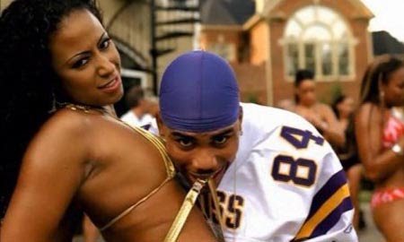
Hip hop & gender

Slide 29
Focus questions
1. Are you a fan of hip-hop or rap? What do you like about it? Who are some of your favorite artists? Why do you like these particular artists?
2. What do you know about the origins of rap music-when and where it started, its historical influences, the political and social conditions that accompanied its emergence?
3. Is there anything about rap music or videos that bothers you? Why or why not?
4. Do the lyrics of popular music matter? Do they play any role in influencing how people think about the world? What about the images in music videos?

Slide 30
Bitch

Slide 31
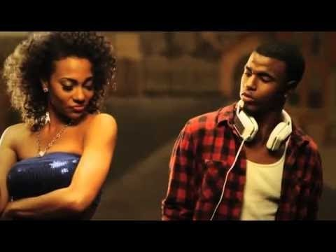
Lupe Fiasco – Bitch bad
https://youtu.be/C3m3t_PxiUI

Slide 32
Bad Bitch?
A bad bitch is a strong, sexualized, self-reliant and materialistic woman. In hip hop culture, the term bitch may "signify a hardcore woman who makes money and proudly flaunts her sexual libido and sexuality" and a woman who can hold her own with rap's gangsta thugs

Slide 33
VOCABULARY
Gender
The socially constructed roles, behaviors, activities, and attributes that a given society considers appropriate for men and women.
Misogyny
Hatred of or hostility toward women – words or images that encourage, condone, or glorify the objectification, exploitation, or victimization of women.

Slide 34
Research
Derogatory naming and shaming of women (50%)
Sexual objectification (67%)
Distrust of women (47%)
Legitimation of violence (18%)
Celebration of prostitution/pimping (20%)
Female rappers

Slide 35
REFERENCES
Dowling KB, Rodger S, Cumming AL: Exploring Attitudes of Future Educators About Sexual Minority Youth. Alberta J Educ Res. 2007, 53 (4): 401-413.
Eales, F. & Oakes, S. (2012). Speakout Elementary Students' Book. Harlow, Pearson Longman.
Johnson, M. & Chang, D. (2012). Balancing Act: Addressing Culture and Gender in ESL Classrooms. Journal of Adult Education, 41(1), 19-26. Retrieved from http://files.eric.ed.gov/fulltext/EJ991459.pdf
Kleinman, S., Ezzell, M., & Frost, C. (2009). Reclaiming critical analysis: The social harms of “bitch”. Sociological Analysis 3(1)
Liddell, S. K. (2003). Grammar, gesture, and meaning in American Sign Language. Cambridge University Press.
McCarthy, M., McCarten, J. & Sandiford, H. (2014). Touchstone Level 2 Student's Book. New York, NY: Cambridge University Press.
Norton, B. & Pavlenko, A. (2004). Addressing Gender in the ESL/EFL Classroom. TESOL Quarterly, 38(3), 504-14. Retrieved from http://onlinelibrary.wiley.com.proxy.bib.uottawa.ca/doi/10.2307/3588351/epdf
Sunderland, J. (2000). New Understandings of Gender and Language Classroom Research: Texts, Teacher Talk and Student Talk. Language Teaching Research, 4(2), 149–173. Retrieved from http://journals1.scholarsportal.info.proxy.bib.uottawa.ca/details/13621688/v04i0002/149_nuogaltttast.xml
Thurlow. C.(2011). Naming the ‘‘outsider within’’: homophobic pejoratives and the verbal abuse of lesbian, gay and bisexual high-school pupils Journal of Adolescence 2001, 24, 25–38 doi:10.1006/jado.2000.0371,
Weiler, E. M. (2003). Making school safe for sexual minority students. Principal Leadership, 10, 10–13.
Weitzer, R., & Kubrin, C. (2009). Misogyny in rap music. Men and Masculinities, 12(1), 3-29. doi:10.1177/1097184X08327696

