Slide 1
Heterosexism and Homosexuality in the Primary Classroom
by Angela, Jessica, Julie and Ruth

Slide 2
Current Sex Education in Ontario
Created in 1998 and has not been updated since
Students may be removed from class the day the material is covered
New Curriculum developed after more than a year of consultations
Revised curriculum available January 2010, expected implementation Fall 2010
Grade 3: gender identity and sexual orientation

Slide 3
The Controversy
April 2010
Religious and conservative groups
Evangelist Charles McVety & the Ontario Christian coalition
“I can’t imagine a child now has to question their gender, question their identity. I think there’s enough confusion among our children in the world, for them now having to question themselves. This is where I would draw the line.”
Muslim community reaction
Protest: May 10th, 2010

Slide 4
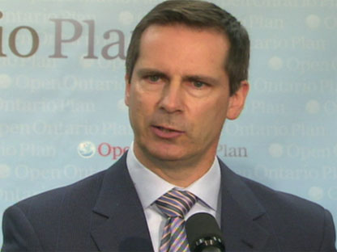
Dalton’s Defence
“We can provide (this information) in a format and in a venue where we can have some control or they can get it on their own and be informed by potentially uninformed sources like their friends at school or the Internet.”

Slide 5
“Rethinking” the Curriculum
April 22, 2010: Ontario Government declares new curriculum will be pulled
McGinty: “It’s obvious from listening to parents over the past two days that the curriculum needs a ‘serious rethink’. There’s no need to rush into setting up a new sex-ed curriculum. We’ll take our time to get it right.”

Slide 6
Reaction to the “rethink”…
“McGinty has his government turned their backs on research, evidence, common sense and the critical educational needs of Ontario’s kids when they decided to ‘rethink’ the new curriculum. They allowed ideology to bully knowledge and genuine, realistic caring for children who have never been more in need of the kind of education the new health and physical education curriculum offers on so many critical fronts.” – John Corlett, Toronto Star, April 27th 2010
http://www.youtube.com/watch?v=otL-FKaLRjY

Slide 7
Why discuss sexuality in
the Elementary school?
– Article 1
Teachers help children learn to share public space
Sexuality is already present in students’ lives
Easily integrated into curriculum → HPE, Language Arts, Social Studies
Gender identity and sexuality are inescapable
Respect and tolerance of diversity

Slide 8
It’s Elementary
http://www.youtube.com/watch?v=EzrznSpf8V4
http://www.youtube.com/watch?v=-uMU9BCVO5w

Slide 9
Why don’t teachers talk about homosexuality? ~ Article 2
Assume children cannot deal with the topic
Scared of complaints from parents and community
Personally uncomfortable with gay and lesbian discussions

Slide 10
Why should we teach homosexuality?
Name calling exists
Cultural message tells students that hate speech directed toward lesbians and gays is allowed
Oppression against homosexuality is related to and other oppressions

Slide 11
How might children respond?
Children felt that they were old enough to learn the truth
Children identified with the isolation which might be felt if one’s parents were homosexuals
Children demonstrated that gay and lesbian issues can be integrated in several places in the curriculum

Slide 12
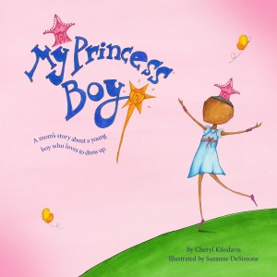
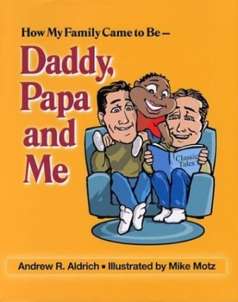
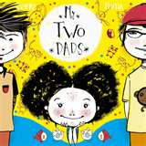
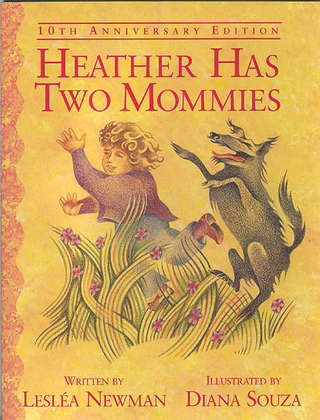
Teaching Resource: Books

Slide 13
In the Classroom…
Read Alouds
Independent Reading
Discussions
Reader’s Theatre

Slide 14
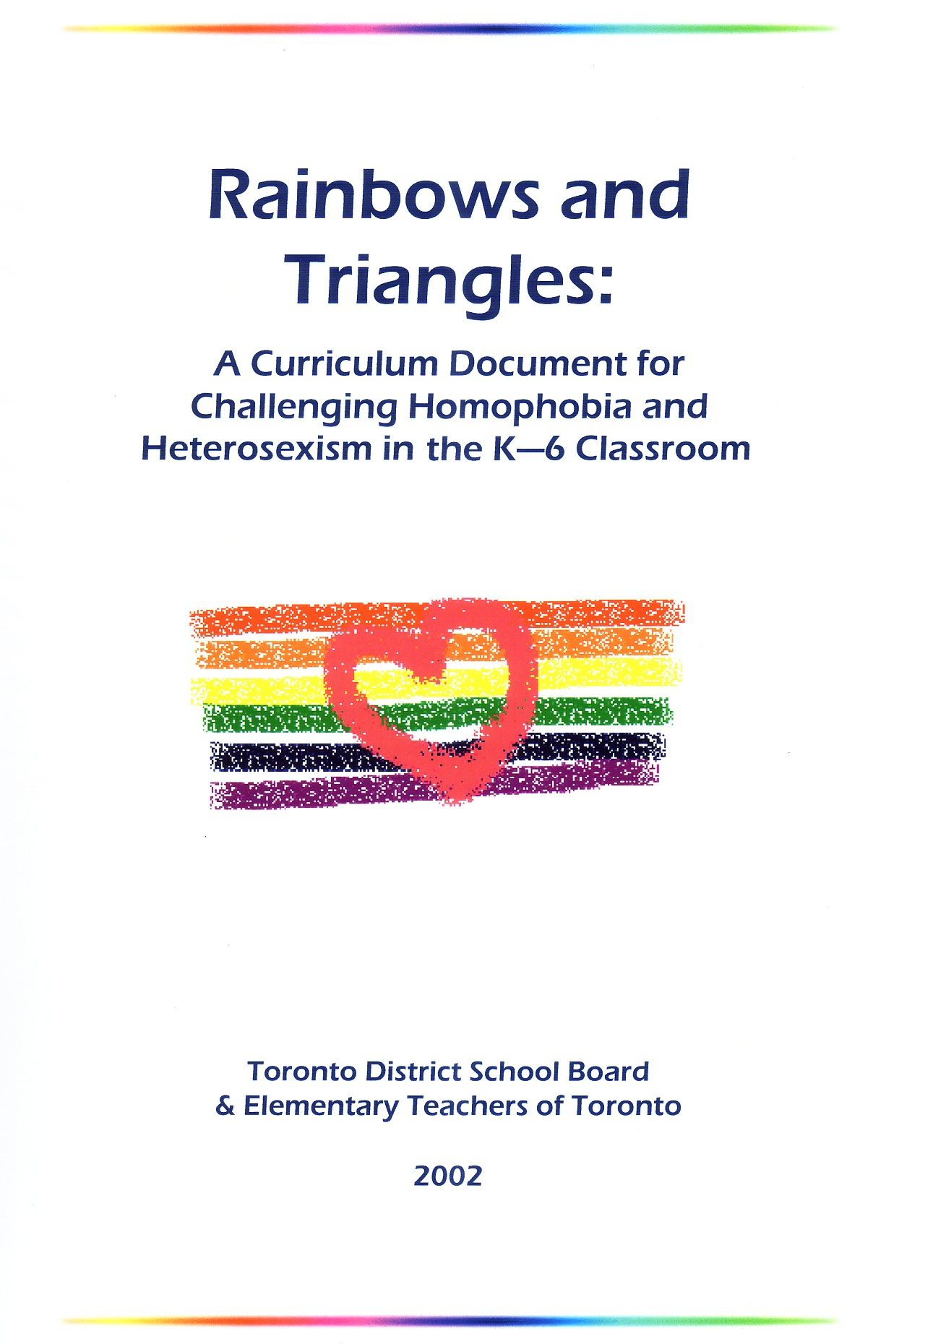
Teaching Resource: Specialized Curriculum Documents
Definitions
FAQ
How to link it to Ontario curriculum
Lessons divided by theme and grade

Slide 15
A style of theatre in which participants sit/stand together and read through a script, using expressive voices to tell a story.
Can be used in the classroom to introduce and teach children about same sex families, homosexuality, etc.

Slide 16
http://www.youtube.com/watch?v=Tupjs3-Lr2k

Slide 17
References
Bickmore, K. (1999) Why Discuss Sexuality in the Elementary School? Teaching Queerly: Affirming Diversity in Elementary Schools. 1-15.
Schall, J. and Kauffman, G. (2003) Exploring literature with gay and lesbian characters in the elementary school. Journal of Children’s Literature. 29(1)
Swartz, P. C. (2003) Bridging Multicultural Education: Bringing sexual orientation into children’s and young adult’s literature classroom. Radical Teacher. 66

