Slide 1
Linguicism and Language Discrimination
EDU 5244
By: Ikram H., Brittany T., Dania T., Emma W. & Noor E.

Slide 2
Outline
What is Linguicism?
Lingua Franca & ESL Hiring Bias
Living with an accent
Bidialectalism
CRT, Literacy & Voice
Discussion Activity & Concluding Thoughts

Slide 3
Proper diction is a sign of intelligence.

Slide 4
What is Linguicism?
Linguicism:
Linguicism (Skutnabb-Kangas, 2000) or Linguistic Discrimination is discrimination based on language or dialect. (Nordquist, 2016)
It is based upon the ideologies involved in legitimizing, effectuating, regulating, and reproducing the unequal divide of power and resources (both material and nonmaterial) between groups defined on the basis of language. (Skutnabb-Kangas, 1995)

Slide 5
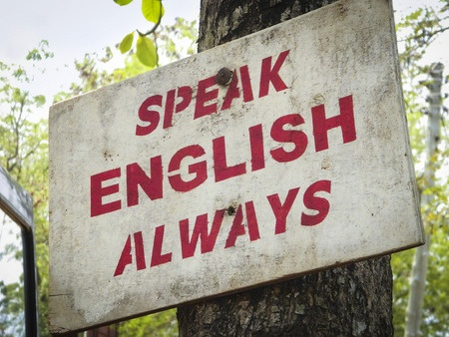
Types of Linguicism
Overt Linguicism:
Is the open, conscious, visible and active representation of linguicism.
Covert Linguicism:
Is the hidden, unconscious, invisible and passive representation of linguicism.
Systemic/Institutional Linguicism:
Linguicism existing as a result of the emphasized efforts geared towards the learning of the majority language. (Skutnabb-Kangas, 2000)
Notes:
Open: agent does not try to hide it
conscious: agent is aware of it
visible: is easy for non agents to detect
actively action oriented as opposed to merely attitudinal
Covert racism is more apparent in countries that have developed more sophisticated forms of racism (culture and language based racism vs biological)
Many children living in societies with institutional and cultural linguicism are not allowed to positively identify with their original cultures and mother tongues. Especially in countries where racism is subtle and not openly expressed, these children often internalize whatever negative views the majority has on their particular minority group and voluntarily attempt to shift their identity and align their culture and language with that of the majority.

Slide 6
English is the most important language in the world.

Slide 7
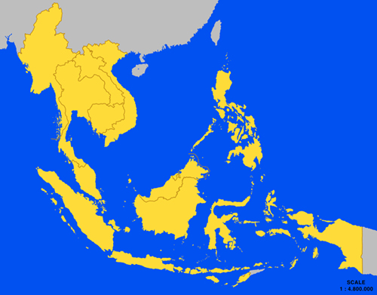
Lingua Franca
Communication Language
Association of South East Asian Nations (ASEAN)
ASEAN "Sample" Scholarship Quiz
(“Association of South East Asian Nations”, 2016; House, 2003; Seidlhofer, 2005)

Slide 8
Hiring the Ideal ESL Teacher
Discrimination on:
Race
“ESL teachers of color often get constructed as nonnative speakers of English lacking credibility as legitimate instructors while white teachers are positioned as native speakers and normal instructors without an accent” (Kubota, 2004, 47)
Accent
“It is known that some accents sound more attractive than others” (Karakas, 2012)
Native Speakers vs. Non Native Speakers
Accent Reduction/Elimination
(Balushi, 2012; Cicerchia, 2015; Kiczkowiak, 2014)

Slide 9
Accent itself is an undesirable characteristic.

Slide 10
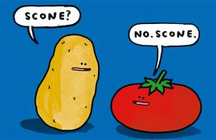
Living with an Accent
Discrimination based on:
language & power imbalances
Accent is a result of difference in phonetic system - but linked to linguicism in daily lives of non-native English speakers.
Standard English is a way of talking without a foreign accent
The struggle of living with an accent
“Accent.. I wish I could take it off. Because of my accent I am blocking myself. For example, I know I can (speak with a person), but eventually I prefer not to speak.” (Kayaalp, 2014)
Gawker’s ugliest accents
Sexiest accents

Slide 11
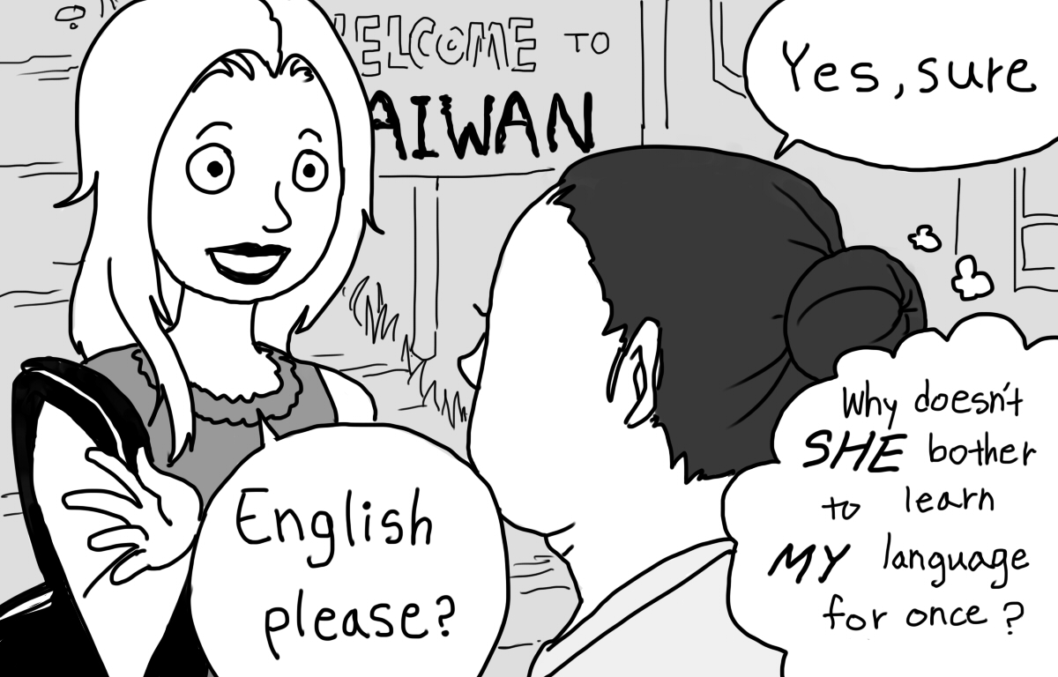
What can educators do?
Educators must…
Be informed
Convey positive attitudes
Speak to community
Raise questions
What do you know about accents?
How do you feel when you hear a different accent?
How are they portrayed in media?
Both the speaker and the listener have a responsibility for the act of communication.

Slide 12
Standard English should be the only dialect of English taught in schools.

Slide 13
What is Bidialectalism?
Bidialectalism: Being “fluent” in two dialects of a language (a dialect is form of a language that is unique to a specific region or social group). Diglossia: The use of two varieties of a language in different social situations Code-Switching: The use of two varieties of a language within a conversation African American English (AAE): A dialect of English that reflects the expressive oral culture of African American peoples and originates in the mixing of languages during the slave trade. Spoken by 80% of African Americans (Mordaunt, 2012). AAE is not broken English or slang (Boutte & Johnson, 2013)
Notes:
AAE is “ a rule-governed language system with distinct patterns and complexities”. It is “ not ‘‘broken English’’ or slang” (Boutte & Johnson, 2013)
Bidialectalism: Being “fluent” in two dialects of a language Diglossic: The use of two different varieties of a language in different social situations (formal or “high” variety at work and informal or “low” at home or with friends)- Arabic, Greek etc. African American English (also known as Black English, Ebonics etc.) is considered closer to English than any creole language, and therefore is defined as a dialect of English
Pidgin: “A very simplified and basic language that arises when people who speak different languages come into contact” (for example a blend of an African language and one of the slave trade languages- English, Spanish, Dutch, Portuguese)
Creole: A mix of different languages. For example Louisina Creole is a mix of French, Native American and African languages). “A pidgin becomes a creole when it develops into the first language of a language community” (Mordaunt, 2012) Canadian spelling a mix of British and American spelling

Slide 14
Characteristics of AAE
- Reduction or simplification of consonant clusters (phonology) “dis” vs. “this” “lass” vs. “last”
- Changing/dropping of verbs (syntax) “He alright” vs. “he is alright” “He be sick” vs. “He is sick” - Absence of third person singular ‘s’ and/or possessive ‘s’ (syntax) “My momma name is Annie” vs. “My momma’s name is Annie.” “The school seem nice” vs. “The school seems nice” (Mordaunt, 2012).
Notes:
These phonological and syntactical differences are in addition to the many slang/vocabulary that are distinct to AAE “Regarding the size of the AAE-speaking population, the vernacular is spoken throughout the USA mono- or bidialectally by at least 80% of continental African Americans, as well as by a number of Southern whites and urban Hispanics” (Mordaunt, 2012, p. 78)

Slide 15
Supporting AAE Speaking Students

Slide 16
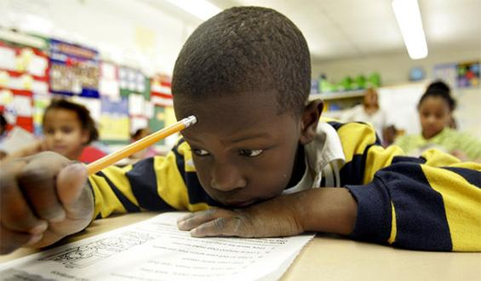
Implications for AAE-Speaking Students
African American students are more likely than their peers to be placed in special education classes and drop out of highschool (Mordaunt, 2012).
Almost half of African American 17-year-olds are functionally illiterate (Mordaunt, 2012).
Ann Arbour School Board lawsuit 1979
An Oakland California school board received backlash from the black Community for teaching with AAE
Notes:
In 1979 there was a lawsuit again the Ann Arbour School Board by the parents of 11 black elementary students. “The parents charged that their children’s AAE dialect was a language barrier that limited their children’s educational opportunity, violating the Equal Educational Opportunities Act of 1974. Many of the children had, in fact, been placed in ‘learning disabled’ classes, suspended, or otherwise routed on some lower track.” –They won the suit. (Mordaunt, 2012).
Conversely, a school board in Oakland California voted to use AAE in the classroom and many African American leaders (such as Jesse Jackson) thought it was “teaching down” to African American children, and that they should learn Standard English in schools.

Slide 17
What can we do as Educators?
“Schools need to maintain AAE-speaking students’ self-worth by respecting that dialect’s use in informal situations and assignments (e.g. brainstorming, discussion with peers, personal letters, oral history projects, or two-way journaling), while at the same time encouraging the transition, or switching, to SAE for formal work.” (Mordaunt, 2012, p. 84) - We can also use AAE to help students understand SE (for example in literature)
“The key clearly, is to begin with an attitude of respect and appreciation for the students’ home dialect, even while we help them master another code” (Mordaunt, 2012, p. 84).
Notes:
“Schools need to make every effort – especially at the early elementary levels where children’s language learning capacity is at peak readiness – to avoid condemning AAE, their students’ home dialect, and thus avoid magnifying the double consciousness and negative reaction of blacks living in white America” (Mordaunt, 2012, p. 83)
(Boutte & Johnson, 2013) reccomend Teach children to code-switch; and use a variety of contrastive analysis activities between SE and AAE. - Teachers can lead children in discussions, role-plays, storytelling, and other activities to help them differentiate between formal and informal clothing, speech, and behavior.

Slide 18
Language learning should be standardized & should not account for individual modes of expression.

Slide 19
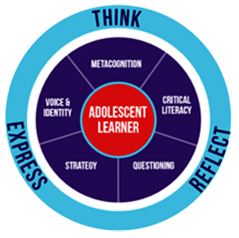
CRT, Literacy & Voice
Issue: Academic Standard English vs. Multimodal Forms → penalized or assimilated based on language (e.g accent, diction) → A right to your voice in literacy? (identity, culture, class, etc.) * “How much must a variety deviate from the “standard” before it is labelled nonstandard?”
“Language persuades us to forget the ways in which we are inside and outside privilege simultaneously, the ways in which we are sited in more than one place, see from more than one perspective.” (Fleckenstein, 2003)
CRT: Interaction between race & language → lingual modes can highlight interrelationship to develop empathy & be “a form of individuality” → The Primitive Language Myth
“The teacher could record people with different accents and dialects from the radio or television or from real life, and discuss with pupils why some speakers sound ‘posh’ or ‘educated’ or ‘working class’, and why such judgments may be very misleading.” (Delpit & Dowdy, 2002, p.81)

Slide 20
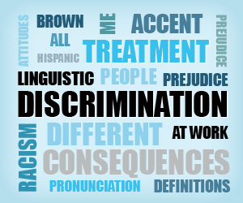
Poetry & Literacy
Get Lit: Using poetry to increase literacy in over 100 schools (http://getlit.org/) → "Somewhere in America"
One approach to linguicism in high school → Poetry allows for variant dialects & forms of vernacular → Use of narrative: Storytelling & counter-storytelling (experiences & struggles) → Guided experience: critical & conscious discourse (not art for the sake of art)

Slide 21
Activity!

Slide 22
Questions or Comments?

Slide 23
References
Balushi, Z. A. (2012). Am I an ideal teacher? Humanising Language Teaching, 3. Retrieved
from www.hltmag.co.uk/jun12/mart03.htm
Boutte, G. S., & Johnson, G. L. (2013). Do educators see and donor biliteracy and
bidialectalism in African American language speakers? Apprehensions and reflections of two grandparents/professional educators. Early Childhood Education Journal, 41(2), 133–141. Retrieved from http://search.proquest.com/docview/1347457166?accountid=14701
Cicerchia, M. (2015, October 9). American vs British English. Lingua.ly. Retrieved from
https://lingua.ly/blog/american-vs-british-english/
Creese, G., & Kambere, E. N. (2003). “What colour is your english?”. Canadian Review of
Sociology, 40(5), 565-573. doi:10.1111/j.1755-618X.2003.tb00005.x
Delpit, L., & Dowdy, J. K. (Eds.). (2002). The Skin That We Speak: Thoughts on Language and
Culture in the Classroom. New York, NY: The New York Press.
Fleckenstein, K. S. (2003). Embodied Literacies: Imageword and a Poetics of Teaching.
Carbondale, IL: Southern Illinois University Press.

Slide 24
Get Lit. (2016). Retrieved from http://getlit.org/
House, J. (2003). English as a lingua franca: A threat to multilingualism? Journal of
Sociolinguistics, 7(4), 556-578. Retrieved from http://uk-online.uni-koeln.de/remarks/d5134/rm2169656.pdf
Ingram, P. D. (2009). Are accents one of the last acceptable areas for discrimination? Journal of
Extension, 47(1). Retrieved from https//joe.org/joe/2009february/comm1.php
Karakas, A. (2012). Foreign accent problem of non-native teachers of english. Humanising
Language Teaching, 5. Retrieved from www.hltmag.co.uk/oct12/mart06.htm
Kiczkowiak, M. (2014, July18). Native english-speaking teachers: always the right choice?
Retrieved from www.britishcouncil.org/voices-magazine/native-english-speaking-teachers-always-right-choice
Kubota, R. (2004). Critical multiculturalism and second language education. In B. Norton & K.
Toohey (Eds), Critical pedagogies and language learning (pp. 30-52). Cambridge: Cambridge University Press.
Mordaunt, O. G. (2011). Bidialectalism in the classroom: The case of African-American
english. Language, Culture and Curriculum, 24(1), 77–87. Retrieved from http://search.proquest.com/docview/864939437?accountid=14701
Munro, M. J. (2003). A primer on accent discrimination in the Canadian context. TESL Canada
Journal, 20(2), 38-51. Retrieved from www.teslcanadajournal.ca/index.php/tesl/article/download/947/766

Slide 25
Murillo, L. A., & Smith, P. H. (2011). “I will never forget that”: lasting effects of language
discrimination on language-minority children in Colombia and on the U.S.-Mexico border. Childhood Education, 87(3), 147-153. Retrieved from http://go.galegroup.com.proxy.bib.uottawa.ca/ps/i.do?&id=GALE|A250133767&v=2.1&u=otta77973&it=r&p=AONE&sw=w&authCount=1#
Nordquist, R. (2016, June 11). What Is Linguicism (or Linguistic Discrimination)? Retrieved
from http://grammar.about.com/od/il/g/linguicismterm.htm
Perez, S.A. (1999). Using ebonics or black English as a bridge to teaching standard english.
Race, Class, and Culture, 2(7). Retrieved from http://www.ascd.org/publications/classroom-leadership/apr1999/Using-Ebonics-or-Black-English-as-a-Bridge-to-Teaching-Standard-English.aspx
Queen Latifah (screen name). (2014, November 4). Changing the world, one word at a time! The
Queen Latifah Show [video file]. Retrieved from https://www.youtube.com/watch?v=YshUDa10JYY&t=1s
Seidlhofer, B. (2005). English as a lingua franca. ELT Journal, 59(4), 339-341. doi: 10.1093/elt.cci064
Skutnabb-Kangas, T. (1995). Multilingualism and the Education of Minority Children. In O.
García & C. Baker (Eds.), Policy and Practice in Bilingual Education: A Reader Extending the Foundations (pp. 40-62). Clevedon, England: Multilingual Matters.

Slide 26
Skutnabb-Kangas, T. (2000). Linguistic Genocide in Education. London: Erlbaum.
Teachers with Foreign Accents Need Not Apply! (2011, May 5). International Schools Review. Retrieved from
https://internationalschoolsreviewdiscuss.wordpress.com/2011/05/05/teachers-with-foreign-accents-need-not-apply/
Their Learning Tree (screen name). (2016, May 18). Honey Baby Sugar Child. Retrieved from
https://www.youtube.com/watch?v=wzzEg0-wvPg
Up Next (screen name). (2015, October 30). Don’t judge my African American english [video].
Retrieved from https://www.youtube.com/watch?v=j7_rihFMB78
Wolfram, W. (2000). Everyone has an accent. Teaching Tolerance, 18. Retrieved from
http://www.tolerance.org/magazine/number-18-fall-2000/feature/everyone-has-accent

Slide 27
Photo References
http://asean.org/asean/asean-member-states/
http://i.huffpost.com/gen/1384621/images/o-BLACK-CHILDREN-facebook.jpghttp://plpnetwork.com/wp-content/uploads/2016/03/Conversation-Bubbles-2.jpg
http://www.educationnews.org/wp-content/uploads/2015/06/black_bias.jpg
http://www.edugains.ca/newsite/literacy/adolescent/visionofliteracy.html
http://www.languageonthemove.com/linguistic-discrimination-at-work/
http://www.nytimes.com/2015/01/04/upshot/the-measuring-sticks-of-racial-bias-.html?_r=0
https://employmentdiscrimination.foxrothschild.com/2015/11/articles/general-employment-discrimination/national-origin-discrimination/can-an-employer-limit-the-use-of-a-foreign-language-in-the-workplace/
https://lucylaituenchausheen.wordpress.com/category/accent/
https://www.panmacmillan.com/PanMacmillanCorporateSite/media/PanMacmillan/Blogs/spudsmcduff.jpg?ext=.jpg

