Slide 1
SAT Math Scores
Video

Slide 2
Closing the Gap
Notes:
A recent report in Science by Janet S. Hyde and colleagues, ‘Gender Similarities Characterize Math Performance,’ used a mass of standardized testing data generated under the No Child Left Behind program to compare male and female performance and found the gap in average performance on math tests has shrunk significantly since the 1970s, disappearing in most states and grades. (2008)

Slide 3
Myths or Reality
“Real” women don’t do math
You are too pretty to be a math major

Slide 4
Myths or Reality
2. Women are qualitative - Men are quantitative

Slide 5
Myths or Reality
3. There is a biological basis for sex differences in math
There is a sex-linked math gene

Slide 6
Myths or Reality
4. Girls learn better from female teachers
Notes:
‘Teachers who are anxious about their own math abilities are translating some of that to their kids’ - says University of Chicago psychologist Sian Beilock
Women make up 90 percent of elementary school teachers in the United States and what they believe about their own ability can have serious consequences on their female students. Educating female teachers to develop positive math attitudes is essential in helping raise the math abilities of girls.

Slide 7
Female teachers’ math anxiety affects girls’ math achievement
Beilock et al., 2009

Slide 8
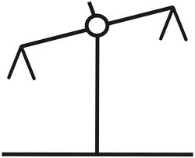
Measures
Math
Achievement
& Stereotypes
Math
Achievement
& Stereotypes
Notes:
Study measured math anxiety and ability of Grade 1 and 2 teachers. Students’ math achievement was measured at the beginning and end of the year. The degree to which students adhered to the traditional gender stereotype (boys are better at math, girls are better at reading) was also measured. At the beginning of the year, there was no relationship between teachers’ math anxiety and students’ math achievement or bender ability beliefs.

Slide 9
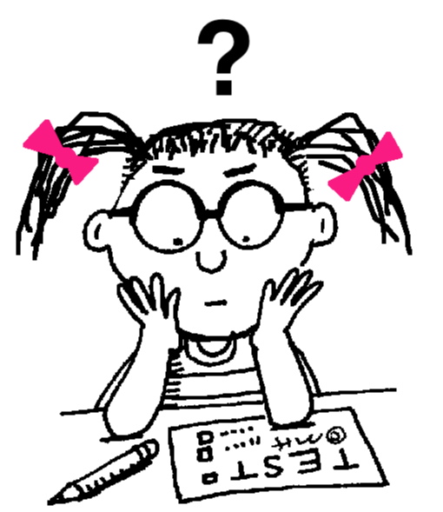
At the end of the school year
Boys are better at math
Boys are better at math
Notes:
By the end of the year, the higher the teacher’s math anxiety, the more likely girls were to believe the stereotype that boys are good at math and girls are good at reading.
The more girls believed the stereotype, the lower their math achievement.

Slide 10
Implications & Conclusions
Training, education reduces math anxiety
Increase math requirements for Primary/Junior teaching degree
Develop strong math skills and positive math attitudes in educators
Notes:
“Math anxiety can be reduced through math training and education. This suggests that the minimal mathematics requirements for obtaining an elementary education degree at most US university need to be rethought. If the next generation of teachers-especially elementary school teachers- is going to teach their students effectively, more care needs to be taken to develop both strong math skills and positive math attitudes in these educators.”

Slide 11
Stereotype Threat
I don’t think math is for me.
I’m really better at languages than math.
I’ve got natural math ability!
I think I’m going to succeed in math.
Notes:
Stereotype threat occurs when people feel that they are at risk of confirming a negative stereotype about their group.
It causes people to underperform when they feel that their performance is going to be affected, or seen to be affected, by a negative stereotype. In the case of math, it can cause students to do poorly on tasks that they feel are going to be difficult for their group.
There are many stereotypes around the math performance of minoritized groups. Chinese kids are good at math. Boys are good at math. Girls are bad at math. Black students are bad at math. Students bring these stereotypes with them into the classroom and there’s nothing we as teachers can do about that. But are there things we can do to avoid perpetuating these stereotypes? Are there ways that we can avoid activating stereotype threat?
There have been a lot of studies done on stereotype threat for different groups. In one math-related study (Stereotype Threat Among Schoolgirls in Quasi-Ordinary Classroom Circumstances, 2007) students in a classroom were given a test that involved memorizing and copying a geometric figure. Girls did worse than boys when they were told that the test measured geometric ability. However when students were told that the test measured drawing ability, the girls actually did better than the boys. You can imagine the way that this could affect girls’ attitudes about a geometry class – or boys’ performance in art class for that matter. Interestingly, the researchers were also able to reduce the performance gap by first separating students into same-gender groupings. They were quick to point out, however, that while this did reduce the stereotype threat felt by the students in this particular instance, it would likely lead to more stereotyping in the long run if used on a permanent basis. They suggest other methods of minimizing stereotype threat, such as teaching students about stereotype threat and providing positive role models of minoritized groups.

Slide 12
Two Mathematicians?
Notes:
One possible reason that has been cited for girls’ underrepresentation in higher math and science is the lack of female role models in these fields. Girls may have a stereotyped vision of what a ‘math person’ looks like, and it’s not something that they aspire to. In these two images, who do you think looks more like a mathematician?
The person on the left is Danica McKellar, who some of you may remember as Winnie on the 1990s TV Show “The Wonder Years”. McKellar has tapped into the market of parents who are hungry for their daughters to succeed in math by publishing three best-selling books.

Slide 13
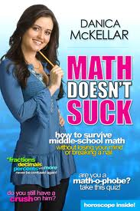
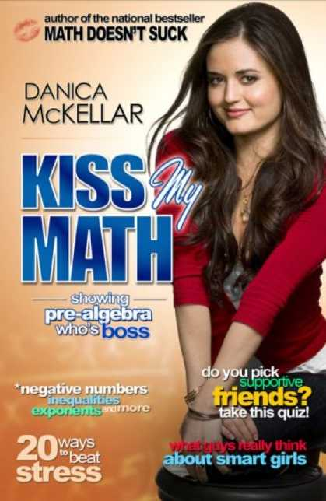
Notes:
These books are aimed directly at young girls and try to make math more appealing through their graphical appeal – see how much they look like the cover of a teen magazine? – and by focusing on applications that relate to the lives of teen and preteen girls. They also feature short biographies (and photos!) of beautiful women who use math in their careers.

Slide 14
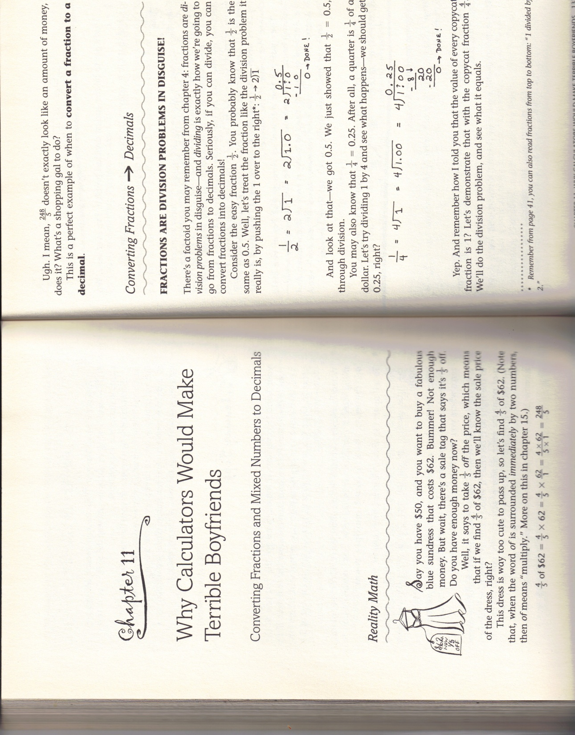
Notes:
Here’s an example of a typical page from one of the books. You can see that math is being contextualized in terms of boyfriends and shopping. Other applications found in the books include calculating how much face cream is required for a five week long trip, figuring out how many text messages your boyfriend sends you on an average day, and comparing absolute value bars to a spa for numbers – they end up feeling so positive!
While the hundreds of thousands of copies sold are a testament to the popularity of this idea, it’s not without it’s controversy. You might ask yourself, is this effective? Does it really help convince young girls that math is something they can succeed at? And at what cost? Are we dumbing down math? Does it insinuate to girls that society has lower expectations of them – that they can’t handle math unless it had been specially adapted?
I think there is a risk here of actually increasing girls’ feelings of math inferiority when these books represent a lone voice of so-called ‘girliness’ in a math curriculum that is otherwise de-contextualized and not relevant to girls’ lives. It seems that being given these books might actually increase a girl’s awareness of her presupposed math inferiority and thus activate the phenomenon of stereotype threat. The idea of “Math for Girls” just feels a little bit too much like “Math for dummies”.
However, if these books signal a shift towards the appearance of more female mathematical role models and the inclusion of more girl-friendly explanations and applications in math class, then I think that will work towards increasing equity in the math classroom. For those of you who find yourselves teaching math at any level, this kind of book could be an interesting resource that could help you integrate a more diverse range of applications in your classroom.
As for ‘dumbing down’ math with these books, McKellar herself has an interesting quote on the topic.

Slide 15
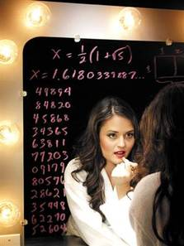
To all those who'd say or argue are you dumbing down math for girls?' I'd say, 'only if you think there's something inherently dumb about being girly.'
Notes:
Indeed it seems that it reveals quite a lot about our views of what is important in society that many of us think of a math problem involving face cream is somehow less worthy than one involving transmission fluid. For anybody who is interested in seeing more on what these books are about, we have a couple of copies that people could look at during break or after class.

Slide 16
Teach students that academic abilities are expandable and improvable.
Notes:
Teach students that working hard to learn new
knowledge leads to improved performance.

Slide 17
Provide prescriptive, informational feedback
Notes:
Provide students with feedback that focuses on strategies used during learning, as opposed to
simply telling them whether they got an answer correct. This strategy encourages students to correct
misunderstandings and learn from their mistakes. Provide students with positive feedback about
the effort they expended on solving a difficult problem or completing other work related to their
performance.
Avoid using general praise, such as “good job,” when providing feedback to individual students or
an entire class.

Slide 18
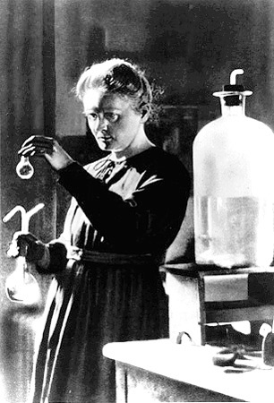
Expose girls and young women to female role models who have succeeded in math and science
Notes:
Invite older girls and women who have succeeded in math- or science-related courses and professions
to be guest speakers or tutors in your class. Assign biographical readings about women
scientists, mathematicians, and engineers, as part of students’ assignments.
Call attention to current events highlighting the achievements of women in math or science.
When talking about potential careers, make students aware of the numbers of women who
receive advanced degrees in math- and sciencerelated disciplines.
Provide girls and young women with information about mentoring programs designed to support
students who are interested in mathematics and science.
Encourage parents to take an active role in providing opportunities for girls to be exposed to women
working in the fields of math and science.

Slide 19
Create a classroom environment that sparks initial curiosity and fosters long-term interest in math and science.
Notes:
Embed mathematics word problems and science activities in contexts that are interesting to both
boys and girls.
Provide students with access to rich, engaging relevant informational and narrative texts as they
participate in classroom science investigations.
Capitalize on novelty to spark initial interest. That is, use project-based learning, group work, innovative
tasks, and technology to stir interest in a topic.
Encourage middle and high school students to examine their beliefs about which careers are
typically female-oriented and which are typically male-oriented. Encourage these students to learn
more about careers that are interesting to them but that they believe employ more members of the
opposite gender.

