Slide 1
Multicultural Day: oral presentations
By: Vanessa Papai, Kayla Howard and Michelle Roussy
Notes:
Michelle ROussy

Slide 2
Warm-Up Game
Headbands(ESL game)
Everyone is assigned a Disney character, where they stick the image on their forehead
They walk around the class asking a variety of questions to others, and answering questions from classmates
With the use of their second language, they will guess their character and sit back in their desks

Slide 3
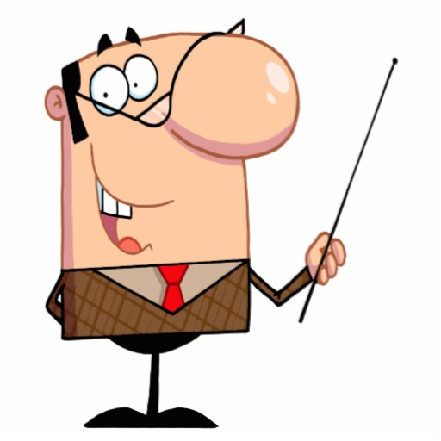
Purpose of This Activity
Allows students to walk around freely and use their second language comfortably;
It’s a fun environment where students are also able to enjoyably educate themselves;
Helps with their confidence in speech;
Does not have to deal with the pressure of standing in front of a crowd.

Slide 4
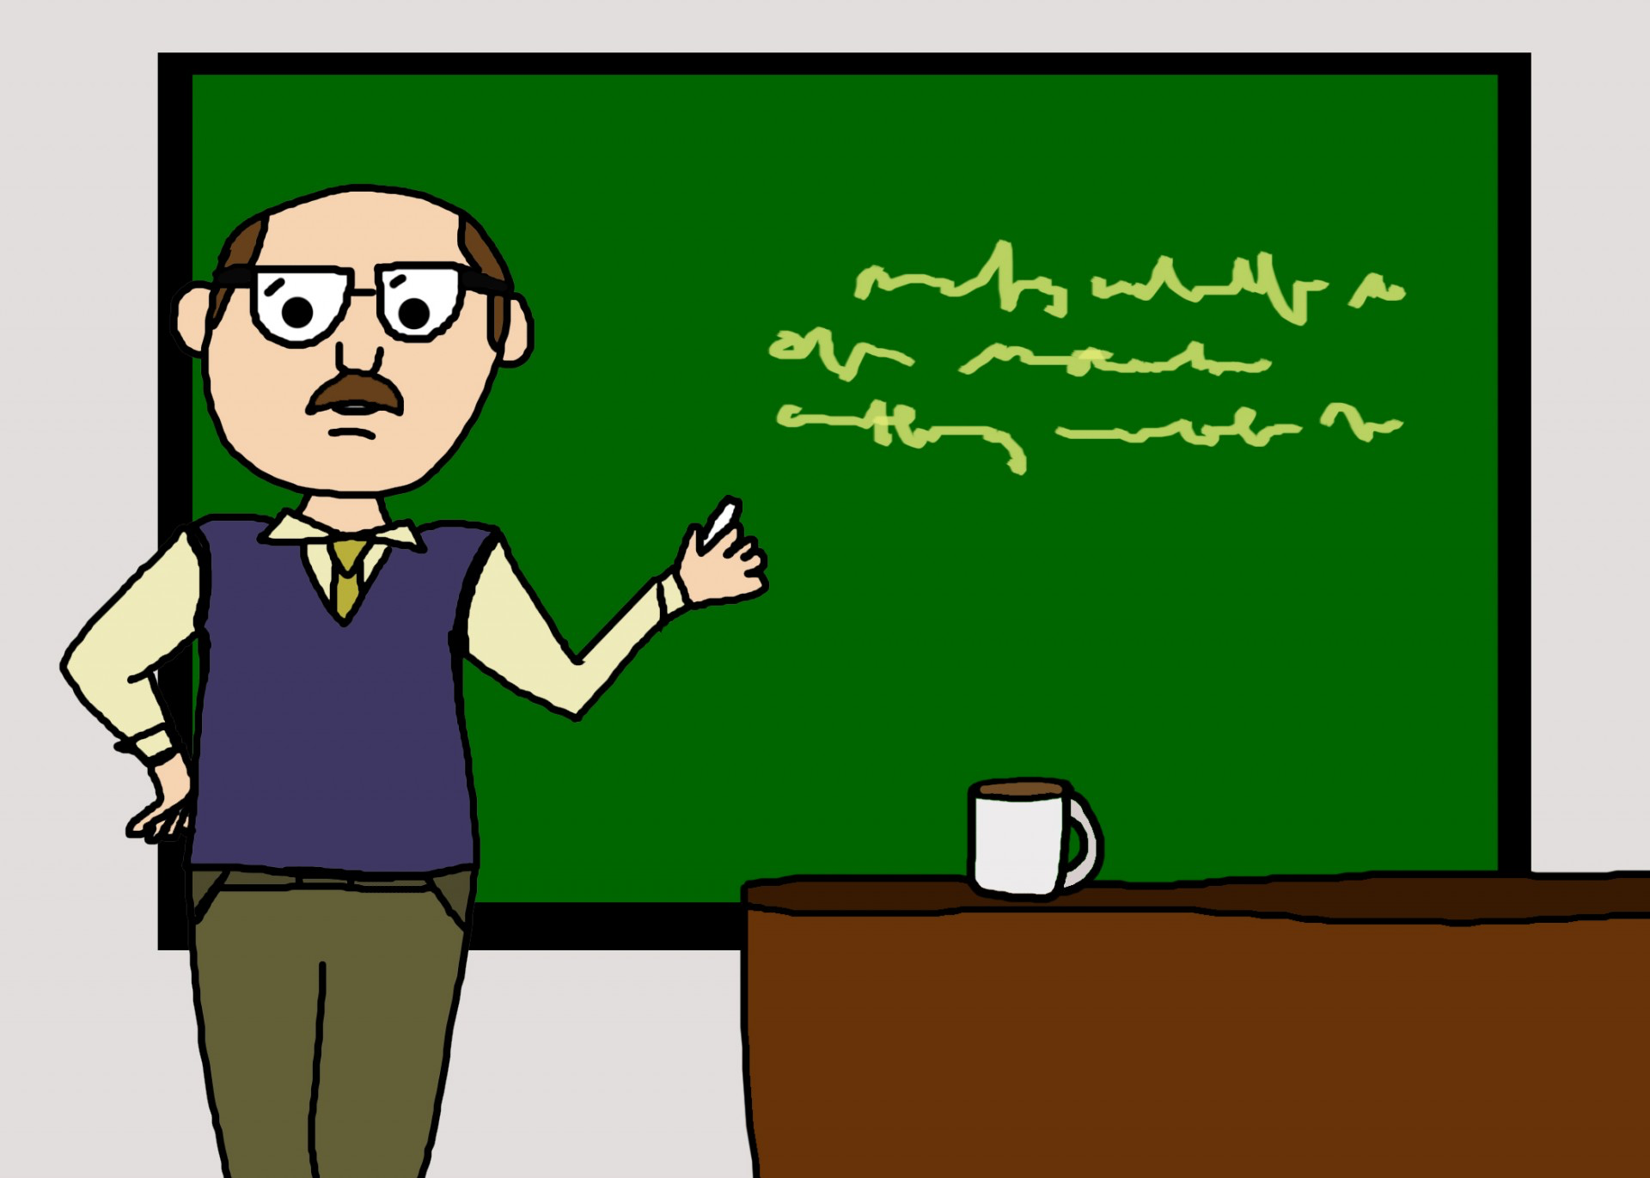
Link to our Presentation
Most of the key elements and principals throughout the warm-up game, are linked to our presentation!

Slide 5
Classroom Context
Grade 5 (10-11 years old)
In a French school, learning English as a second language
Class of about 18 students (9 boys 7 girls)
Enough for 6 groups of 3 students
We, as teachers, are bilingual and have a sufficient knowledge in the second language (French). We are able to teach and help the students in both languages if necessary
Notes:
Kayla Howard

Slide 6
What The Students Have Previously Learned
The students have been studying a variety of material in their second language, such as:
numbers;
colours;
basic conversational skills (oral skills).
All of the above are essential to aid the students during their oral presentations
Notes:
Van

Slide 7
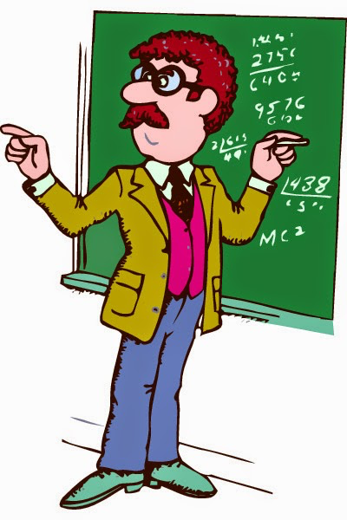
Importance of Oral
Oral communication is important for students because:
students are apart of the communication, that goes on in the discussion, without feeling pressured by the class;
the students feel more prepared to present information because they are not put on the spot;
oral presentations offer the students a chance to practice their oral communication which is very important for their professional careers;
good way for students to demonstrate their achieved knowledge and understanding of the material in class;
puts students in position to present material using their own logic.
Notes:
Mich

Slide 8
Pros and Cons
Regular Oral Presentations | Our “Multicultural Day”
Students may be nervous | Improves social and conversational skills
Lack of fluency (forced to memorize) | Able to casually practice everyday speech (easier than being in front of a class)
Not interactive | Interactive
Boring for the other students watching | More exciting
Notes:
Kayla

Slide 9
Ontario Curriculum for Grade 5 ESL- Speaking
Students should be able to:
ask questions
participate in social and academic discussions using short phrases and short sentences
recount familiar events, stories, and key information
rephrase key ideas from written or oral texts, with support
give straightforward directions and instructions
express opinions and emotions
speak with sufficient clarity and accuracy for listener comprehension
speak at almost the pace of first-language speakers, showing some control of stress, timing, and rhythm
use (with some accuracy) prepositions of direction and time and common idioms

Slide 10
Description of Multicultural Day
Students will make groups of 3;
As a team, students will decide on a country of their choice;
Students will have to do a small research on the chosen country, such as: colour of the flag, population, weather, etc.;
We will provide students with guidelines of information they should research;
The newfound information about the country will be presented in the form of a bristle board. Students are also encouraged to bring items that represent their chosen country to use as visual aids;
With the help from the visual aids the students will set up their station (of their chosen country) around the class. The teachers and students will be circulating and presenting their bristol board in their second language.
Notes:
Mich

Slide 11
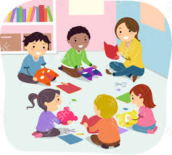
What to include
Students, in their presentations, will include:
capital of the country;
colours of the country;
flag;
food;
animals;
population (numbers);
traditional clothing;
how many seasons, and which.
Notes:
Kay

Slide 12
Evaluation
Notes:
Van

Slide 13
The End
Thank you for listening…
Now its time for you to present!!!
Notes:
Mich

