Slide 1
Listening Activities: Movies
Dominique, Nicole, Stephanie, Joanna, and Leslie

Slide 2
Our Learners…
-ESL learners from rural Quebec
-Advanced learners
-Grade 8

Slide 3
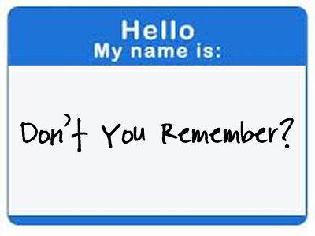
Warm Up:
Name Game
Beginner Learners: “My name is __________.” “Her/ His name is ________.”
Intermediate Learners: “My name is __________. I like (to) __________.” “Her/His name is ______ and he/she likes (to) _______.”
Advanced Learners: “My name is __________ and I like /dislike _________ and _________.” “Her/His name is ______ and he/she likes/ dislikes _______ and ______.”

Slide 4
Your Turn!
Person 1: “Hi, my name is ________. My favorite movie is _______.”
Person 2: “His/her name is ______ and he/she likes ________. My name is _______. My favorite movie is ______.”

Slide 5
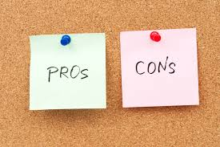
Pros and Cons
Pros:
Form is provided for the students
No written grammar
Ice-breaker activity to get to know students
Have to pay attention
Cons:
Memory challenges
Shyness
Hard to pick under pressure.
If their favorite movie is in a different language, that might be hard for others.

Slide 6
We chose to focus on listening because...
-It’s the skill that is generally spent the least amount of time on in terms of teaching even though:
-Listening comprehension is a key initial step in communication.
-The better a student can understand what is being said, the better will be their ability to communicate.
-They will be better able to notice the characteristics of the target language which will help improve their language development in all four key skill areas.
Most teachers don’t know what to use
Normally not fun
So we decided to shed some light on listening…

Slide 7
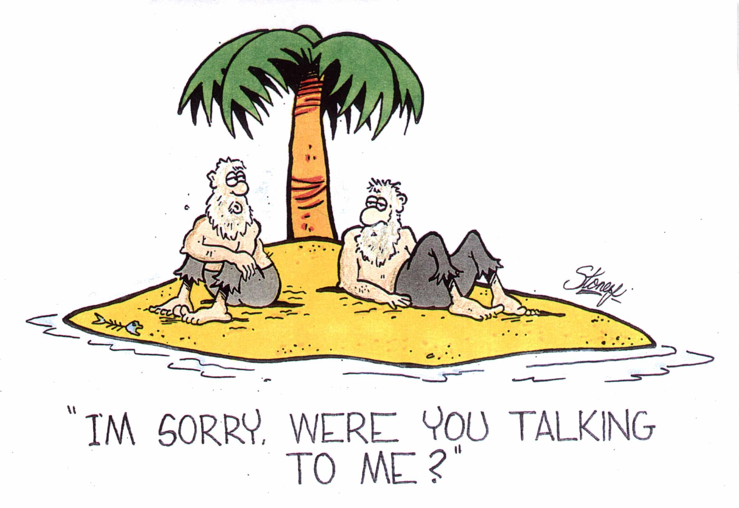
Why did we decide that videos are okay? -different voices and accents -background noise -more realistic than recordings

Slide 8
Types of Listening:
Top Down Listening:
- consists of understanding the general meaning of a listening selection without paying attention to specific structures, words and so on. It is like a general overview where the listener gets a general view of the listening passage while still understanding the general idea.
2) Bottom Up Listening:
- students have to pay attention because here, specific details are very important to understand the whole meaning of the conversation or another kind of listening activity. The listener focuses on individual words and phrases, and achieves understanding by stringing these detailed elements together to build up a whole

Slide 9
Activity 1:
Lyrics training
-Different levels available for every video: beginner, intermediate, advanced, expert -Each level has a different number of words to fill in. The more words the harder it gets -Looking for specific words -Can alter the choice of video for the different levels: slower pace and less background noise for beginners, faster pace for advanced

Slide 10
For example...
Movie Trailer: Fantastic Beasts and Where To Find Them

Slide 11
Pros and Cons
Pros: -fun and entertaining for the learners -learn about current trends (movies, music, etc.) -can be altered for the different levels
Cons: -need materials -might be hard to use one screen for the whole class -might be hard to coordinate

Slide 12
Activity 2:
Slap
https://www.youtube.com/watch?v=3EkBuKQEkio

Slide 13
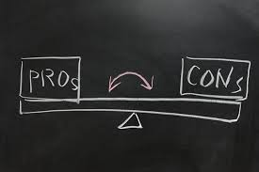
Pros and Cons
Pros:
Total Physical Response
Energizing
Good for young learners
Can be adapted to fit learning objectives :
Vocabulary (ex: months, family members)
Pronunciation (ex: specific sounds, homonyms)
Grammar (ex: types of verbs, nouns, adverbs)
Can be adapted to fit the level of students

Slide 14
Pros and Cons
Cons:
Competitive
Physical contact (though different variations exist)
Good for practice, nothing else (evaluation, indication of comprehension etc…)

Slide 15
Activity 3: Organize the events
Notes:
https://www.youtube.com/watch?v=oaa_jzILsuo

Slide 16
Objectives:
Understand the dialogue or movie clip in order to arrange the pictures in terms of order of events
Listening for detail
-play sound clip

Slide 17
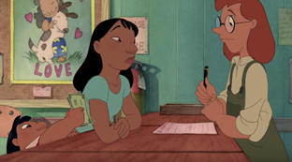
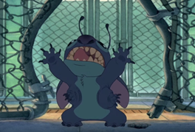
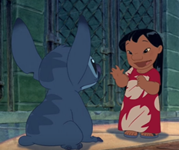
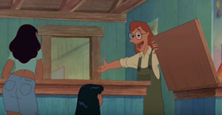
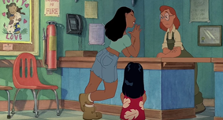
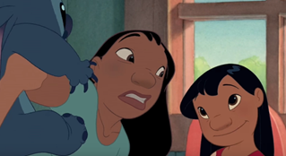
a
b
c
d
e
f
g
i
h

Slide 18
Answers:
h f d e g i c b a

Slide 19
Pros and Cons
Pros:
Fun
Creative
Adaptable to all levels of learners
Cons:
Background noises may be a challenge and cause confusion
Not visually seeing the video makes it harder

Slide 20
Adaptations
Choose longer or shorter clips
Include more or less background noise
Give the students fewer or more pictures to organise in sequence
Include more complicated words and/or sentences
Include a clip where the speech is at a faster pace
Show the students the pictures as they listen to make it easier

Slide 21
Activity 4:
Listen for Lies

Slide 22
Objectives:
Students will be able to use intensive listening skills to isolate specific information within spoken texts.
Improve overall listening comprehension.

Slide 23
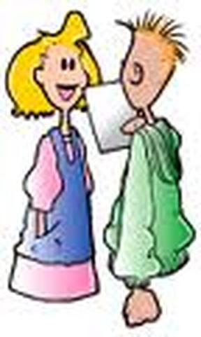
Instructions:
-Groups of 2 (1 Reader, 1 Listener)
Reader: Reads Version 1 aloud clearly Listener: Listens and tries to remember key words and phrases
Reader: Reads Version 2 aloud Listener: Listens carefully and attempts to identify any of the 12 differences between the 2 versions.
-

Slide 24
Adaptations
Easier:
Shorten text
Use easier vocabulary
Read each version more than once
Harder:
Lengthen text
Use more difficult vocab
Have learners write their own texts and make their own changes to version 2.

Slide 25
Pros and Cons
PROS:
Adaptable
Minimal prep/materials
Blends easily into different themes/lesson types
Develops students’ concentration, listening and reading skills
CONS:
Rigid structure
Requires a lot of focus -difficult for young learners/beginners
Not highly authentic

Slide 26
Conclusion
Things to remember:
- promote active listening-giving the students something to listen for ensures that they are involved in the task
-identify listening strategies giving the students the tools they need to guide their listening
-make sure the students know the goals of the activity
-provide opportunities for reflection
-chose authentic materials

