Slide 1
You would like to teach French or English as a second language?

Slide 2
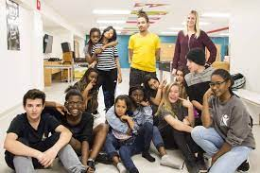
Honours B.A. in Second Language Teaching (SLT)
Major program in Second Language teaching (SLT)

Slide 3
Career opportunities
Our graduates are working in positions including:
Teachers of French or English;
School administrators ;
Language assessment specialists;
Pedagogical material developer;
Researchers in second languages;
Authors of language policies;
etc.

Slide 4
You are asking yourself some questions?
What are the different possible paths?
What are my options?
Can I design my own program?
Are there specific requirements

Slide 5
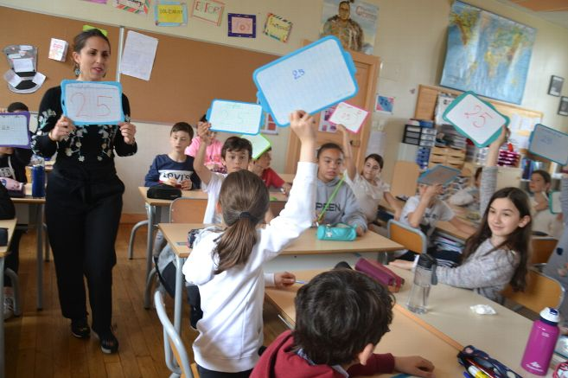
Possible paths
Formation à l’enseignement
(B. Éd.) - 2 years
Teaching at the elementary or highschool levels
Teacher Education
(B.Ed) - 2 years
B.A. in Second Language Teaching
Graduate studies: Master’s / Ph.D.
Workforce:
Adult education
uOttawa.ca
uOttawa.ca

Slide 6
Your options:
Design your own program!
Why don’t you include another field
of interest like:
history
mathematics
geography
sciences
etc.
or language courses to improve your competence.
uOttawa.ca

Slide 7
Design your own program!
120 credits (40 courses)
Honours B.A. with specialization in SLT
Honours B.A. with specialization in SLT with a Minor
Honours B.A. with a Major in SLT + Major in another field
Honours B.A. with a Major in SLT+ Minor in another field
3 credits+ 1 course
Credits: First discipline
Credits: Minor (30 credits / 10 courses) or Major (42 credits / 14 courses)
Credits: Elective courses
Credits: Basic skills/foundation courses
https://catalogue.uottawa.ca/en/undergrad/honours-ba-second-language-teaching-english-second-language/#programrequirementstext

Slide 8
During your studies… you will discover the field of second language teaching
you will put into practice the skills you will have learned
uOttawa.ca

Slide 9
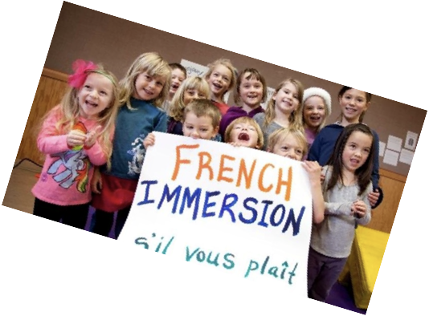
Exemples of Second Language Teaching courses
DLS 2101 Listening and reading in a second language
DLS 3103 English for specific purposes
DLS 3130 Initiation to language assessment

Slide 10
DLS 4900 Field experience
4th year course
Internship of 25 hours
In a professional setting chosen by the student

Slide 11
The language you wish to teach!
Students must have an excellent knowledge of the language they intend to teach.
Teaching of French: majority of courses in French.
Teaching of English : majority of courses in English.
To maintain and keep improving your language skills:
French courses : FLS or FRA / English courses : ESL or ENG

Slide 12
Admission requirements
Language proficiency test
In the language you wish to teach.
Steps:
Submit your application
You receive a link for the test
Do the test as soon as you get the link
3) Offer of admission for the program is sent when the test is completed and passed.
Cette photo par Auteur inconnu est soumise à la licence CC BY-SA

Slide 13
Upon graduation…
Faculty of Education at the University of Ottawa
Places reserved for B.A. in SLT graduates who meet the admission requirements
40 places: Formation à l’enseignement (B.Éd.)
40 places : Teacher Education (B.Ed.)
Graduate studies
Master’s Degree in Education
Master’s Degree in Bilingualism

Slide 14
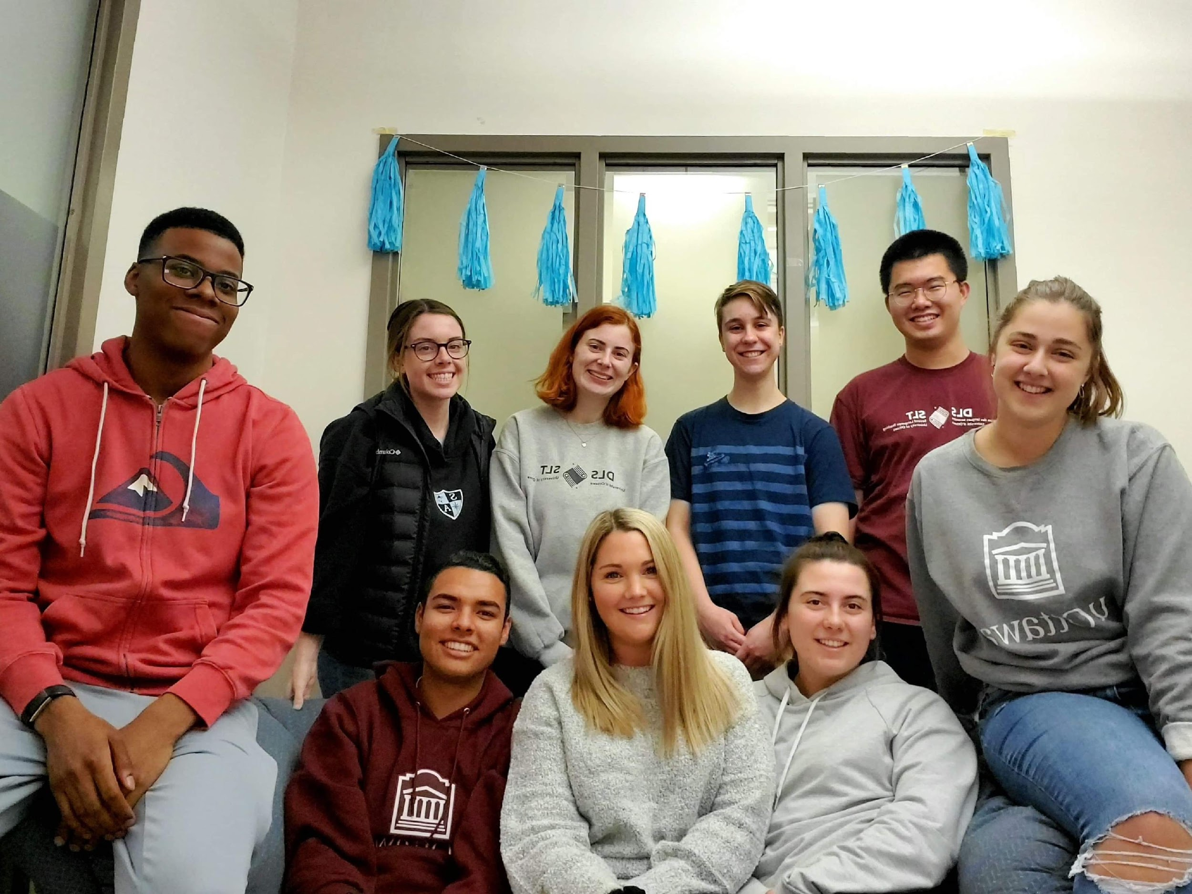
Your association!
ELS/SLT An active and engaged student association!

Slide 15
Questions about the program?
Douglas Fleming
Faculty of Education
dfleming@uottawa.ca
Marie-Claude Dansereau
OLBI, Faculty of Arts
mcdansereau@uottawa.ca
Our web page :
https://ilob.uottawa.ca/enseignement-langues-secondes

Slide 16
Thank you!
Any questions ?
uOttawa.ca
Notes:
PAGE COUVERTURE (option 4) ÉBAUCHE (DOCUMENT NON FINALISÉ) À lire avant d’utiliser le gabarit
NOTE : Les éléments du gabarit suivants ne peuvent être modifiés : • Entête organisationnelle grenat (Université d’Ottawa | University of Ottawa) • Pied de page organisationnel comprenant la bande grise et grenat ainsi que le logo, à l’exception de l’adresse Web qui peut être modifiée en suivant les étapes suivantes : dans le document PowerPoint, cliquez sur l’onglet View, puis sélectionnez Slide Master. Sur le menu d’affichage (à gauche), sélectionnez la troisième diapositive et inscrivez la nouvelle adresse sur celle-ci.
COVER PAGE (option 4)
DRAFT ONLY (FILE NOT FINAL) Read before using template
NOTE: The following elements of the template should remain untouched and cannot be modified:
• Corporate (Université d'Ottawa | University of Ottawa) garnet header
• Corporate uOttawa footer including the grey/garnet stripe and logo, with the exception of the URL which can be customized to a specific URL by following these simple steps: On the PowerPoint View tab, in the Master Views group, select Slide Master. Select the third slide on the left side panel, and type in the desired URL on the slide.

