Slide 1
Poetry
Across the Curriculum
Alexandria Bleich, Kyley Chapman, Nicholas Holub, Jessica Whitworth

Slide 2
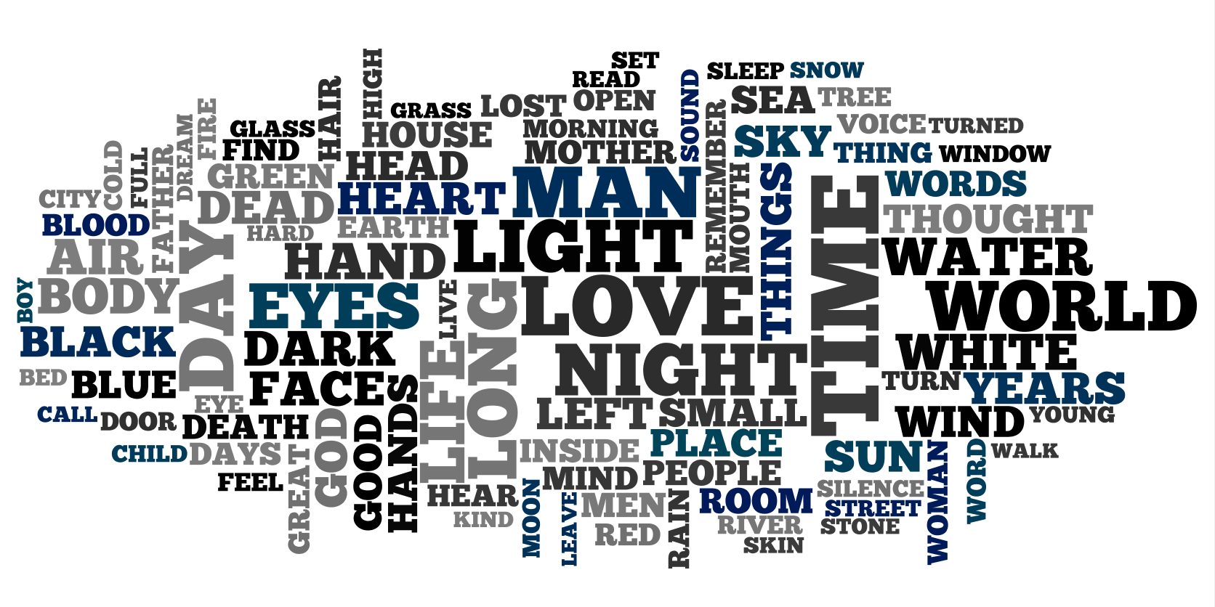

Slide 3
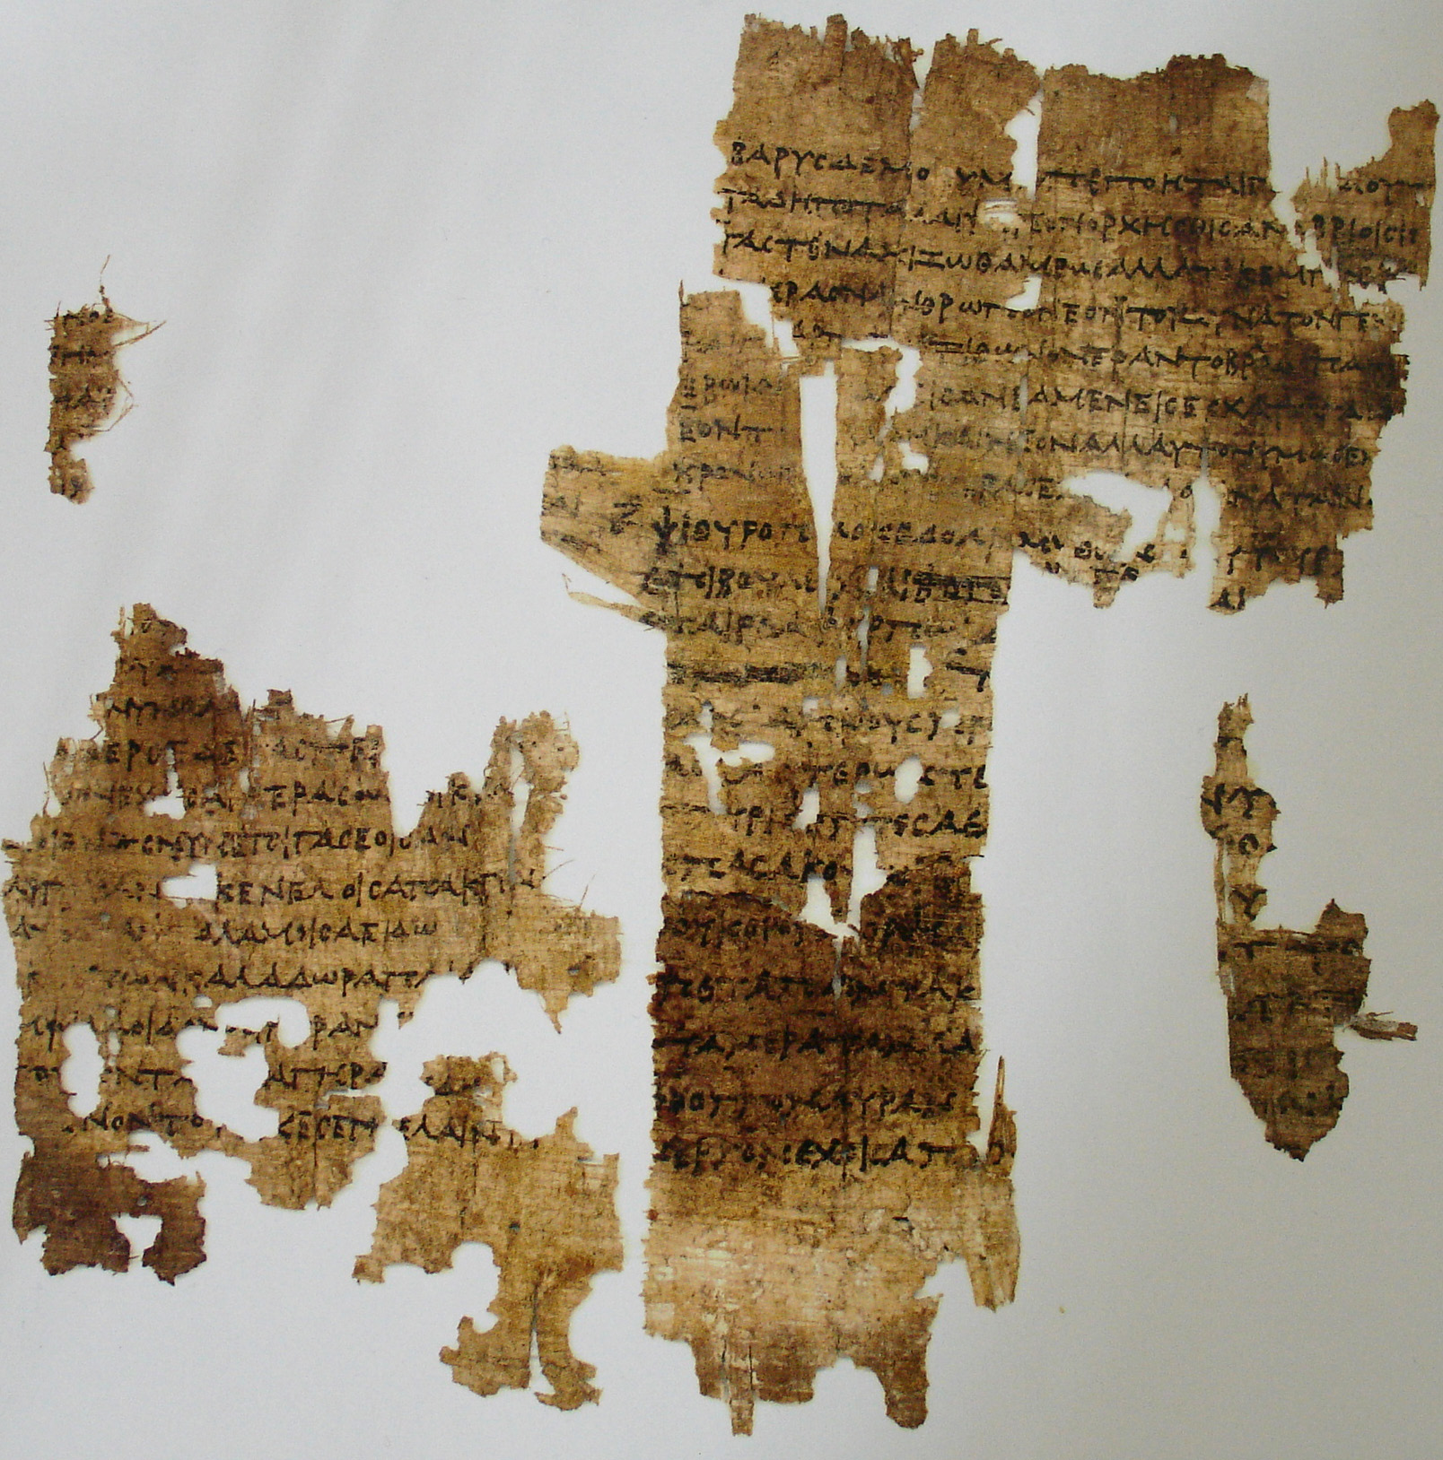
The History of Poetry
Predates literacy
Recited or sung
Remembering oral history, genealogy, laws, religion

Slide 4
Poetry and Creative Problem Solving
The Osborne-Parnes Creative Problem Solving Process: Includes 6 stages to problem solving.
The total six stages are:
1) Mess-finding (Objective finding) 2) Fact-finding 3) Problem-Finding 4) Idea-Finding 5) Solution Finding (idea evaluation) 6) Acceptance-finding (Idea implementation)
Kendall Hunt, 1998
Notes:
The steps guide the creative process. They tell you what to do at each immediate step in order to eventually produce one or more creative, workable solutions. A unique feature is that each step first involves a Divergent thinking phase in which one generates lots of ideas (facts, problem definitions, ideas, evaluation criteria, implementation strategies), and then a convergent phase in which only the most promising ideas are selected for further exploration. These steps can be used when teaching poetry across the curriculum - students and teachers together can identify the goal of the poem, gather the data, clarify the problem (they may be having problems in the writing process), generate their ideas, find a solution, and plan.

Slide 5
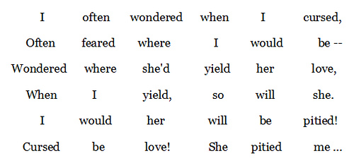
Poetry in Math
1800’s: Lewis Carroll experimented with mathematical logic to create The Square Stanza.
JoAnne Growney, 2010

Slide 6
Expression of science through poetry could enrich and better kids’ understanding of science education.
Encouraged use of imagination to deconstruct and reconstruct their learned knowledge.
Neither poetry nor science is allowed to be vague.
For poets: characteristics of each feeling, each mood and each notion and
For Scientists: characteristics of the object
Zayani Bhatt, 2016

Slide 7
The subject I address today
Is that of star formation.
And what we’ve found out recently
About the situation.
Stars start out as clouds of gas and
Dust and bits of spinning stuff.
Collapsing gravitationally
Until they’re dense enough.
J Storey, (1984)
Notes:
Research paper that a scientist had written solely in poetry format

Slide 8
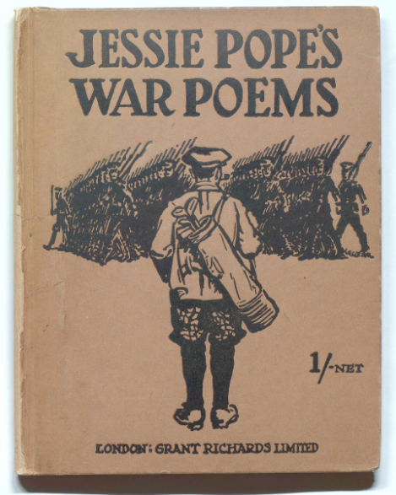
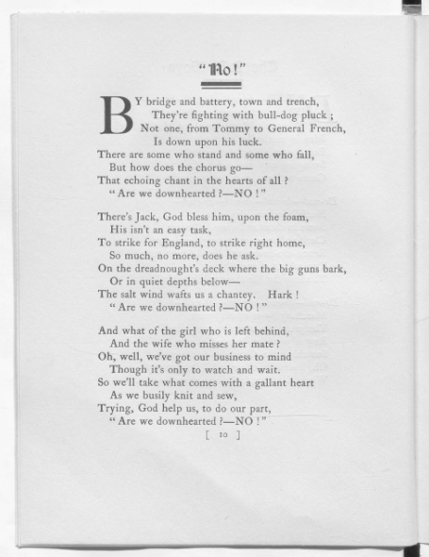
Poetry in History
“First World War poetry represents one of those primal moments when poetic form bears most fully the weight of historical trauma. Art and testimony are often yoked together by real-life violence, leading to formal realignment, invention or dissonance”
Edna Longley has powerfully argued that First World War lyric poetry may be a ‘quintessential case’ of the ‘encounter between form and history’. See ‘The Great War, history, and the English lyric’, in Vincent Sherry ed. The Literature of the First World War (Cambridge: Cambridge University Press, 2005)
Santanu Das, 2013
Notes:
Jessie Pope’s war poems was published in 1915. They are pro war poems that were meant to encourage enlistment and they were very popular

Slide 9
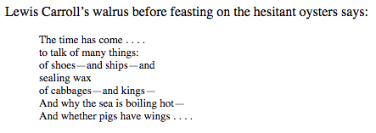
Poetry in Geography
1. Learning the essential facts: For example, what borders the country? Is the river navigable? When was the nation founded? The major religion? What is the temperature range? Language? What is its elevation?
2. Skill development: interpreting maps, globes and charts. Reading social studies materials. Locating information. Understanding time and chronology.
3. Introduction of concepts: How are the nation’s resources used in its economy? What influence does the climate have on a region’s agriculture? What are the cultural characteristics?
U Alberta

Slide 10
Poems in the Media
Cash Me Outside
Bohemian Rhapsody
Rap God

Slide 11
METACOGNITION

Slide 12
Metacognition
Ministry jargon
awareness or analysis of one's own learning or thinking processes.
(first known use 1972) https://www.merriam-webster.com/dictionary/metacognition
higher-order thinking that enables understanding, analysis, and control of one’s
cognitive processes, especially when engaged in learning. (origin 1975-1980)
http://www.dictionary.com/browse/critical-thinking?s=t
Livingston, Metacognition: an overview, “thinking about thinking” (1997) http://gse.buffalo.edu/fas/shuell/cep564/metacog.htm
So if I understand my own thinking; is this simple recognition good enough?

Slide 13
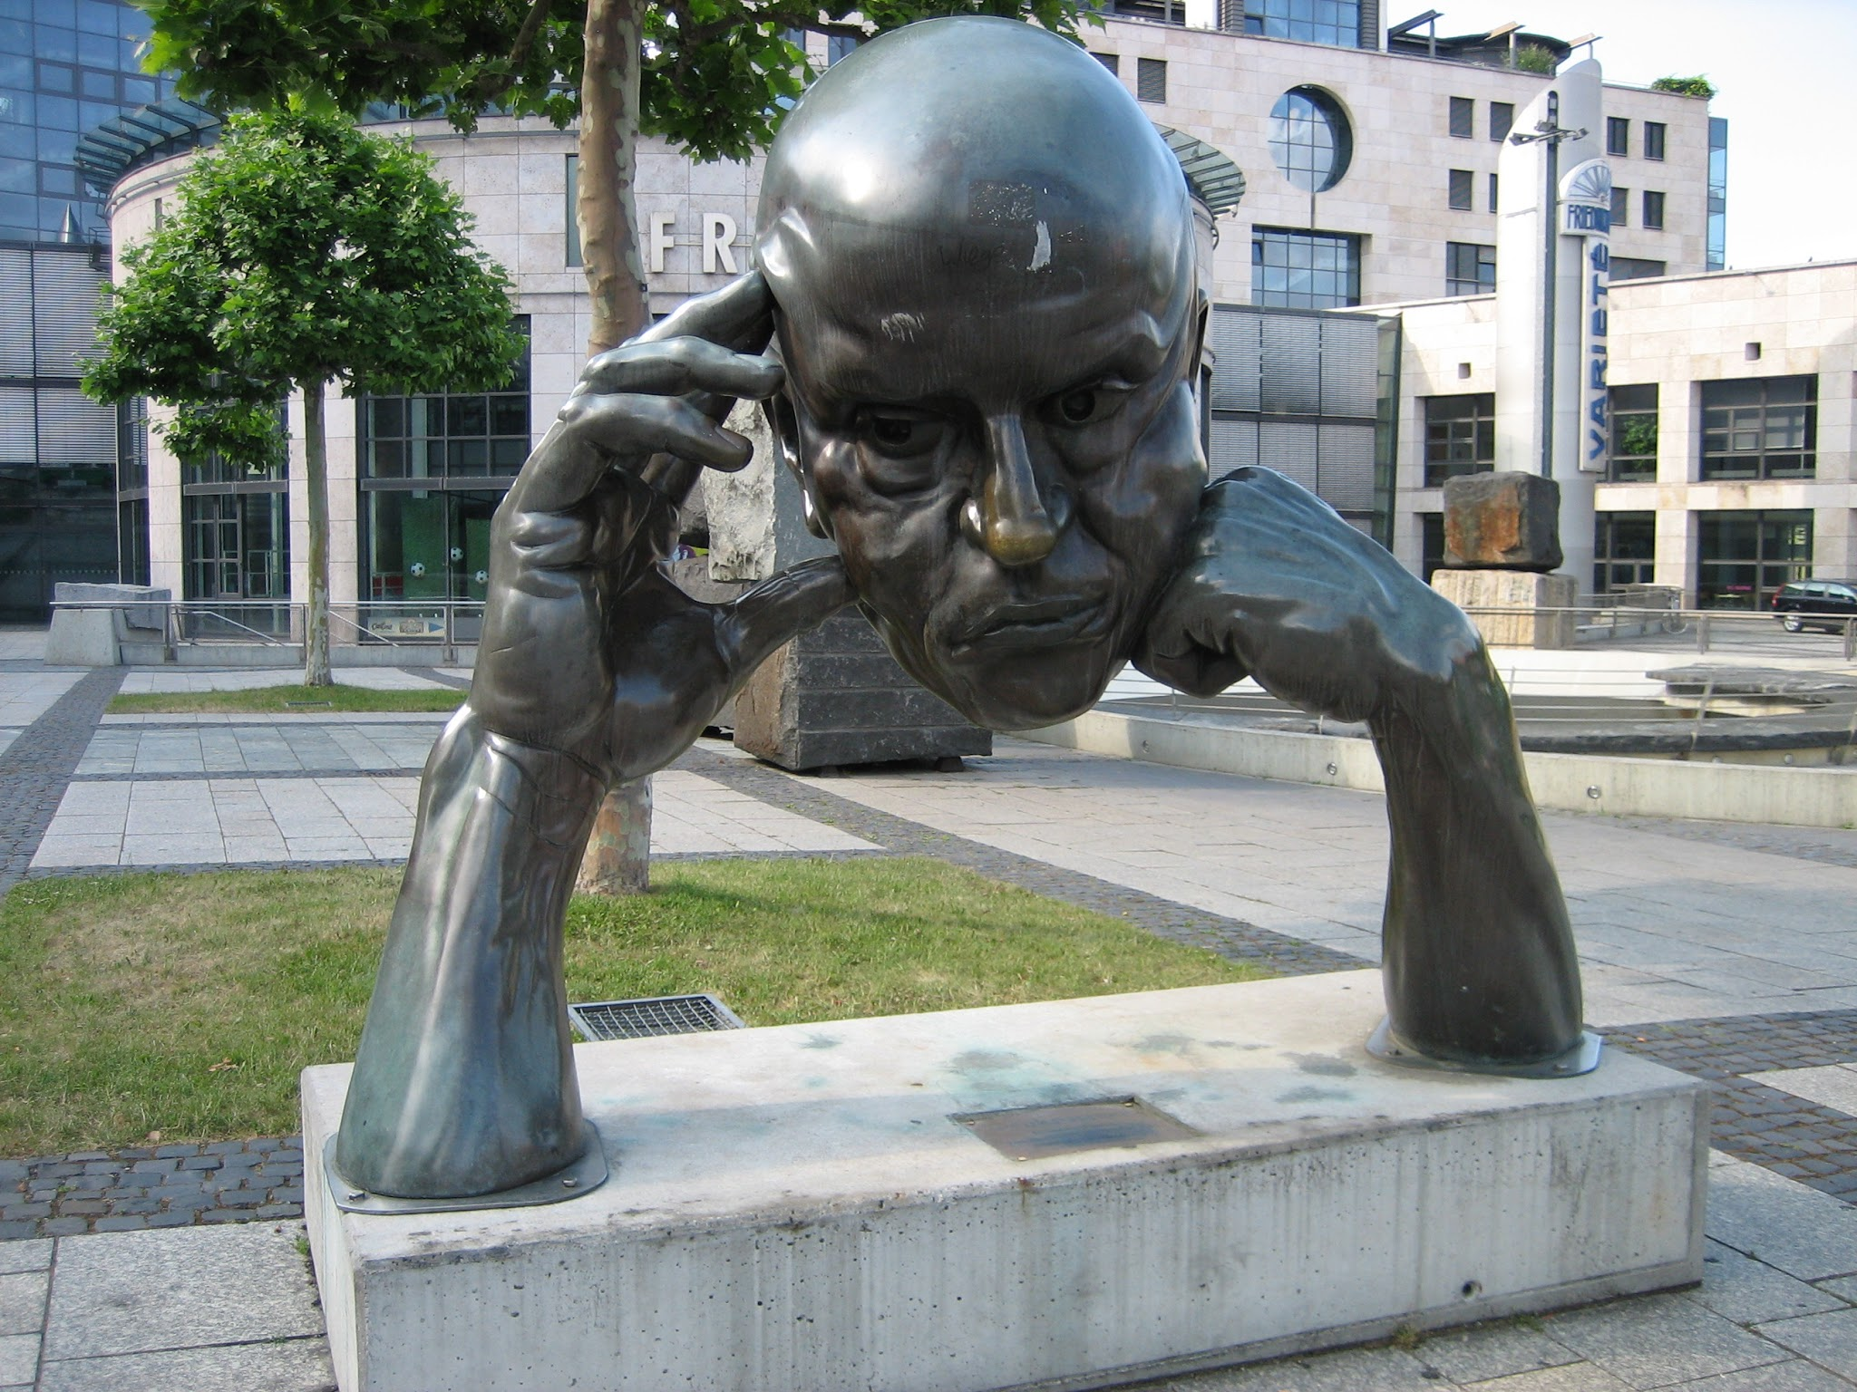
Critical Thinking
Meta:
2. a prefix added to the name of a subject and designating another
subject that analyzes the original one but at a more abstract, higher
level: metaphilosophy; metalinguistics.
http://www.dictionary.com/browse/meta
Cognitive:
1. the act or process of knowing; perception.
http://www.dictionary.com/browse/cognition?s=t
Combined this would mean: higher order (analyse) processing of knowing
Critical Thinking
"The art of thinking about your thinking while you are thinking in order to make your thinking better: more clear, more accurate, or more defensible."
http://www.criticalthinking.org/pages/glossary-of-critical-thinking-terms/496

Slide 14
Amalgamation
Is simple recognition (that I’m thinking) good enough?
My reason for analysis: ‘thinking about thinking’
But, what about:
thinking about thoughts (on poetry),
thinking about thinking (about poetry)
or even:
thinking about writing (poetry),
writing about writing (poetry) {WAW},
writing about thoughts (on poetry),
writing about thinking (about poetry)
Modified definition
The analysis of one's own thinking processes (where thinking and writing share the thought process)

Slide 15
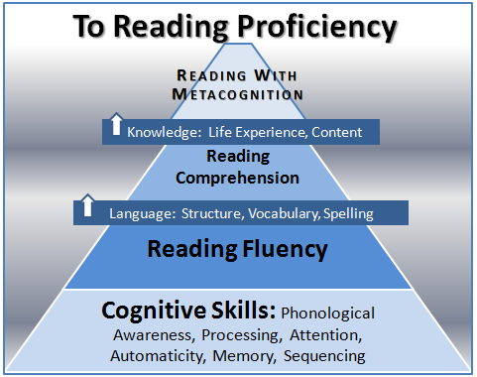
A Proof is a Proof
Martinez, in Missing Link: Metacognition and the Necessity of Poetry in the Composition Classroom (University of California- 2001)
‘Not only does poetry improve: writing and revision, ability to read and understand, style and grammar, but it also helps metacognitive functions.’ (35)
“Because poetry offers complex interpretations of human and non-human situations, often in concise form, it lends itself very well to conscious analysis and higher order reasoning”(36)
": ‘the process of writing is best understood as a set of distinctive thinking processes which writers orchestrate or organize during the act of composing’ Making this process conscious for the writer is the goal of metacognition.”(45)

Slide 16
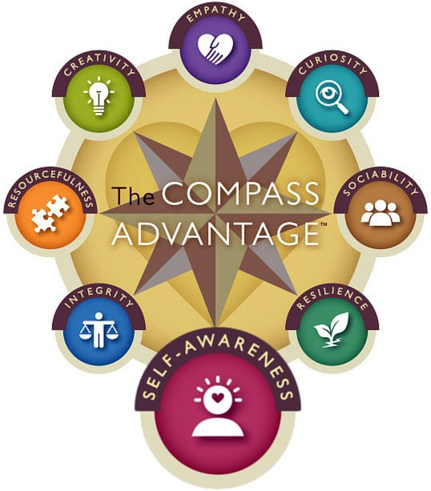
A Proof is a Proof
Dr. Price-Mitchell has a 7 piece plan to improve metacognition in students.
Part of #4 includes student reflection on how they learned during a week.
“Encourage creative expression through whatever journal formats work best for learners, including mind maps, blogs, wikis, diaries, lists, e-tools, etc.”
https://www.edutopia.org/blog/8-pathways-metacognition-in-classroom-marilyn-price-mitchell

Slide 17
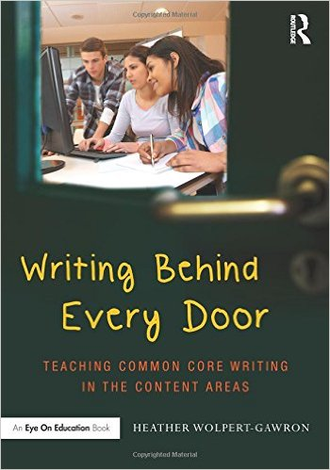
Useful Examples
Wolpert-Gawron. Metacognitive Poetry: Writing About Thinking While Writing Lesson (2009)
"The assignment was deceptively simple: be aware of what’s going on in your head, of the turning of your gears, as you write a poem."
http://tweenteacher.com/2009/01/23/metacognitive-poetry-writing-about-thinking-while-writing-lesson/
Nilsson’s ‘Metacognitive application for Mastery’
(from online presentation Metacognition in the Classroom, Deerfield Academy, MA, Oct 15, 2013)
3 parts: Strategy, Mechanics, Mastery
Instructions: (Strategy) Mechanics
1. Scan the poem < Organizes the task
2. Read the poem for literal meaning < Creates prior knowledge
3. Read the poem for figurative meaning < Works through proximal development (Vygotsky-ZPD)
Mastery – repetition of above function
http://curriculumredesign.org/wp-content/uploads/Nilsson-Metacognition-For-Web.pdf

Slide 18
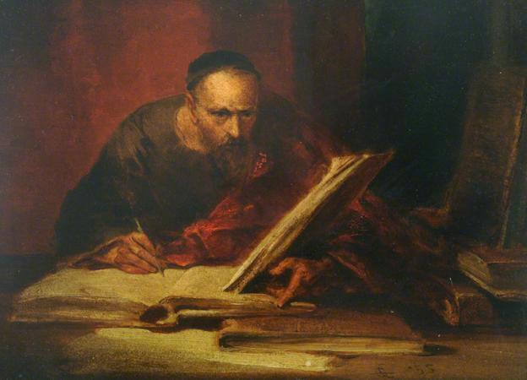
A Poem
ConnectHook
Sep 11, 2015
Amazing Muses’ Amusing Mazes
When painters who paint about painting
meet writers who write about writing,
self-conscious redundancy
bordering lunacy
ends in esthetic in-fighting.
These modernists, right about nothing
(mostly nihilists mad about something)
are so lost in the process
they vent all their excess
in metacognition: dull writing.
You poets who muse about musing –
unaware you are reader-abusing,
provide a terrific
verbose soporific,
yet not of the hearer’s own choosing…
I long for some righteous verbosity –
but I’m stifled by all the pomposity.
This dull erudition,
“sub-metacognition”,
is but an artistic atrocity.
You thinkers who think about thinking
drag my spirit far lower than sinking.
What we want is a Word
which we haven’t yet heard –
so till then I’ll just drink about drinking.
https://connecthook.wordpress.com/

Slide 19
Poetry Overview

Slide 20
Haiku
Japanese poetic form
Usually consists of 17 syllables: three phrases of 5, 7, 5
Non-rhyming lines
Avoidance of metaphors/similes
Whitecaps on the bay:
A broken signboard banging
In the April wind.
— Richard Wright, collected in Haiku: This Other World, 1998

Slide 21
Rhyming
Couplets
2 lines
Last words rhyme
My cat ate a mouse And then brought it in the house.
Triplets
3 lines
AAA or ABA
What a fine day To go out to play In the month of May.
Quatrains
4 lines
AABB or ABAB
I never saw a purple cow, I never hope to see one: But I can tell you, anyhow, I'd rather see than be one. - The Purple Cow by Gelett Burgess

Slide 22
Free Verse Poetry
Now I’m a bird
So high
I close my eyes and take flight
I feel the wind in my wings
Up with the clouds
My hair, now feathers, sweeps behind me
I am as elegant as a swan
Soaring higher than the Earth
Rhymed or unrhymed verse
No set meter

Slide 23
Activity Time!
Individually use the provided object to brainstorm
Who
What
Where
When
Why
Pair a button and a picture.
In pairs, write paragraphs to represent the two plots
Highlight the key words
Form into a poem

Slide 24
Critical and Analogical Thinking

Slide 25
Critical Thinking
Explaining cause and effect relationships
Analyze and evaluate the meaning of words
Synthesize evidence to create meaning
When writing poetry i.e. Haiku
What is being conveyed?
Who is the speaker? The audience?
Where & when is the scene taking place?
Why are these words related or important?
Solving this puzzle using the strict structure (5, 7, 5)

Slide 26
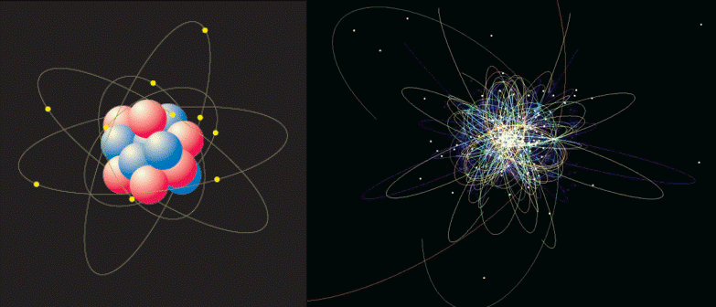
Analogical Reasoning
Primarily concerned with systemic correspondences
Solving a structurally similar problem
Can explain new concepts
Encourages students to make conclusions
Making analogies give students a way to
see the probability of an investigation
Encourages the recognition of patterns
Applicable to Math, Science, History, Geography
Heuristic approach to learning

Slide 27
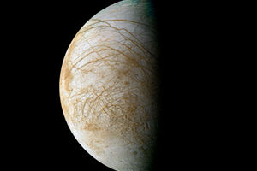
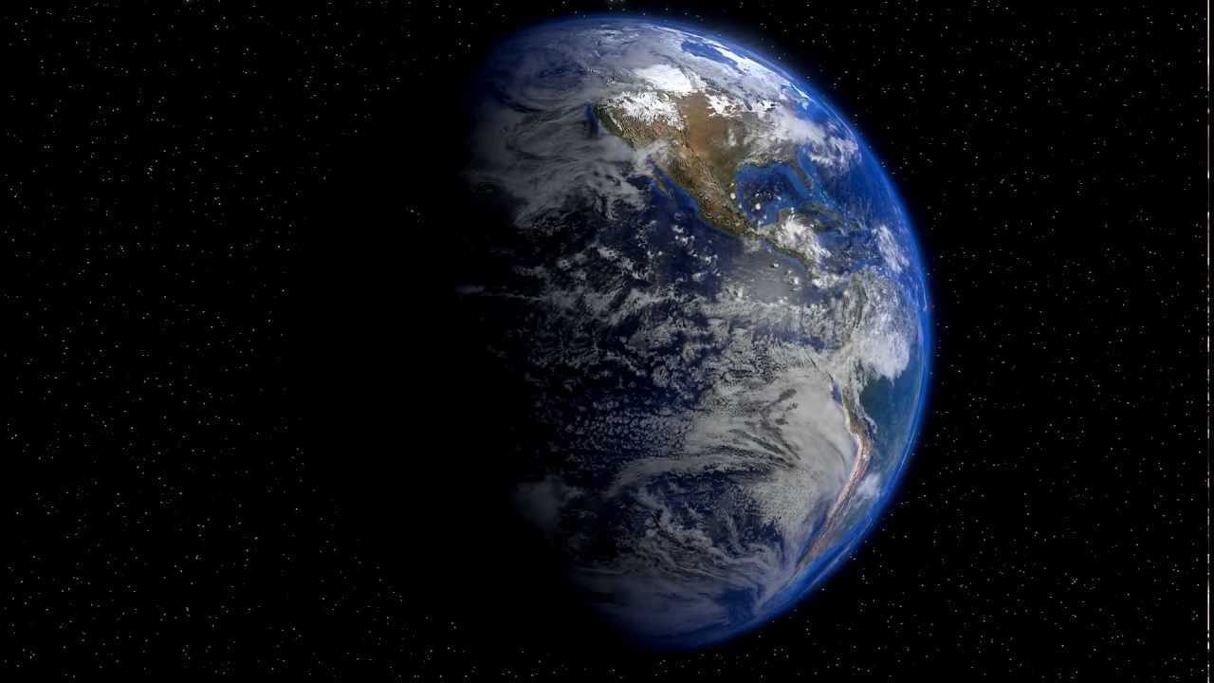
Analogical Argument
An explicit representation of a form of analogical reasoning.
Cites accepted similarities between two systems to support the conclusion that some further similarity exists.
For Example: There might be life on Europa because it has an atmosphere that contains oxygen just like the Earth.

Slide 28
Poetry and Analogies
Metaphor
A comparison not using “like” or “as”
Simile
A comparison using “like” or “as”
Archetype
Basic models for which others are based i.e. a prototype
Character archetypes (hero, lover)
Archetypal themes (birth, death, revolt)
Symbolic patterns (white, cross)
“Shall I Compare Thee to a Summer’s Day,” -William Shakespeare
“Twinkle, twinkle little star,
How I wonder what you are
Up above the world so high,
Like a diamond in the sky.” - Unconfirmed
“How sweet is the shepherd's sweet lot! From the morn to the evening he strays; He shall follow his sheep all the day, And his tongue shall be filled with praise.” - William Blake

Slide 29
Brain
Activation

Slide 30
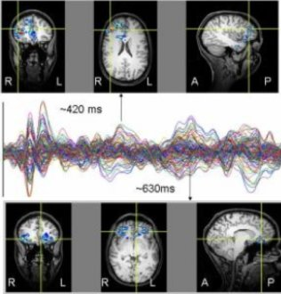
Greater Brain Activation
MRI scans comparing people reading poetry and modern day writing.
Powerful neurological responses to poetry
Greater brain activity with poetry
Long-lasting brain activation
University of Liverpool (2006)

Slide 31
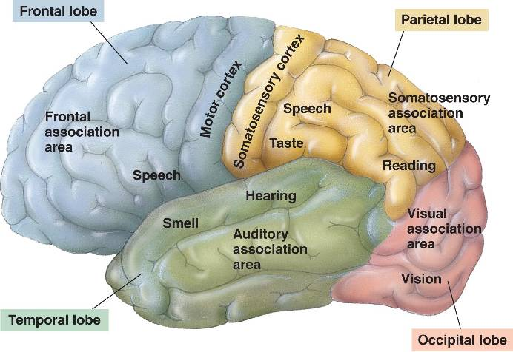
Mental Images & Pain Reduction
Activation in the visual association cortex
Mental images to support holistic understanding
Reduced chronic pain
University of Liverpool (2006)

Slide 32
Reward & Pleasure
fMRI scans of people reading various types of texts
Activates reward areas of the brain
Poetry is like music; shivers down the spine phenomenon
University of Exeter

Slide 33
Mental Health

Slide 34
Poetry as a Self-Help Book
Triggers introspection
Increases activity in brain area associated with “autobiographical memory”
Reader reflects on & reviews own experiences in light of what they read
University of Liverpool

Slide 35
Improved Social Functioning
Brain pathways involved in perception of social world & decision making
Same skills as the ability to understand oneself and others
More fluid, reasoned responses
Power to alter how you find meaning in life events
University of Liverpool

Slide 36
Resources
Bhatt, Z. (2016). The Love Affair Between Science and Poetry. Science and Tech. Retrieved from http://www.newstatesman.com/culture/poetry/2016/06/love-affair-between-science-and-poetry
Davis, B., & Sumara, D. (2007). Interchange. Complexity Science and Education: Reconceptualizing the Teacher’s Role in Learning,38(1), 53-67. Retrieved March 9, 2017.
Das, S. (2013). Reframing First World War Poetry. World War One. Retrieved from https://www.bl.uk/world-war-one/articles/reframing-first-world-war-poetry
Growney, J. (2010). Special Square Stanzas. Intersections – Poetry with Mathematics. Retrieved from https://poetrywithmathematics.blogspot.ca/2010/11/special-square-stanzas.html
Hunt, K. (1998). CPS Model. Creativity is Forever. Retrieved from http://members.optusnet.com.au/charles57/Creative/Brain/cps.htm
O'sullivan, N., Davis, P., Billington, J., Gonzalez-Diaz, V., & Corcoran, R. (2015). “Shall I compare thee”: The neural basis of literary awareness, and its benefits to cognition. Cortex, 73, 144-157.
Storey, J. W. (1984). The Detection of Shocked CO Emission From G333.6-0.2. Publications of the Astronomical Society of Australia, 5(04), 566-569. Retrieved from, https://www.brainpickings.org/2012/07/12/first-science-poem-2/
University of Alberta. (n.d.) Teaching Geography Using Poetry Writing. Journal of Geography. Retrieved from https://sites.ualberta.ca/~jkirman/junior%20high%20social%20studies%20text.htm#Teaching%20Geography%20Using%20Poetry%20Writing

Slide 37
Resources 2
University of Liverpool. (2006). Reading Shakespeare Has Dramatic Effect On Human Brain. ScienceDaily. Retrieved from www.sciencedaily.com/releases/2006/12/061218122613.htm
Zeman, A., Milton, F., Smith, A., Rylance, R. (2013). fMRI Study of Brain Activation by Poetry and Prose. Journal of Consciousness Studies, 20, 132-158.

