Slide 1
Correlational
Designs

Slide 2
Correlational Research
Objective:
to relate variables to one another as opposed to attempting to manipulate them as in experimental designs.

Slide 3
Today’s Learning Objectives:
To learn and get familiar with:
- how to define Correlational Research and when one can use it
- components of the two types of correlational designs
- key characteristics of this research
- potential ethical issues that may arise
- steps for conducting such research
- criteria for evaluating such a study

Slide 4
Definitions
Relevent Terms | Academia | Street
Correlational research design | “quantitative designs in which investigators use a correlational statistical technique to describe and measure the degree of association (or relationship) between two or more variables or sets of scores” | A design in which science people use fancy math to describe how things are related.
Co-vary | “means that a score can be predicted on one variable with knowledge about the individual’s score on another variable” | How the fancy math numbers can fortune tell that one thing is going to influence another thing.
Product-moment correlation coefficient (aka Pearson r) | “a statistic that expresses a correlation statistic as a linear relationship” | The fancy math calculations of how things are related.

Slide 5
When do you use Correlational Research?
When you are looking to find a relationship with two or more variables to see if they influence each other.
Which, in turn, allows one to make predications of outcomes.
***Corrlation does not imply causation***

Slide 6
Brief History
Since the 19th century statitions were using correlational research and had procedures for calculating the data.
Karl Pearson – late 1800s -one of the first to elaborate on the formula and present essential elements such as adequate sample size, precise measurement, and the unbiased samples.
In the 1970s and 80s, the introduction of computers allowed researchers to conduct more complex studies consisting of various variables.
Notes:
- in a way the Freud of correlational research – as in he did not ‘invent’ the method, but one of the first to elaborate on the formula and present essential elements for validity and reliability such as adequate sample size, precise measurement, and the importance of unbiased samples.

Slide 7
WHAT ARE THE TYPES OF CORRELATIONAL DESIGNS?
Explanatory Design
The extent to which two variables or more co-vary
Prediction Design
Researchers seek to anticipate outcomes by using certain variables as predictors

Slide 8
Explanatory Design
Characteristics of an
Explanatory Design:
Two or more variables are correlated
The researchers collect data at one point in time
The investigator analyzes all participants as a single group
The researcher obtains at least two scores for each individual in the group- one for each variable

Slide 9
Prediction Design
Characteristics of a
Prediction Design:
The researchers typically measure the predictor variable(s) at one point in time and the criterion variable at a later point in time

Slide 10
Displays of Scores
Scatter plot (graph)
Correlation matrix (table)

Slide 11
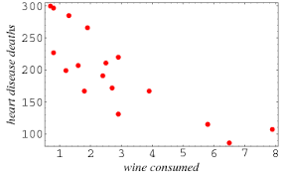
Scatter Plot
Visual representation of relationship (strength and direction) between independent and dependent variables
Shows correlation between two variables only;
I.V. on horizontal or x-axis and D.V. on vertical or y-axis

Slide 12
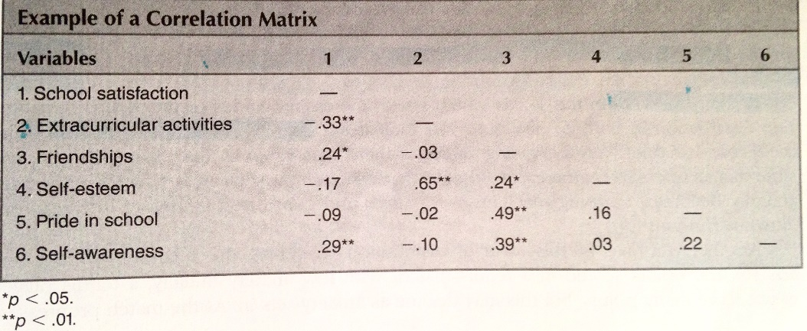
Correlation Matrix
Table featuring the correlation coefficients for all variables in a study:
Notes:
All variables are listed both horizontally and vertically
Shows strength of correlation between each of the variables
Only half of table is filled as to not repeat information

Slide 13
Associations Between Scores
Types of relationships
Other correlation statistics (beyond Pearson’s “r”)
Magnitude (strength of relationship)

Slide 14
Types of Relationships
Linear:
Positive vs negative
Uncorrelated:
variables are independent of each other
Curvilinear or nonlinear:
U-shaped relationship
Notes:
as one variable increase, the other also increases (e.g. class attendance and student grades); negative linear relationship means that as one variable increases, the other decreases (e.g. depression and social engagement)
- no predictable relationship between the two variables being studied, i.e. the variables do not “covary
- distribution can be upright (decrease, plateau, increase) or “inverted” (increase, plateau, decrease)

Slide 15
Correlation Statistics
Pearson’s “r”
(product-moment correlation coefficient) only appropriate for a linear relationship between two variables, hence the need for other statistics
Spearman rho (r_{s})
used for nonlinear data and for data measured on categorical scales
Point-biserial
used when one variable is measured on a continuous scale and the other is a categorical, dichotomous scale
Phi coefficient
is used when both variable measures are dichotomous

Slide 16
Strength of Relationship (magnitude)
The degree of association between variables is expressed in a numerical coefficient, ranging from -1.00 to +1.00
Coefficient of determination (r²): square value of correlation
The squared value of the correlation assesses the proportion of variability in one variable that can be determined by a second
Hypothesis testing in correlational research is examining whether the correlation coefficient value is high enough to reject the null hypothesis
Notes:
In research, if a correlation is found to be >.85, the variables are understood to be measuring the same underlying trait and should thus be combined as one in analysis
Plus or minus sign in coefficient simply denotes whether the relationship is positive or negative; the numerical value denotes the strength, with 1 being a perfect correlation and 0 as no relationship

Slide 17
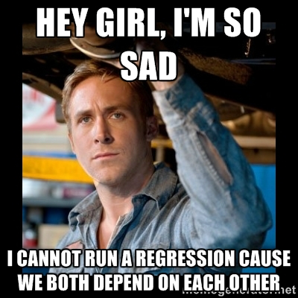
Multiple Variable Analysis
Correlations can have more than one predictor variable
Account for the impact of each variable
Partial Correlations
Multiple Regression

Slide 18
Partial Correlations
An association between two variables by controlling the effects of a third variable
Intervening variable (influences both the DV and IV)
Determine shared variance between the DV and IV
—> Shared variance or r squared

Slide 19
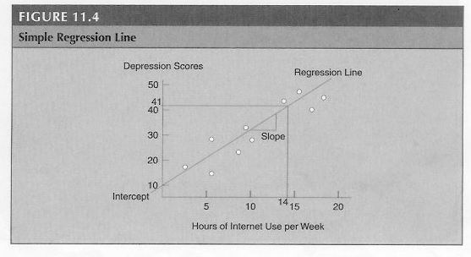
Simple Regression
How one variable (IV) predicts an outcome (DV)
Regression line or “line of best fit”
Y (predicted) = b (X) + a

Slide 20
Multiple Regression
How multiple variables (IV) combine to correlate with an outcome variable (DV)
Y (predicted) = b1 (X1) + b2 (X2) + a
Regression table: Useful for selecting variables and evaluating their importance
Beta weight: Magnitude how each variable contributes to the outcome variable by controlling the effects all other predictor variables

Slide 21
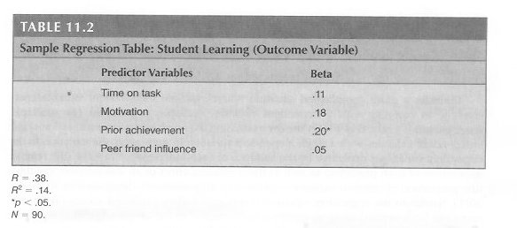
Example – Regression Table:

Slide 22
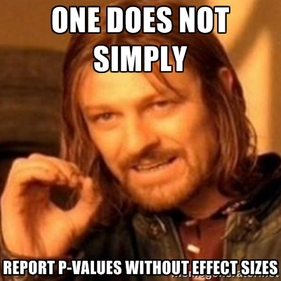
Meta-Analysis
Quantitative analysis of studies with a similar topic
Coined by Gene Glass (1976) to synthesize the growing literature of research
Needed to find a way to compare and understand results of similar studies
Effect sizes (magnitude of differences) allow us to make comparisons
Pearon’s r, Cohen’s d

Slide 23
Advanced Correlational Statistical Procedures
Factor Analysis
Discriminant Functional Analysis
Path Analysis
Structural Equation Modeling
Hierarchical Linear Modeling

Slide 24
Factor Analysis
A multivariate technique for identifying whether variables are moderately or highly correlated
Highly correlated variables can then be combined into one variable
i.e. peer friend influence, best friend influence & family influence→ close proximity influence

Slide 25
Discriminant Functional Analysis
Used for determining what independent variables best explain the differences among the categories in the dependent variable
Independent Variable=
Continuous Variable
Dependent Variable
Categorical Variable

Slide 26
Path Analysis
Extension of multiple regression
A statistical procedure for looking at the likely causal relationship among three or more variables that influence an outcome:
1) Specify a theory
2) Measure the variables
3) Identify correlations among variables
4) Combine highly correlated variables

Slide 27
Structural Equation Modeling
SEM provides information about which variables influence each other and the direction of these effects
Confirmatory procedure
Two classes of variables: Observed & latent
Observed variables (extrovert behavior): Measured by continuous scores from collected data
Latent variables (socialization): hypothetical constructs that are not directly observed
This ability to analyze both observed variables and latent variables distinguishes SEM from analysis of variance and multiple regression
Notes:
Factor analysis, path analysis & regression are all special cases of SEM

Slide 28
Hierarchial Linear Modeling
Provides an advanced approach to linear regression:
Level 1: achievement scores of each student
Level 2: achievement scores of all students in the class
Level 3: achievement scores of all students in the university
Conceptual and statistical approach for investigating and drawing conclusions regarding the influence of phenomena at difference levels of analysis
Enable researchers to compare the variations that exist within each level with the variations that exist among the different levels in terms of outcome variables

Slide 29
Steps in a Research Process
1) Determine if a Correlational Study Best Addresses the Research Problem
2) Identify Individuals to Study
3) Identify two or more measures for each individual in the study
4) Collect data
5) Analyze the data and represent the results
6) Interpret the Results

Slide 30
Method
Participants
252 participants
  Age range: 14 to 65 years (58.73% females; M =33.47; SD =16.98)
Age groups: 14-18, 19-25, 26-45, and 46-65 years.

Slide 31
EXAMPLE OF MORAL ATTRIBUTES
Accepting Generous
Benevolent Loving
Caring Loyal
Kind Non-judgmental
Compassionate Tolerant
Confident Truthful
Considerate Understanding
Genuine Virtuous
Grateful Wise

Slide 32
Measure
l. Moral Identity
The Good Self-Assessment scale
(Arnold, 1994)
Very important
to me
To assess people’s current moral identity in the contexts: family, school/work, community
Important to me
Somewhat Important to me
Not important to me
Notes:
Participants rated 80 attributes based on how well, according to them, each of them described a highly moral person. Then they narrowed the list to 12 to 15 attributes that defined the core of a highly moral person

Slide 33
There are age group differences in moral identity
Multivariate Analyses of Variance
DV: Moral Identity
Family
Community
School/work
IV: Age groups

Slide 35
Age-group differences in moral identity F (9, 741) = 3.13, p < .001
Family context F (3, 247) =5.48, p < .001
Work/School context F (3, 247) =5.62, p < .001
Community context F (3, 247) = 3.10, p= .027

Slide 36

Results
Age group differences in Moral Identity
3.45
3.4
3.35
3.3
3.25
Moral Identity
3.2
Family
Work/School
3.0
3
Community
14-18
Notes:
Everything verbally

Slide 37
Results
Correlations between Moral Identity and the Big Five Personality Traits
Openness Conscientiousness Agreeableness Extraversion Neuroticism
Moral Identity -.010 .29** .30** .11 -.26**
Note. **p<.01
Notes:
Age groups marginally differ with regard to moral identity (neuroticism)

Slide 39
Results
Age group differences controlling for agreeableness and conscientiousness
Pillai’s Trace, F (9, 735) =2.14, p = .025
Family, F (3, 245)= 3.09, p=.028
School/Work, F (3, 245)=3.06, p=.029

Slide 40
Correlational Research Design
Strengths
Weaknesses
Describes relationships between variables
Cannot assess causality
Non-intrusive-natural behaviors
Directionality problem
High external validity
Third variable problem
Low internal validity

Slide 41
Funny Correlations
http://www.tylervigen.com/spurious-correlations
http://twentytwowords.com/funny-graphs-show-correlation-between-completely-unrelated-stats-9-pictures/
http://www.buzzfeed.com/kjh2110/the-10-most-bizarre-correlations#.vfba1RVkG

Slide 42

Presented by:
Victoria Martindale
Dana Takkale
Lourdes Murua
Sierra Pecsi
Liane Kupfert

