Slide 1
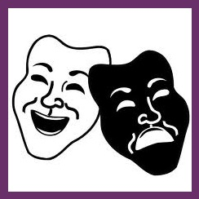
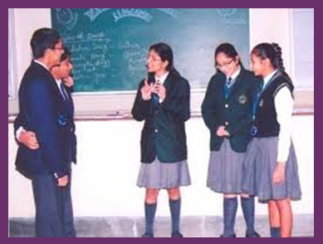
Role-Play activities
Using the course pack
« Themen Aktuell »
by Conor Doyle and Cassandra Martineau

Slide 2
What is a Role-Play?
“The Dictionary of Education explains role-playing as ‘an instructional technique involving a spontaneous portrayal (acting out) of a situation, condition, or circumstances by selected members of a learning group.’ The situation to which the person responds may be either structured or unstructured.” (Jones et al., 1994)
Spontaneous? Creativity? Fake?
Who (group/pair or teacher-student)
How do you feel about role-plays?
Negative feelings? Positive feelings?
What is your personal experience with them?
Notes:
Cassandra
Does it have to be “fake”?
In the part :How do you feel about role-plays, invite students to share their experience of role-plays in a language classroom or even in another subject.

Slide 3
Why use Role-Plays? The Positives:
For students and teachers:
A role-play is a golden opportunity to practice stringing a conversation from beginning to end (for begginners)
Learners are being prepared for actual situations that they will face in their lives
“One learns to organize thoughts and responses instantly while reacting to a situation or question [and] to remain calm in the face of adversity or pressure.” (Jones et al., 1994)
Role-playing can be used to help students develop social skills and be more comfortable with their classmates
Provides an opportunity to introduce cultural knowledge of appropriate behaviour and actions
Notes:
Cassandra
Often in language classes we learn how to start a converstion (greetings, etc.) and how to fill the middle of one, but we rarely learn how to end one, and even less often, how to string a conversation from end to end. Role-plays are a golden opportunity to teach and practice these.
“This method provides the learner with the opportunity to "feel" the situation rather than merely intellectualize about it.” (_)

Slide 4
The Problems with Role-Plays
“This method may be harmful to those learners who lack the necessary skills (those who are shy, or those who have speech problems).” (Jones et al., 1994)
And it can be STRESSFUL
“Role-playing may benefit only the actual participants unless the objectives for the class have been clearly specified.” (Jones et al., 1994)
Should role-plays be done in front of the class or in
groups?
Notes:
Conor

Slide 5
When would role-plays best occur?
Warm-up →
Body of a lesson
→ Wind-Down
Usually, the body of a lesson.
However, it can occur in different sections within the body of a lesson, depending on the function which you attribute the role-play:
Pre-activity → Activity → Post Activity
During the main activity: as a means of trying out the newly learned elements.
During Post Activity: to further reinforce previously learned elements from the lesson, integrating these elements into what has previously been studied.
Notes:
Cassandra

Slide 6
Structured → semi-structured → unstructured
The situation to which the person responds may be either structured or unstructured.
“A mock job interview in which the learner is aware of the questions ahead of time exemplifies a structured situation. Using unusual or surprise questions in the interview would be unstructured for the learner and would require spontaneity.” (Jones et al., 1994)
Rehearsed – Semi-Improvised – Improvised
A teacher can vary this dimension according to the level of the students.
Notes:
Cassandra
There are varying degrees of semi-structured-ness

Slide 7
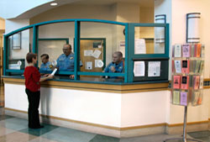
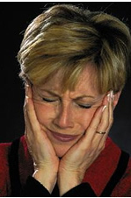
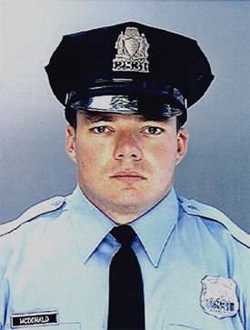
An example with Lost and Found
Other Dimensions
Notes:
Conor

Slide 8
Recap of Dimensions of Difficulty
Time to prepare ( depending on level, familiarity, topic)
Duration of the Role-Play
Amount of scaffolding given by the teacher or in groups
Props
Model dialogue
Vocabulary, grammar
Time allowed to prepare in groups
Whether the role-play is presented to the class; and from where
No presentation
Present from their seats
In front of the class
Notes:
Conor & Cassandra (from Whether the role…)

Slide 9
Comfort → risk
Role-plays are often stressful for students, because:
spotlight syndrome
lack of confidence
comfortability with the topic
How can a role-play be modified to give more or less comfort?
Presenting or not
Where they are presenting
Pairing (with friends, etc.)
Expectations of the teacher
Evaluated or not
Notes:
Cassandra

Slide 10
Assessing role-plays
Should you assess role-plays?
How often?
How would you assess them?
Notes:
Cassandra

Slide 11
Assessing role-playing
Do you assess them?
If you use them for assessment, do it only once the students have had enough experience performing a role-play and presenting it. This limits the anxiety of the students’ and allows the assessment to better represent their actual competence.
Why assess role plays?
Role-plays are a good method for examining students’ general oral competence of communication in the target language, as opposed to merely testing isolated grammatical points.
How to assess role-plays?
Basically, evaluated the same way as an oral presentation
Originality, content, grammar, intonation & pronunciation , etc.
Notes:
Cassandra

Slide 12
Skills integrated into Role-Plays
Grammar
Vocabulary
Discourse
Body Language
Pronunciation
Intonation
 | info gap |  | debates
shopping |  | improvisation |  | complaining
 | introducing yourself |  | conflict resolution
at a restaurant |  | lost and found
Notes:
Cassandra

Slide 13
Notes:
Conor

Slide 14
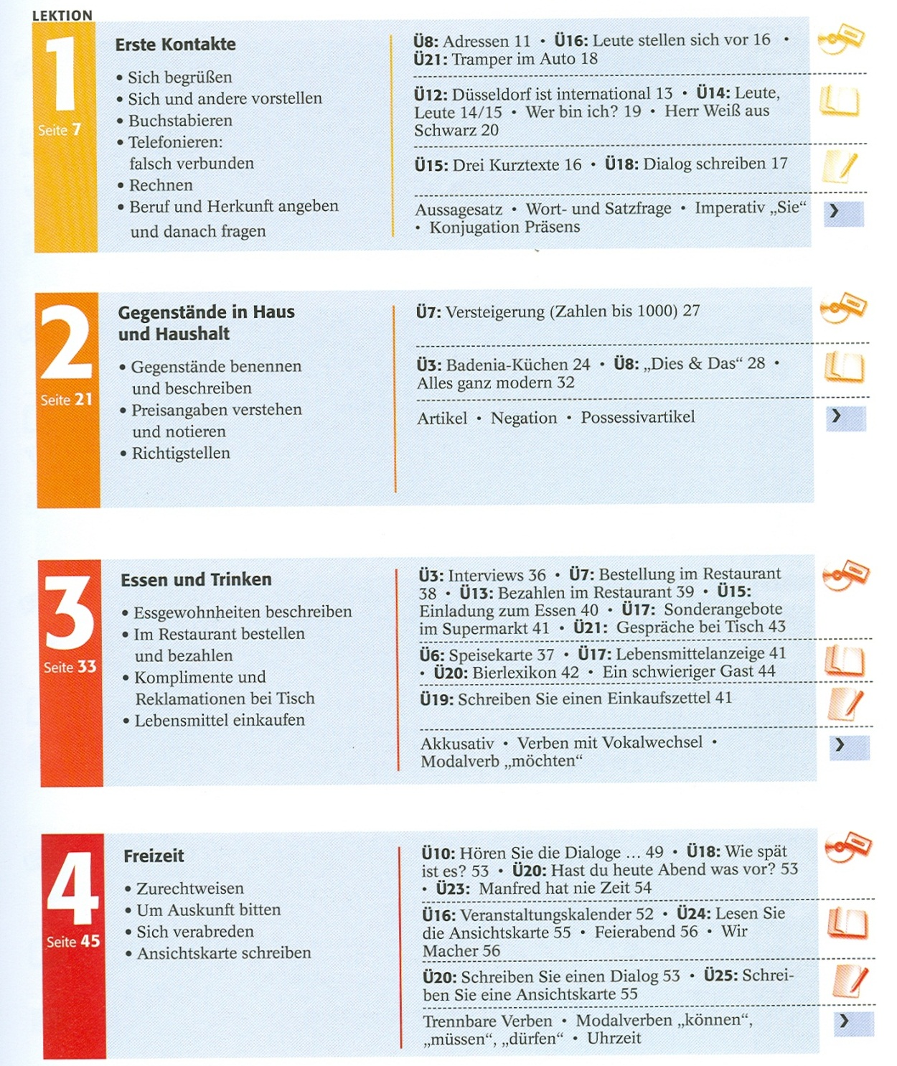
Role-Plays integrated into Curriculum
Themen Aktuell
Notes:
Conor
Why did we choose Themen Aktuell? Why I’d recommend it?
The Layout – How does is help curriculum?

Slide 15
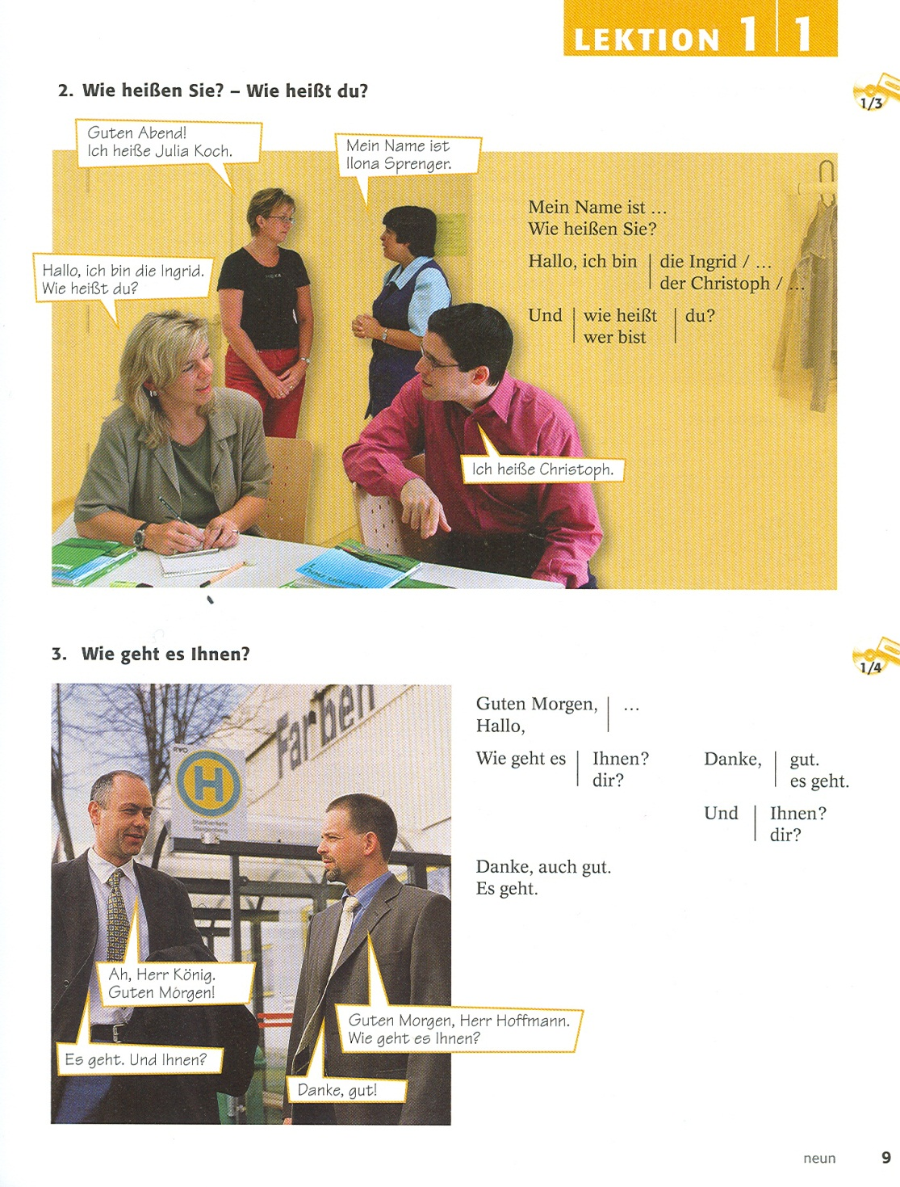

Slide 16
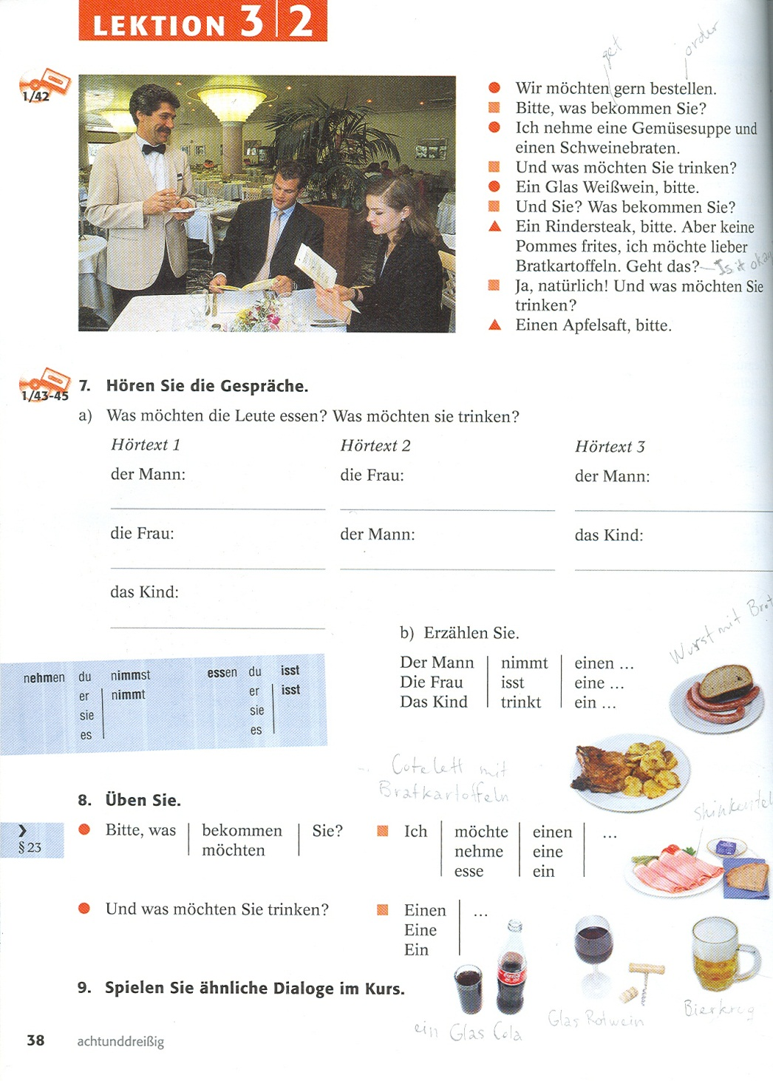
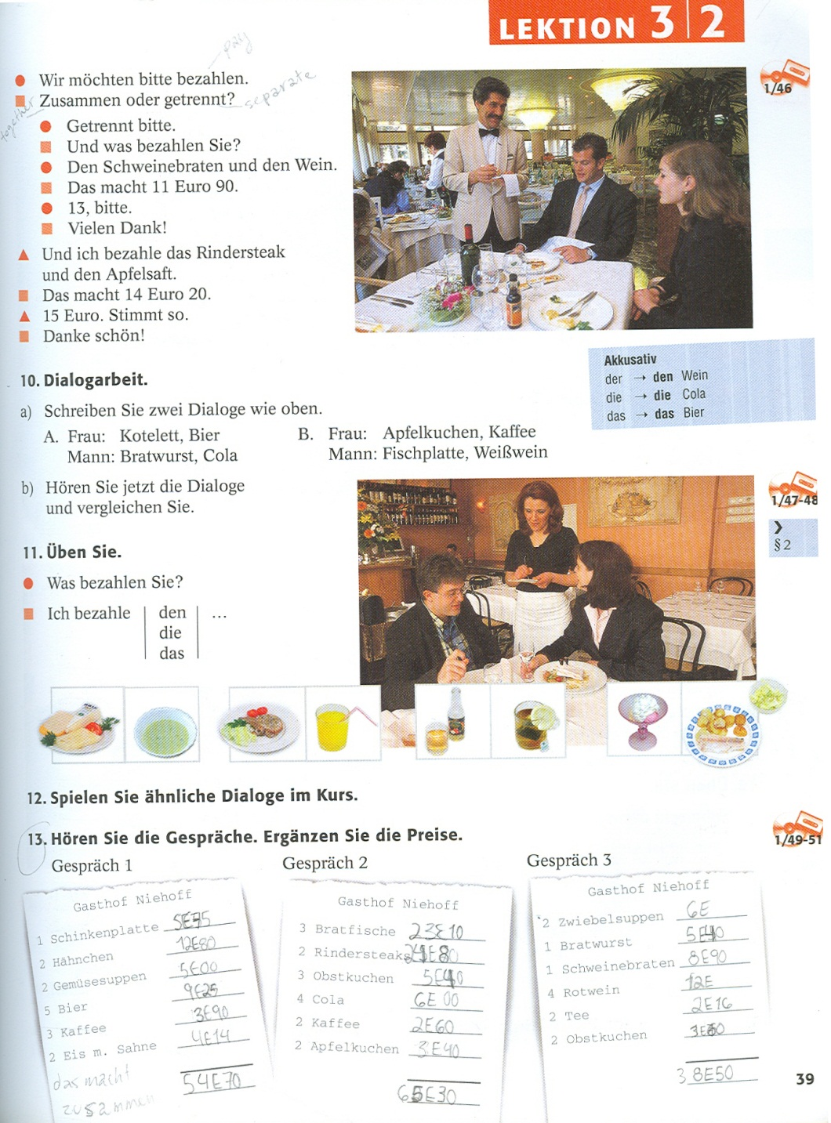
For Example:
Notes:
Conor
For example:

Slide 17
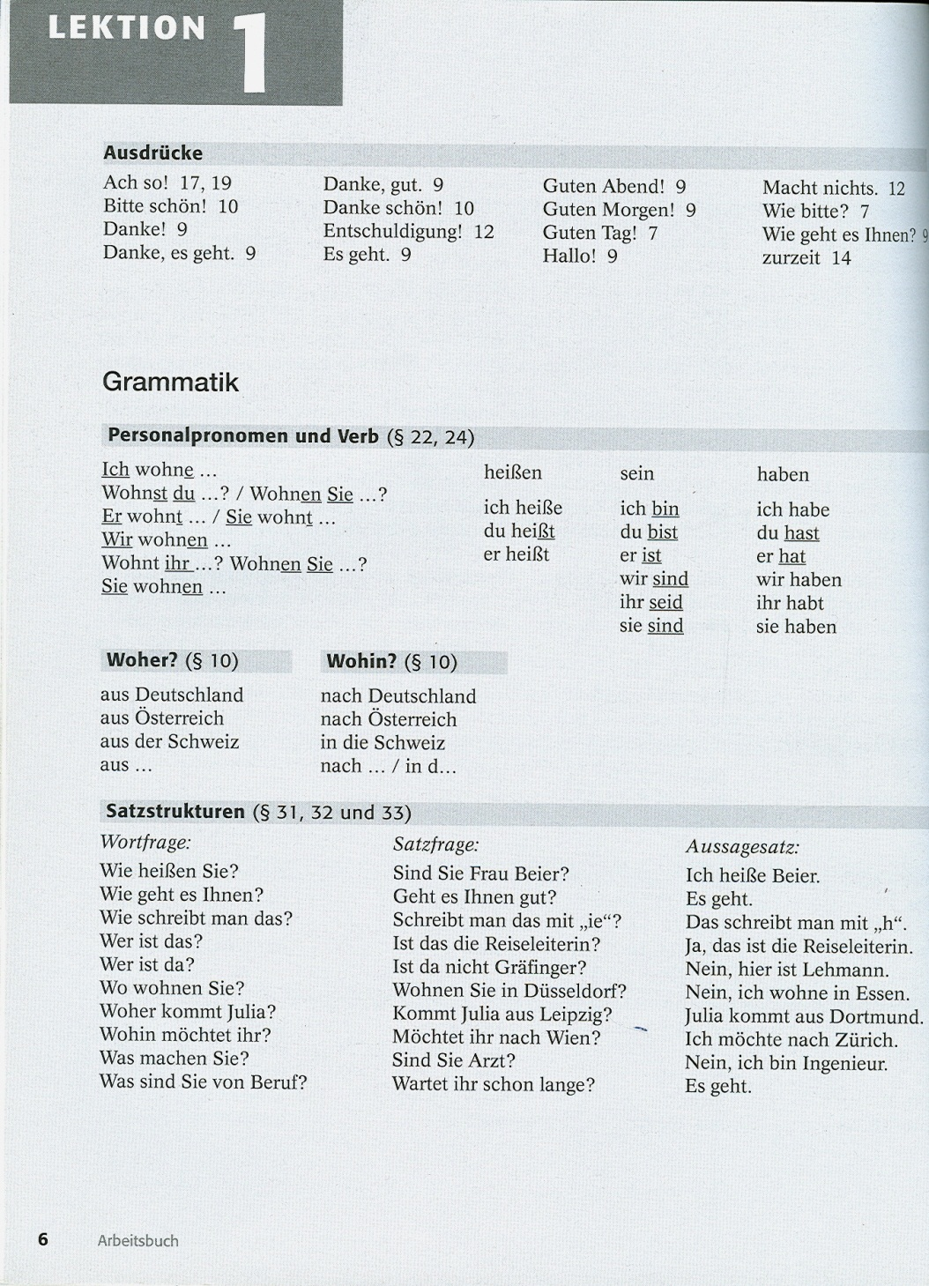
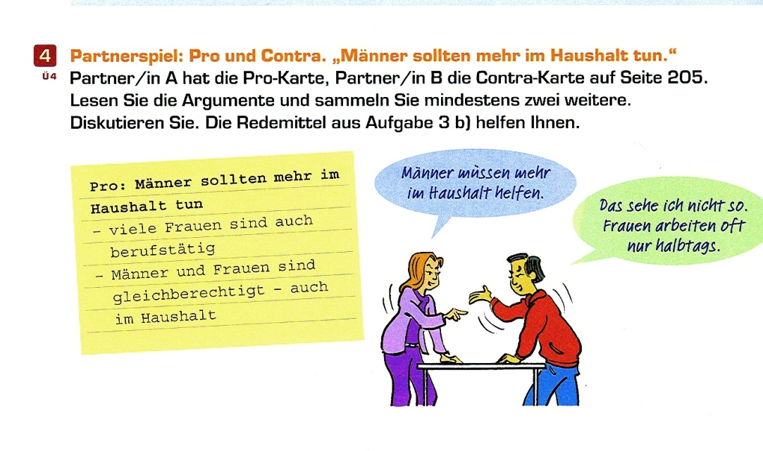

Slide 18
Let’s do an example
Greeting
Exchange names
How are you
Nice to meet you.
Where from
To give you a real experience of what it is like to do a role-play, we decided not to make you do one in English. Instead, you will do one in German!
First, let us do a basic introductory lesson of German.
Notes:
Cassandra

Slide 19
Greeting
Exchange names
How are you
Nice to meet you.
Where from

Slide 22
Greeting
Exchange names
How are you
Nice to meet you.
Where from

Slide 24
Greeting
Exchange names
How are you
Nice to meet you.
Where from

Slide 25
Notes:
Greeting

Slide 26
Greeting
Exchange names
How are you
Nice to meet you.
Where from
Es freut mich, dich kennenzulernen.
Freut mich.
Mich auch.
Auf Wiedersehen!
Tschüss!
Bis bald
Bis später.

Slide 27
Model dialogue 1
B: Guten Tag!
A: Guten Tag! Mein Name ist Cassandra.
B: Wie bitte?
A: Ich bin Cassandra.
B: Ich heiβe Conor. Wie geht‘s?
A: Gut, und dir?
B: Danke, auch gut. Woher kommst du?
A: Ich komme aus Kanada, aus Toronto.
B: Ich komme auch aus Kanada, aus Ottawa. Freut mich.
A: Mich auch!

Slide 28
Woher kommen Sie?
ich komme
du kommst
er/sie kommt
…
Sie kommen
Ich komme aus ...
Wie geht es die/Ihnen?
Es geht.
Und dir/Ihnen?
Gut auch. Dancke
Es freut mich, dich kennenzulernen.
Freut mich.
Mich auch.

Slide 29
An ideal role-play
Contextualised (gives a focus)
Adapted to the level of students
Adaptable to students’ level of comfort
Meaningful
Entertaining and fun

Slide 30
Contextualised role plays
Topic: Weather
Participants:
Divide the class in groups of 2, and one group of three if the class is odd-numbered.
Context:
One student is waiting for the class to begin, when a classmate sits down beside them. They know each other by face, but are not relatively close.
While waiting, they strike a conversation about the weather (complaints, rejoicing, previsions, etc.). Other topics may be brought up as seen fit.
Duration: 2-3 minutes
Notes:
Cassandra
Explain when these role-plays can be used, and how to modify them for the different levels.
Describe advantages, weaknesses of each.

Slide 31
References
Role-playing (http://www.neiu.edu/~sdundis/hrd310/roleplying.doc.pdf) Based on excerpts from The Expert Educator (Jones, et al. , 1994)
Aufderstrasse, H., and Bock, H. Themen Aktuell: Kursbuch Bk.1. Max Hueber Verlag, 2003
Cornelsen. Studio D (vol. b1). Cornelsen Verlag GmbH & Co, 2007.

