Slide 1
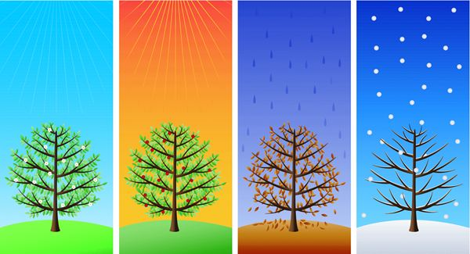
Teacher Resources: The seasons
Rebecca, Summer, Stephanie

Slide 2
Let’s get some context
Ontario, Canada
Primary classroom
ESL students integrated into classroom setting

Slide 3
Let’s start with a song…
should ask students what types of songs or favorite artists they like
singer needs to have a clear voice
recoding has good quality
make sure language and subject matter is at a suitable level of difficulty
https://www.youtube.com/watch?v=8ZjpI6fgYSY

Slide 4
Pros
Cons
Exposes students to different seasons
fun and motivating
Relaxing & reduces intensity of the language-learning phobia.
Provide authentic text or material
Invokes learners’ curiosity
Pronunciation & vocabulary
A whole brain activity – visual, audio, verbal etc. – multiple intelligences
Learners don’t think songs are academic – too silly
some learners may not like the songs we have chosen
grammar, syntax etc. may not be correct morally dubious texts and language
unclear vocals or ‘slangy’ pronunciation

Slide 5
Curriculum

Slide 6
Modifications
Listen to songs which describe people, places or emotions
young learners can write stories or poems of their own
Teacher can ask students to put lines in order or simply to fill the text with single words or phrases that are missing
Teacher can also ask students to listen to a song and predict what the title might be or to tell the story described in the song in their own words
Song Building
Oral Song Project
Contrasting/ Comparing two styles or themes
Ear Training and Pronunciation
Discussion
Translation
Writing the next verse
Dictation
True/False Statement
Comprehension questions
Role playing

Slide 7
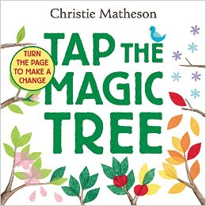
Book: Tap the Magic Tree
Tap
Rub
Touch
Jiggle
Wiggle
Brush
Shake
Knock

Slide 8
Pros
Cons
The book is interactive
Encourages the listeners to be active
Touches on the life cycle of a tree
Depicts the seasons with it’s beautiful illustrations
Good to point out basic vocabulary, the tree, the seasons, as well as the actions
A student with limited English can still participate
Unless modified, it is difficult to read with a large group of students
Most suitable for primary students

Slide 9
Curriculum

Slide 10
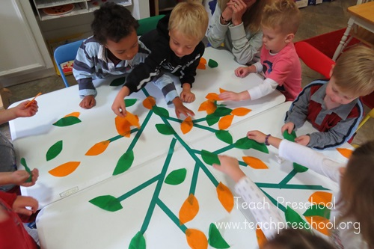
Modifications
This book can be modified to be suitable to a large group by not actually touching the book but still doing the actions
This book could be modified to be a project for intermediate students where they have to create their own book that involves actions
ESL students lessons on actions/verbs
Could have an interactive model of tree, displays knowledge of seasons, actions and colors (evaluate)
Create a tree for each season (evaluate)
Could be tied into art and science

Slide 11
Worksheets
The website offers a variety of themed worksheets
The age range offered for these worksheets are from preschool level to fifth grade
These worksheets would be most appropriate for younger learners
Older audiences may not be as interested in the offered activities and therefore may potentially lose motivation to learn using them
https://en.islcollective.com/resources/search_result?Vocabulary_Focus=Seasons

Slide 12
Pros
Cons
Vast variety of activities
Adaptable for different age groups
Colourful and include lots of pictures
Free and easy to incorporate into a lesson plan on seasons
Easy and quick teaching material so that the teacher can focus on creating other interesting and engaging activities and lessons
Different worksheets focus on different skills; reading, writing, or both
The worksheet levels do not exceed grade five
Some of the activities presented may be questionable on how effective they are
Not all students will be engaged

Slide 13
Curriculum

Slide 14
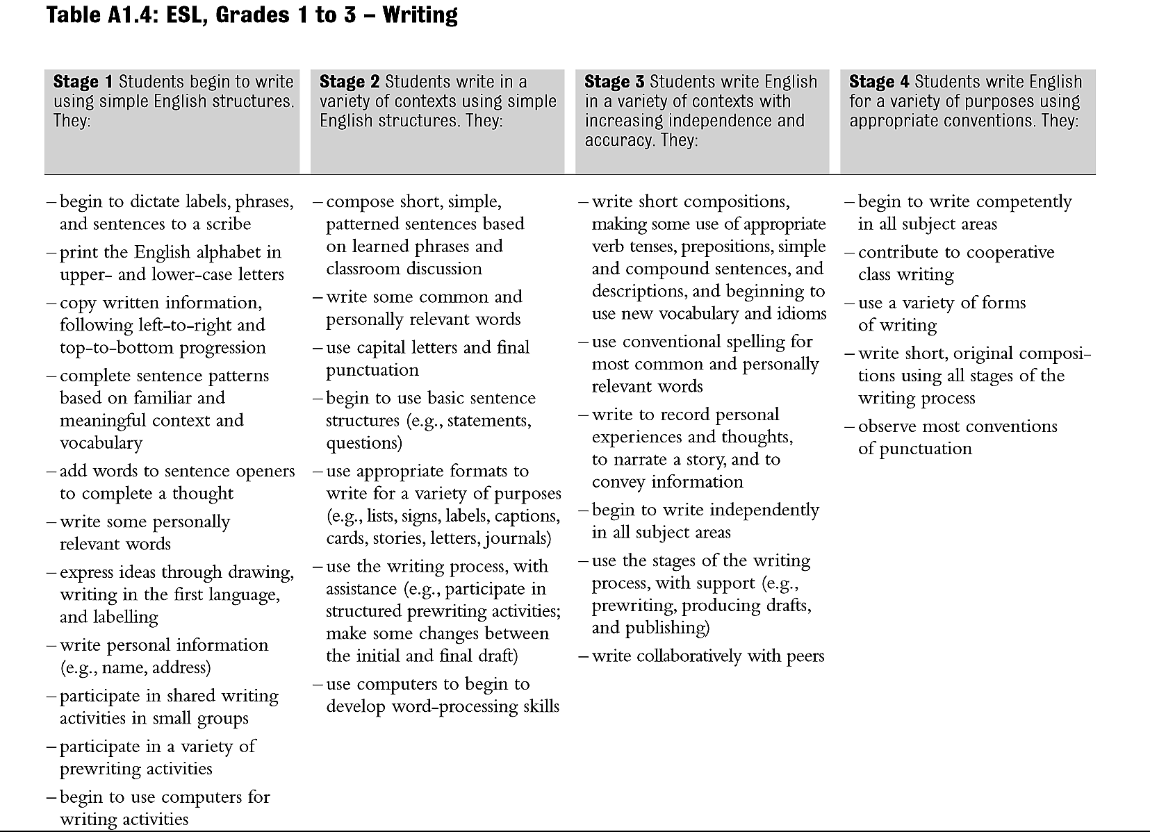

Slide 15
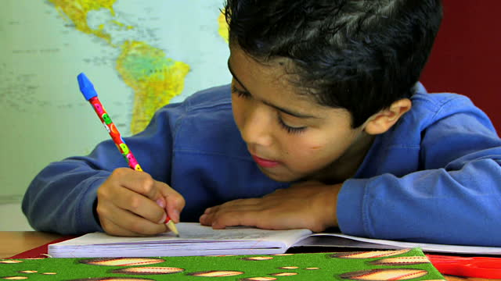
Modifications
Present the worksheet with a song or video, keeping the student’s senses stimulated
Work on the worksheets as a class or in groups so that students have a chance to talk to their peers and teacher and receive feedback and alternative thoughts
Reverse a few of the pictures on the given worksheets so that students must draw a picture associated with the provided word
Contingency plans, worksheets on the wall

Slide 16
Book: Hi Koo
Filled with ‘Hi Koos’ on every season
Lends itself to a poetry lesson
Beautiful art
panda

Slide 17
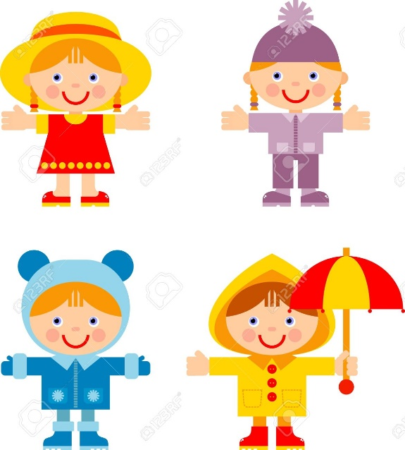
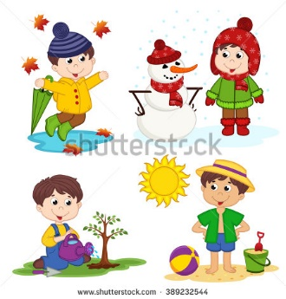
Activity!
Can I get four volunteers!
Mystery bag of goodies
Identify item and place it on the correct volunteer
Write the item on board

Slide 18
Pros
Cons
This story book is suitable for story time for many ages
Incorporates poetry
Seasons are well represented
Could easily be divided and presented, each page is it’s own independent poem
Fun way to see the students comprehension
Book is long
Not everyone likes poetry

Slide 19
Curriculum

Slide 20
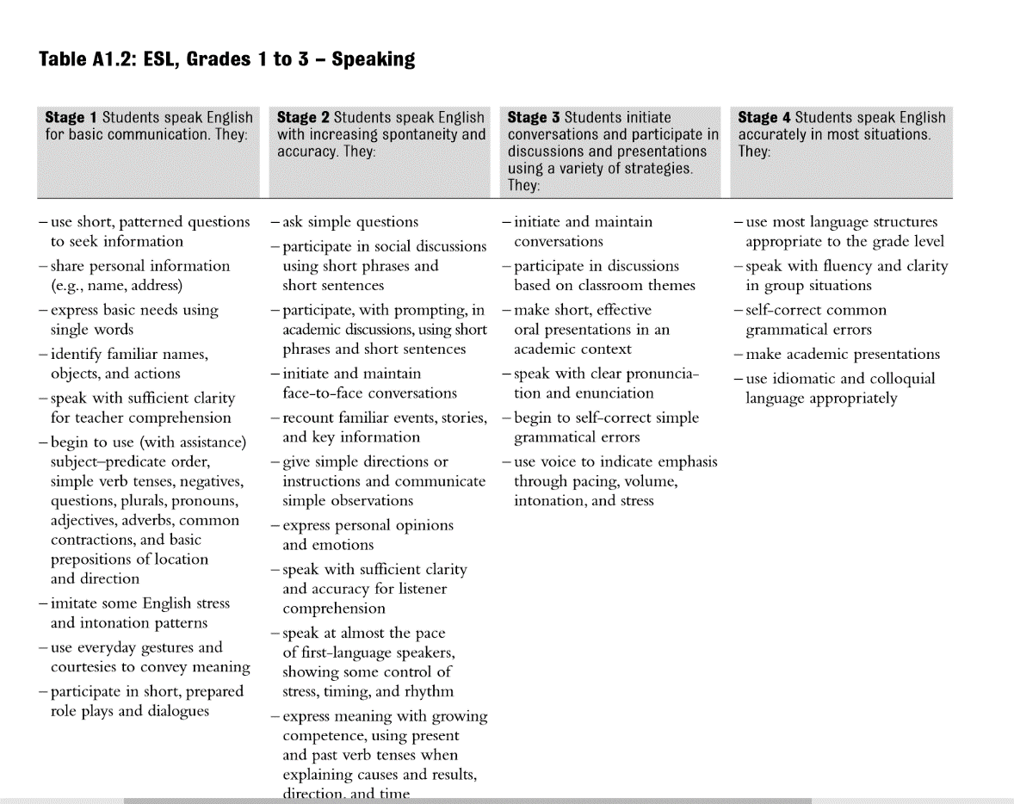

Slide 21
Modifications
Simple Storytime (1 poem, 1 season, or entire book!)
Could read one poem at a time and point out vocabulary through pictures
In groups of two, students could practice a page of the story together and recite it
Could write their own haiku poem on a season
Art; they could draw a panda in their favourite season

Slide 22
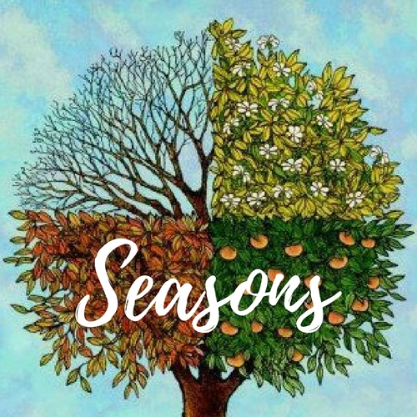
Thank you!
Questions, Comments, Concerns?

